Slide 1



THE 'GATEWAY TO AFRICA' CONCEPT:
LOGISTICS CHALLENGES IN OPTIMISING INTRA-REGIONAL INTERMODAL FREIGHT TRAFFIC IN LIMPOPO PROVINCE, SOUTH AFRICA
DINESH CHAITHOO
16th African Renaissance Conference
"AFRICA IN MOTION"
ICC Durban
(22-23 May 2014)
Notes:
This presentation demonstrates the new capabilities of PowerPoint and it is best viewed in Slide Show. These slides are designed to give you great ideas for the presentations you’ll create in PowerPoint 2010!
For more sample templates, click the File tab, and then on the New tab, click Sample Templates.

Slide 2
OVERVIEW OF PRESENTATION
1. Introduction and background
2. Methodology
3. Literature review
4. Discussion and study findings
5. Conclusion and recommendation
STRUCTURE OF PAPER PRESENTATION

Slide 3

INTRODUCTION AND BACKGROUND
AFRICA IN MOTION
1
The ‘Gateway to Africa’ concept: logistics challenges in optimising intra-regional
intermodal freight traffic in Limpopo Province, South Africa
Dinesh Chaithoo

Slide 4

AFRICA IN MOTION
1.1 Transportation infrastructure
Contributes to economic growth, while simultaneously being a catalytic input to human development
Road networks provide links to global and local markets
Africa’s infrastructure network deficient in coverage & prices for services are exceptionally high by global standards
Inland transport constitutes an estimated 40% of the total cost from point of origin to port of destination
Challenges attributed by border post infrastructure capacity constraints, corrupt customs administration, or restrictions on entry to the transport market (or combination of these factors)
Problem is multinational and should be tackled as a regional or a corridor problem
‘Gateway to Africa’ – alternative approach will allow and provide space to implement concepts for the Musina/Beitbridge border post
Notes:
Economic growth

Slide 5
AFRICA IN MOTION
1.2 The Transshipment Hub Concept
Transshipment is the shipment of goods to an intermediate destination, and then from there to yet another destination
Reasons:
change the means of transport during the journey (trans loading); and/or
combine small shipments into a large shipment, dividing the shipment at the other end
Transshipment usually takes place in transport hubs.
‘Dry port’ – transshipment intermodal terminal hub as an inland terminal directly connected to a sea port/s with high capacity transport means
Relieves congestion and there is a need to reduce the need for scarce space at the sea port/s

Slide 6
AFRICA IN MOTION
Classification of inland or dry ports
Distant dry-port: provides cost saving advantage by using rail, rather than road, over long distances
Mid-range dry port: make use of road transport from the sea port and acts as a consolidation point for rail services, although high capacity flows may make dedicated container rail services viable
Close dry port: situated in the immediate vicinity of a sea port and provides a buffer to the sea port by enabling greater terminal capacity and permitting larger container ships to call at the sea port, possibly through the operation of a rail shuttle service

Slide 7

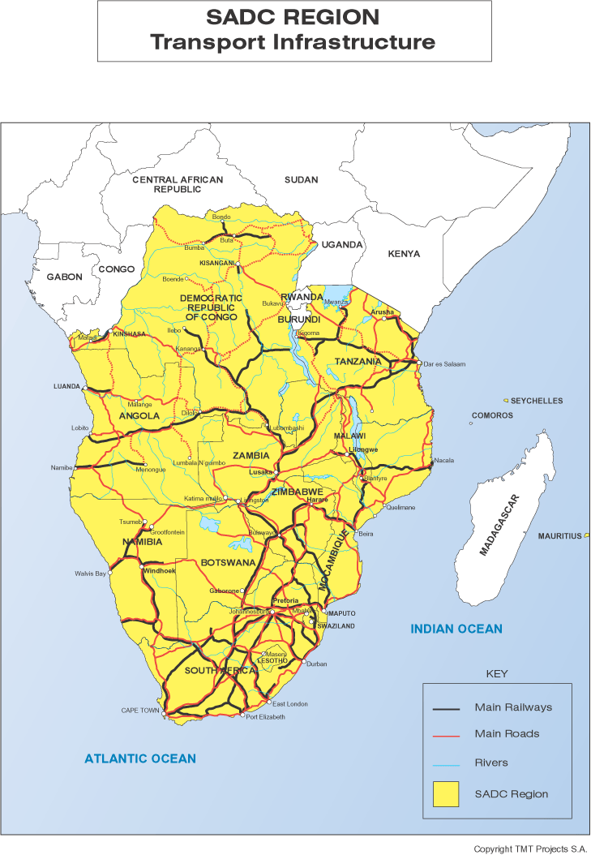

BRIEF DESCRIPTION OF
STUDY AREA

Slide 8
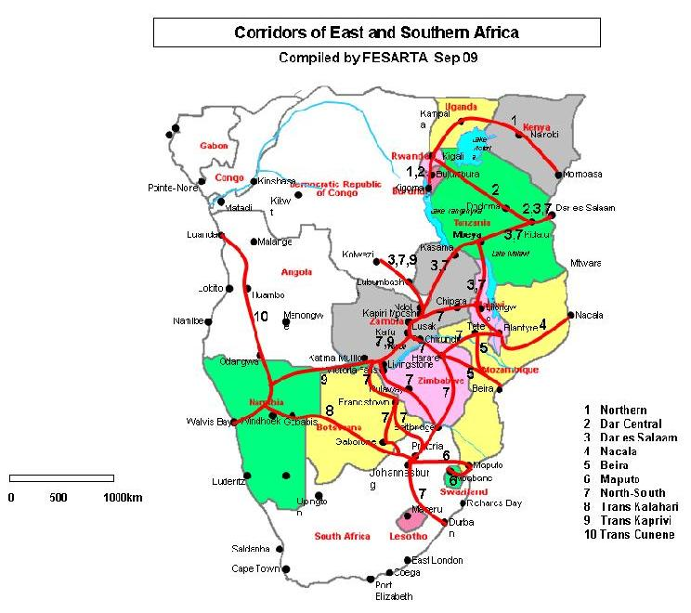
BRIEF DESCRIPTION OF
STUDY AREA

Slide 9

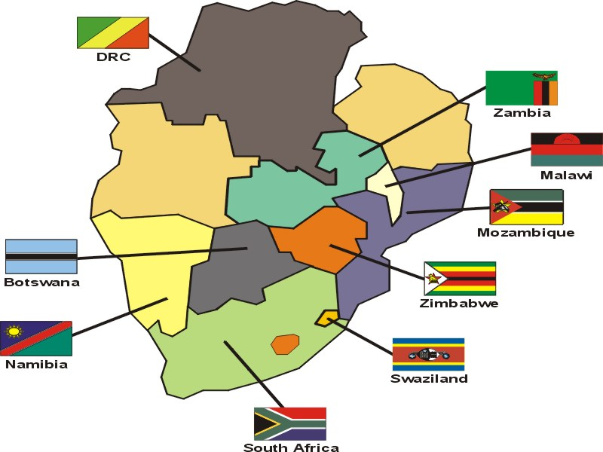
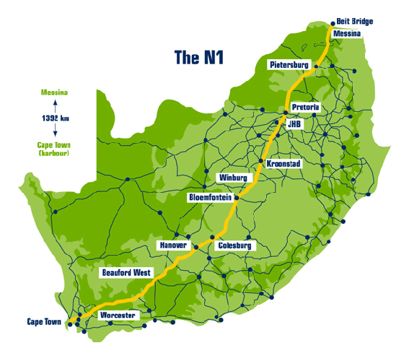
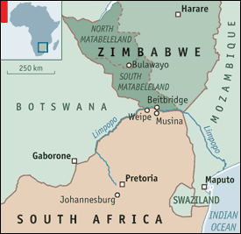
MUSINA LOCALITY MAP

Slide 10
AFRICA IN MOTION
WHY MUSINA? JUSTIFICATION OF STUDY AREA
Industry is moving rapidly to respond to the emerging trends in supply chains through investment in intermodal freight hubs and rail-connected warehousing and distribution centres. Freight is central to the economic and social prosperity of South Africa. Efficient delivery of freight supports employment, health, education, social and other outcomes, which have been identified as a problem. The ‘Gateway to Africa’ concept has identified Musina as the most appropriate area for the development of the transshipment hub based on the geographical location and other related factors.
The key element of Musina is creating or leveraging an integrated distribution and logistics hub that can act as a centre for distribution to dispersed geographical regions in Africa.
WHY MUSINA?

Slide 11

AFRICA IN MOTION
AIM OF PAPER
PAPER ARGUES THAT THE PROPOSED MUSINA
TRANSSHIPMENT HUB IS A VIABLE SOLUTION IN
SUPPORTING EFFICIENCY, AGGLOMERATION
ECONOMIES AND UNPRECEDENTED
INVESTMENT AND GROWTH WITH EQUITY IN
SOUTHERN AFRICA.
THERE IS NO INTERMODAL HUB POLICY AT
PRESENT WHICH ENABLES INDUSTRY TO
COMPREHEND CONSISTENT SCENARIO OF
GOVERNMENT SUPPORT AND INVESTMENT
WITHIN WHICH THE PRIVATE SECTOR CAN
DEVELOP THESE HUBS

Slide 12
METHODOLOGY
AFRICA IN MOTION
2
The ‘Gateway to Africa’ concept: logistics challenges in optimising intra-regional
intermodal freight traffic in Limpopo Province, South Africa
Dinesh Chaithoo

Slide 13
AFRICA IN MOTION
METHODOLOGY
PAPER DRAWS FROM AN EXTENSIVE DESKTOP LITERATURE ANALYSIS EXERCISE, WHOSE INTERPRETATION IS COMPLIMENTED WITH KEY INFORMANT INTERVIEWS INPUTS

Slide 14
LITERATURE REVIEW
AFRICA IN MOTION
3
The ‘Gateway to Africa’ concept: logistics challenges in optimising intra-regional
intermodal freight traffic in Limpopo Province, South Africa
Dinesh Chaithoo

Slide 15
AFRICA IN MOTION
3.1 The connection between SADC Protocol on Transport, Communication and Meteorology and Logistics
Sets out the framework for the integration of the regional transport system through a common approach to the development of the legal and regulatory system
17 major corridors / 14 regional ports
Freight transport generally follow well defined trade routes with road and rail infrastructure
Connections to the west – Angola and DRC – less well established and will require major investments
North-South/Maputo/Dar es Salaam corridors – most important trade routes on the basis of traffic volumes and their role in supporting intra-regional trade and economic development – will require ongoing investments to improve service levels and increase capacity constraints
Border posts are the single most critical blockages to intra-regional trade and travel – delays are often procedural and efforts to simplify paperwork is ongoing

Slide 16
AFRICA IN MOTION
3.2 Logistics costs for landlocked countries
Being landlocked –
Adds 4 days to exports / Adds 9 days to imports for land distribution of equivalent distances within a sea port country
Bribes and unnecessary charges – can add 50% to transport costs between a port and landlocked country
Much smaller involvement in world trade than coastal countries
predominently dependent on export of raw materials – remains vulnerable to a change in that trend

Slide 17
AFRICA IN MOTION
3.3 Major transport logistics and development constraints in SADC
High overhead costs
Low agricultural productivity
High labour costs

Slide 18
AFRICA IN MOTION
3.4 Benchmarking African Infrastructure: some insights

Slide 19
AFRICA IN MOTION
3.4 SADC Road Network

Slide 20
AFRICA IN MOTION
3.4 Addressing regional transport and development mandates in Africa
Address the INFRASTRUCTURE backlog in Africa and propel economic growth – overcome the region’s difficult geography
Facilitate advanced spatial organisation of economic activities to act as catalysts for faster growth
AFRICA’S REGIONAL INFRASTRUCTURE HAVE BEEN IDENTIFIED AS NESTING GAPS THAT INCREASE THE COSTS OF DOING BUSINESS AND PREVENT THE REALISATION OF SCALE ECONOMIES

Slide 21
AFRICA IN MOTION
3.4 Transport logistics and challenges in Africa
Key transport corridors for International Trade in Sub-Saharan Africa

Slide 22
DISCUSSION AND STUDY FINDINGS
AFRICA IN MOTION
4
The ‘Gateway to Africa’ concept: logistics challenges in optimising intra-regional
intermodal freight traffic in Limpopo Province, South Africa
Dinesh Chaithoo

Slide 23
AFRICA IN MOTION
4.1 SADC Logistics Performance Index (LPI) Rankings
Soft infrastructure – institutional reforms / laws / regulations
Hard infrastructure – roads / railways / ports
25% delays along transport corridor – due to poor infrastructure
75% delays along transport corridor – due to poor facilitation

Slide 24
AFRICA IN MOTION
BEITBRIDGE BORDER POST INFRASTRUCTURE GAPS AND DEFICITS

Slide 25
AFRICA IN MOTION
4.3 Freight transport problems of doing business in the SADC region
Poor infrastructure & high transport costs

Slide 26
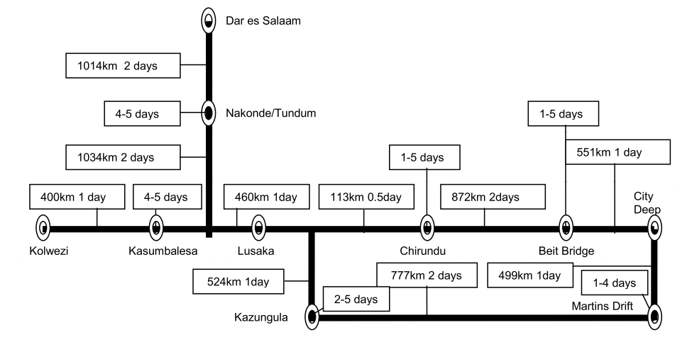
AFRICA IN MOTION
4.4 Freight transport logistics in the North-South Corridor
Road transport is more flexible, more reliable and usually cheaper per
ton/km than rail transport – this will remain until railway investment is
realised
Schematic of distances and journey times (NSC)

Slide 27
AFRICA IN MOTION
4.4 Modelling freight transport services in the North-South Corridor
Gauteng to Harare – 4000 vehicles/day (30% heavies)
Expected impact of policies in east and southern Africa

Slide 28
AFRICA IN MOTION
4.4 Beitbridge Border Post – Looking Ahead
Growth of freight traffic has surpassed most of the 20 year growth forecasts (Moving South Africa)
BBP – example of a failure to address the freight systems’ inability to fulfill the demand for cargo movement at competitive prices, levels and quality of service at acceptable levels of reliability
Delays are prevalent which adds to the negative impact to local businesses
Improvement can be achieved by an integrated system-level approach
Shift from demand-driven delivery of freight logistics services to supply-driven is proposed

Slide 29
AFRICA IN MOTION
Beitbridge freight logistics demand and supply chain design factors

Slide 30
AFRICA IN MOTION
4.4 Beitbridge Border Post – Looking Ahead
No single action can address all of the barriers identified in this research
Complementary actions need to be undertaken together to achieve the development of the transshipment hub in Musina:
  Improve the understanding of freight issues by Vhemba District Municipality
  Develop a freight planning and evaluation toolbox
  Develop regional multi-modal freight strategies
  Develop land use and transport guidelines for the design of freight generating areas
Economic advantages by virtue of geographical location are numerous
Logistics hub will serve as a catalyst for rapid economic development and place Limpopo central to freight movement between South Africa and SADC countries
Industrialisation of Musina will provide an abundance of economic
opportunities for investment to both the government and private sectors by
creating a new epicentre in South Africa for growth and development

Slide 31
CONCLUSION AND RECOMMENDATIONS
AFRICA IN MOTION
5
The ‘Gateway to Africa’ concept: logistics challenges in optimising intra-regional
intermodal freight traffic in Limpopo Province, South Africa
Dinesh Chaithoo

Slide 32


Proposed initiative for the transshipment hub in Musina (3 Phase approach):
Phase 1: Research / Study (data collation) – comprehensive traffic study, border post transportation survey, EIA, etc;
Phase 2: Statement of intent (situational analysis – context and challenges, issues and problems, vision and mission statements, policy principles, strategic policy objectives in line with the DoT’s Freight Logistics Strategy, policy levers and delivery structures) – includes transportation economic analysis, legislative and other related policy reference and business plans; and
Phase 3: Implementation of framework (consultation with key stakeholders, etc) – preparation of roll-out of infrastructure and related projects for the short, medium and long term developments

Slide 33
AFRICA IN MOTION
THE SUCCESS OF THE TRANSSHIPMENT HUB IN MUSINA WILL NOT ONLY DEPEND ON THE EFFICIENT FUNCTIONING OF THE FREIGHT SYSTEM ELEMENTS, BUT ALSO ON HOW THEY ARE MANAGED IN TANDEM

Slide 34
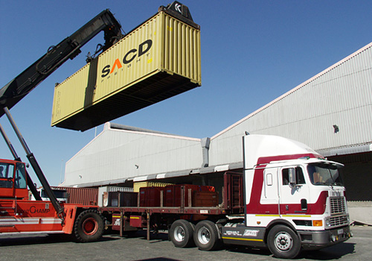
THANK YOU
16th African Renaissance Conference
"AFRICA IN MOTION"
ICC Durban
(22-23 May 2014)
SINCERE THANKS TO
MAC MASHIRI & JAMES CHAKWAZIRA (CO-AUTHORS) &
MY WIFE FOR ALL THE SUPPORT
Notes:
This presentation demonstrates the new capabilities of PowerPoint and it is best viewed in Slide Show. These slides are designed to give you great ideas for the presentations you’ll create in PowerPoint 2010!
For more sample templates, click the File tab, and then on the New tab, click Sample Templates.

