Slide 1
African Renaissance Conference - Implications of the African Maritime Charter and AIMS 2050
Commander Tsietsi Mokhele
SAMSA

Slide 2
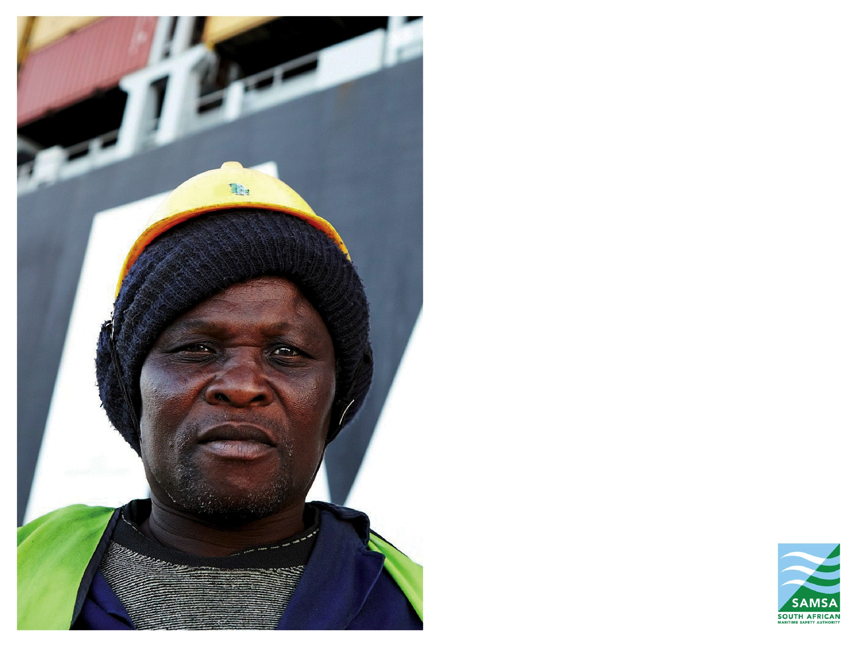
CONTENTS
Overview of Africa
An Overview of the African Economy
The African Maritime Interests
The African Maritime Development Agenda
(a) Africa Maritime Charter
(b)The 2050 African Maritime Integrated Maritime Strategy
(c) REC Maritime Strategies –SADC Protocol

Slide 3
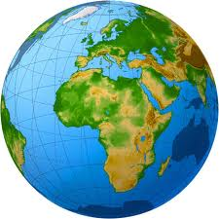
An overview of Africa - The Island Continent
Overview of the Continent
Largest island on earth with oceans on all sides Inland waterways of 300,000 square kilometers
Atlantic Ocean (West)
Indian Ocean (East)
Southern Oceans (South)
Mediterranean & Red Sea (North)
39 (70%) out of 55 African countries are coastal or islands
Trade amongst African countries accounts for 11% of the total trade volume (lowest compared to ASEAN ,Europe and Americas)
Coastline of 31,000 km
African-owned ships account for less than 1,2% of the world’s shipping and only 9% by gross tonnage
Inland waterways of 300,000 square kilometres

Slide 4
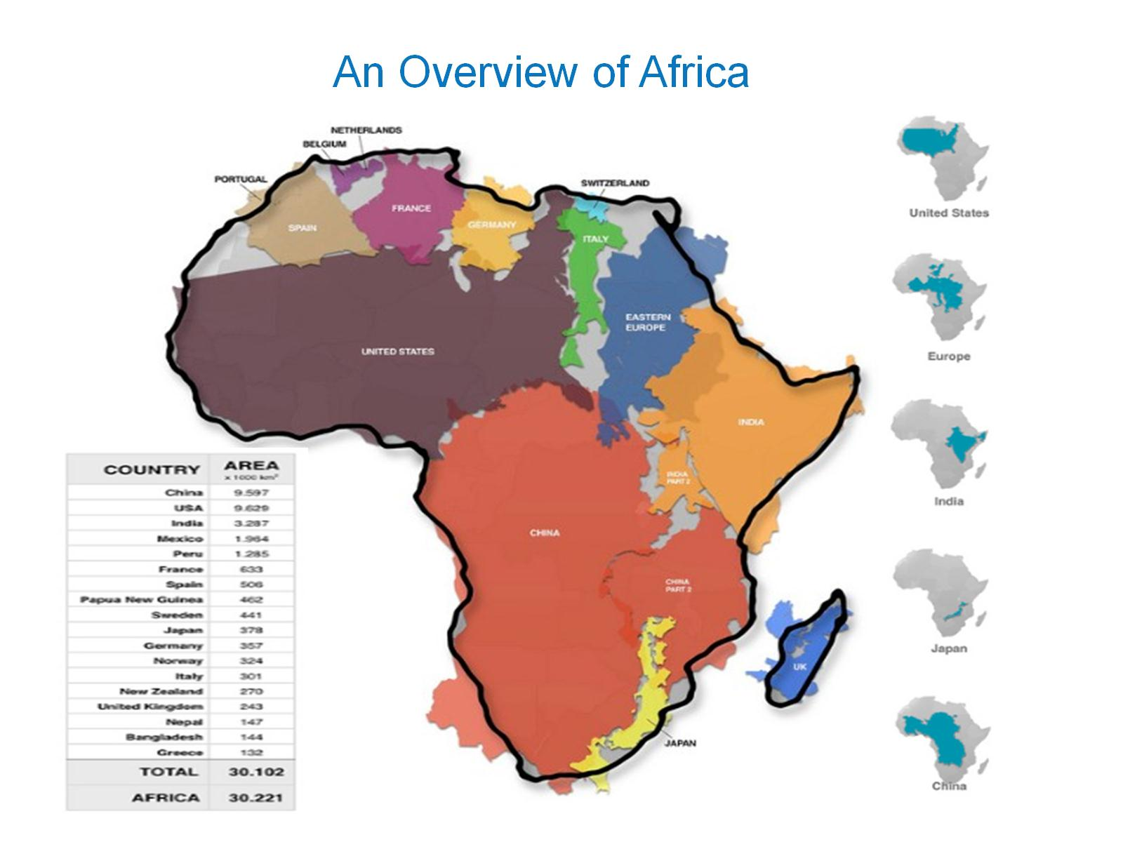
An overview of Africa
Maritime Facts and Figures
39 of 55 (70%) countries are ocean – linked (either littoral or island states)
95% of Africa trade is by sea
Trade amongst African countries accounts for 11% of the total trade volume (lowest compared to ASEAN, Europe and Americas)
A coastline a coastal line of 26 000 nautical miles (48,000km) in length
African-owned ships account for less than 1,2% of the world’s shipping and only 9% by gross tonnage
Africa has a maritime trade economy estimated at US$1 trillion a year
The continent boasts more than 100 ports, of which 52 handle containers and numerous forms of cargo

Slide 5
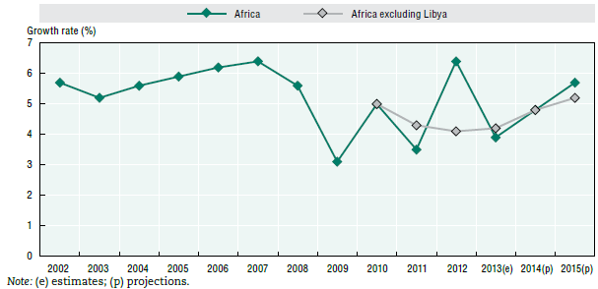
An overview of Africa - Economic Outlook
Economic Facts and Figures
In 2013, Africa average growth rate was greater than global rate (4% vs. 3%)
Growth in sub-Saharan Africa was 5% in 2013 projected to be 5.8% in 2014
Africa’s average GDP growth amounted to 3.9% in 2013
Africa’s growth is projected to accelerate to 4.8% in 2014 and 5.7% in 2015
Global growth is projected to accelerate to 3.5% in 2014 and 4% in 2015
FDI flows into sub-Saharan Africa are forecasted to reach USD 80 billion by 2014
The agricultural sector accounts for around 60% of Africa’s total employment and around 25% of its GDP

Slide 6

An overview of Africa - Economic Outlook

Slide 7



Major sectors of the African economy
Energy
Agriculture
Shipping is central to Africa`s trade capability
The agricultural sector accounts for around 60% of Africa’s total employment and around 25% of its GDP
According to research from The World Bank Group (WBG), the 48 countries of sub-Saharan Africa (with a combined population of 800 million) generate roughly the same amount of power as Spain (with a population of 45 million).
Manufacturing
Mining
Between 2000 and 2011 Africa’s exports of raw commodities expanded by 120% in real terms from USD 160 billion to USD 350 billion (both in 2010 prices. Exports of processed goods grew by 60% from USD 110 billion to USD 180 billion
The manufacturing sector is relatively small in most African countries and contributes
on average only around 10% to GDP. African countries can integrate into global value chains rather than their exports being inputs to foreign manufacturing

Slide 8
Africa Maritime Interests
Maritime Trade – About 90% of Africa’s extra – teritorial and intra – Africa trade is seaborne
Maritime Economic Benefits –Although Africa`s maritime economy is estimated to be $1 trillion annually, it only retains less than a 1% of this amount for its own benefit.
Maritime Job Opportunities –The maritime sector can be a significant employer - Africa’s portion of seaborne cargo carried on the international fleet is significant, yet Africa has not been staking out for even a matching number of jobs related to that cargo (Africa accounts for only 1% of global Seafarer jobs)
Marine Resources – Africa has extensive living and non living marine resources for which its people depend upon fishing for daily sustenance as well as offshore energy and mineral resources for economic development
Maritime Zones - Territorial waters, Contiguous zone, Marine cultural zone, Exclusive Economic Zones, Continental Shelf Claim and freedoms of the International Waters
Maritime Safety - Illegal, unregulated and unreported fishing is estimated to cost sub-Saharan Africa approximately US$1 billion a year. billions worth of maritime oil is stolen.
Marine Environment - Thousands of litres of hazardous waste material is illegally dumped in African oceans and seas annually polluting and degrading Africa’s marine eco-system
Maritime Security - Somalia-based piracy at its height came at an annual price of between US$6,6 and US$6,9 billion (even though direct cost of payments to the pirates was $50m through out the period); this is more than 110% of the Somali annual GDP

Slide 9
Africa Maritime Sector Overview

Slide 10
Ports
Shore based management
Shore side Ops Marine, Aids to Navigation,
Ocean, Tidal Inland Water Resources Management
Minerals Mining
Primary Cluster
SKILLS
Secondary Cluster
Pipeline
Inland based management
Oil and Gas Exploration & Production
Off-Shore Ops,
Ship to Shore Transfer, Diving
Road
Long-Haul Shipping
Pharmaceuts
Hospitality & Entertainment
Sailing
Adventure & Views
Rail
Infrastructure Development & Maintenance
Swimming
Real Estate
Short –Haul Shipping
Catching & Processing
Renewable Energy [Wind, tides, Nuclear]
Cruising, Ferrying
Diving
Maritime Logistics Hubs
Eco-Marine Tourism
Vessel Operations
Ports & Coastal Administration
Aquaculture
Yachting
Marine Activities
INDUSTRIES
MARITIME LOGISTICS
INFRASTR/RE
SHIPPING TRANSPORT
PORTS, MARINE SERVICES & COASTAL
FISHERIES, PHARMACEUTS / AQUACULTURE
OFF-SHORE ENERGY & MINING
BOATING &
CRUISING
SPORTS
& RECREATION
LEISURE
SHIPPING & TRANSPORT (LOGISTICS)
MARINE RESOURCES
MARINE TOURISM, LEISURE & RECREATION
SUB-SECTOR
OPERATIONAL SUPPORT SERVICES
MANUFACTURING/ CONSTRUCTION
BUSINESS SERVICES
PUBLIC INTEREST
SUB-SECTORR
INDUSTRIESS
SHIPPING
LOGISTICS
MARINE TECHNOLOGIES
MARINE & CIVIL
ENGINEERING
BANKING & CONSULTING
MARITIME REGULATORY & NAVAL DEFENSE
Vessel management
Green Technologies,
Vessel Repairs & Construction
Auditing
Safety - Navigation, Environment, Property
Crewing Services
Marine Software,
Marine Equipment Manufacturing
Legal Services
Security, Defence, Customs
Ship/Cargo Agency
Marine Traffic Management
Technical & Business Consulting
Observatories
& Aquaria
Training and Education
Customs Clearance
Environmental Management
Maritime Corridors
Governance, Regulatory, Compliance
SKILLS
Financing
Freight Forwarding
Biotechnology, R&D,
Waterfont & Cruise Terminals & Jetties
Insurance
Research and Development (R&D) and Innovation

Slide 11
Africa Maritime Trade

Slide 12
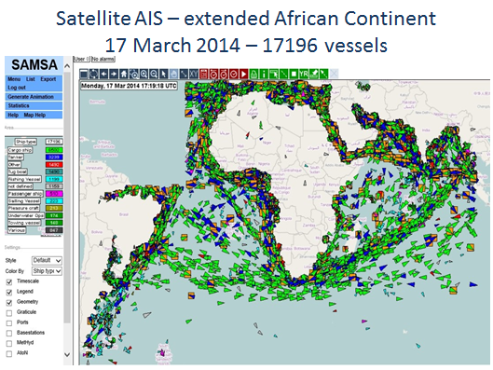
Africa Maritime Trade

Slide 13
Africa Maritime Trade
Ghana | Angola
30 Vessels | 7 Vessels
Nigeria | Ethiopia
60 Vessels (All Oil and Chemical tankers) | 22 Vessels (Took deliver of 9 over the past year)
Brazil | Russia
+172 Vessels | +1891 Vessels
India | China
+534 Vessels | +2044 Vessels
Africa
Under 1% Vessels owned by Africans
0% of South African Import and Export Cargo is carried on the back of South African owned ships.
On board the over 12,000 merchant ships visiting the South African ports annually, they carry about 240,000 seafarers who transport and handle our imports and exports (estimated at 98% of total trade);
South Africa pays over R40 billion (2012) annually for maritime transport services to foreign owners and operators annually.

Slide 14
The African Maritime Development Agenda
African Maritime Domain
Industry Development
Secure Sea Trade
Clean African Seas
Maritime Institutions and Admin
Inland Waterways
Investment in Maritime Infrastructure
Safe Ships
UNCLOS Enforcement

Slide 15
The Africa`s Maritime Governance Framework
African Maritime Governance Framework
African Union
2050 AIMS
SADC Protocol on Transport Communications and Meteorology
African Maritime Charter and Plan of Action
United Nations Convention on the Law Of the Sea
Regional Economic Communities
Indian Ocean Memorandum of Understanding (IOMOU)
Indian Ocean Rim (IOR)
Abuja MOU
Djibouti Code of Conduct
Regional arrangements on Port State Control for member states to curb unseaworthy ships from trading
Safety Of Life At Sea
The AMC was inspired by the objectives stated in the Constitutive Act of the African Union, particularly Article 3;
AMC guides the development of African maritime transport sector and facilitate the integration of effective safety and security considerations in maritime transport
The 2050 AIM Strategy provides a broad framework for the protection and sustainable exploitation of the Integrated African Maritime Sector Domain for wealth creation
Provides for member states to deepen regional cooperation and establish viable and sustainable transport
Proposed Regionalisation of AIMS Strategy into implementable plans
SADC Maritime Security Strategy
African Union – (to establish a stand alone AU Department of Maritime Affairs, supported by a Panel of Champions)
African Maritime Council (made up of Multiple Maritime Sectors eg Africa Ports, Shippers, Administrations, Industries)
Regional Maritime Councils (operating as Regional Focal Points within the RECs)
National Maritime Councils (driving the AIMS Objectives within their National States

Slide 16
The African Maritime Transport Charter
Articulate and implement harmonized maritime transport policies capable of promoting sustained growth and development of African merchant fleets and to foster closer cooperation among the States Parties within and between the regions.
Facilitate and encourage regular consultations for determining African common positions on issues of international maritime policy Promote effective implementation of international maritime instruments to which Member States are parties
Promote the establishment of national and regional shipping companies and provide support necessary for their success
Promote bilateral and multilateral cooperation among the maritime administrations of States Parties
Promote the funding, undertaking of research studies that encourage the promotion and development of the sector
Develop and promote mutual assistance and cooperation between States Parties in the area of maritime safety, security and protection of the marine environment.
Promote the sharing of best practices among States parties in the overall management and operation of Maritime Administrations and other maritime entities established in terms of this Charter
Promote development of multimodal transport and integration of all modes of transport.
Promote the employment of seafarers, decent working conditions and training of seafarers
The African Maritime Transport Charter suggested the establishment of structures to drive its implementation eg:
Associations of African Maritime Administrations (AAMA)
African Shippers Council
Association of African Ports
African Ship Owners Council
Associations of African Maritime Companies
Association African Maritime Training, Education and Research

Slide 17

2050 African Integrated Maritime Strategy
“This strategy is dedicated to the memory of those who died at sea trying to earn a better quality of life, and of those who passed away on the oceans in the course of the slave trade, colonialism, and the fight for Africa’s self-determination and independence.”

Slide 18
African Integrated Maritime Strategy 2050
The objectives of the African Integrated Maritime Strategy are as follows to:
Establish a Combined Exclusive Maritime Zone of Africa (CEMZA)
Engage civil society and all other stakeholders to improve awareness on maritime issues
Enhance political will at community, national, regional and continental levels
Enhance wealth creation, and regional and international trade performance through maritime-centric capacity and capability building
Ensure security and safety of maritime transportation systems
Protect populations, including Africa Maritime Domain(AMD) heritage, assets and critical infrastructure from maritime pollution and dumping of toxic and nuclear waste
Minimize environmental damage and expedite recovery from catastrophic events
Prevent hostile and criminal acts at sea, and Coordinate/harmonize the prosecution of the offenders
Improve Integrated Coastal Zone/Area Management in Africa
Promote the ratification, domestication and implementation of international legal instruments
Ensure synergies and coherence between sectorial policies within and between the RECs/RMs
Protect the right of access to sea and freedom of transit of goods for landlocked States.

Slide 19
REC`s Strategies-SADC Protocol
Member States shall promote the economic and social development of the region by developing and implementing harmonized international and regional transport policies in respect of the high seas and inland waterways which seeks to –
Maximize regional and international trade and exchange
Provide appropriate frameworks for economic and concomitant institutional restructuring
Promote a safe and clean marine, maritime and inland waterway environment
Encourage the provision of accessible, viable and productive landside infrastructure
Establish a customer-sensitive and needs-driven approach
Promote the establishment of an integrated transport system set

Slide 20

Africa Maritime Development Agenda- Way Forward
Support the formation of the African Ship Owners Association
Support the Integration of the Association of African Maritime Administrations into member states.
Request the African Development Bank to set up a seed fund for the African Maritime Development Bank
Establish and/or enhance the Maritime Administrations in African countries
Promote cabotage and private sector operators at national, regional and continental levels. There should be alignment on INCOTERMS
Policy recognition (Maritime Charter) and developing of the regional African coastal shipping as part of the ‘domestic’ transport network planned complete with:
Appropriate cargo consolidation hubs [hub and spokes]
Intermodal maritime corridor s linked to inland regions
Establish a Establishment of a continental short-sea-shipping strategy, enforceable through:
Regional cabotage network (exclusive to African tonnage)
Coastal trade policy to integrate the continent’s coastal economies
Serving to strengthen the state’s capacity and capability to enforce safety, security and territorial integrity
Promote the maritime industrialisation programme:
Provide adequate ship repair infrastructure facilities on the continent
Establish regional maritime industrial hubs for ship building, boat building and component manufacturing
Provide world class ‘soft infrastructure’ development programmes
Introduce maritime awareness and education in the populace
Provide high tech training and research centres
Improve participation of females in maritime

Slide 21
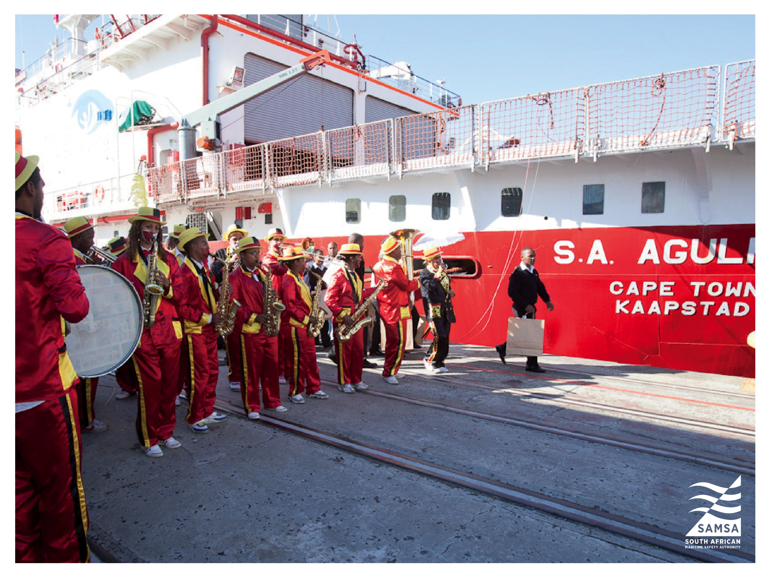

Slide 22
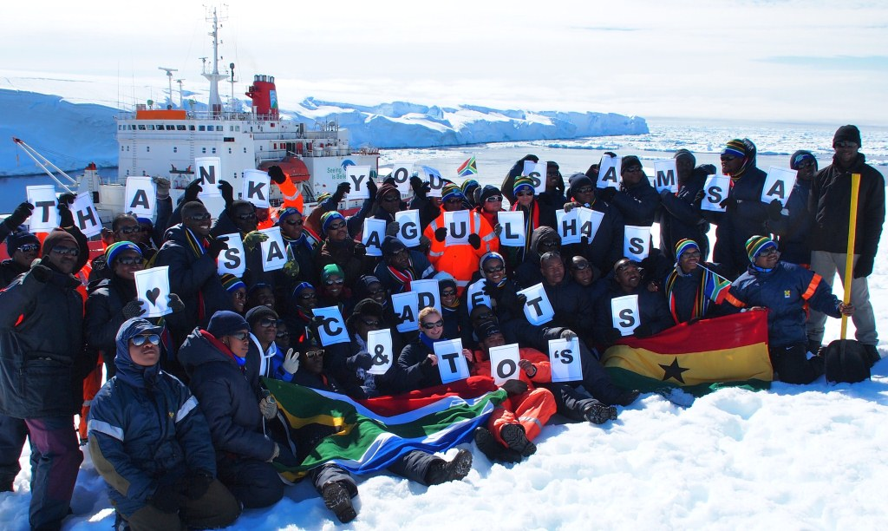
THANK YOU

