Slide 1
BOUNDLESS SOUTHERN AFRICA
Facilitating people-to-people movement in Southern Africa
AFRICAN RENAISSANCE CONFERENCE, DURBAN 2014

Slide 2
TFCA DEVELOPMENT STRATEGY
A Transfrontier Conservation Area (TFCA) is an area straddling two or more international borders where the natural and cultural resources are collaboratively managed by the governments/authorities involved.
In 2005 SADC Ministers responsible Environment and Tourism endorsed a TFCA development strategy for 2010 and beyond (a.k.a. Boundless Southern Africa Initiative)
Objective: To increase the tourism potential of Southern Africa by consolidating the marketing and investment promotion efforts of existing transfrontier initiatives.
Initial Focus: Seven TFCAs straddling the borders of 9 SADC countries. Boundless Southern Africa unit is currently hosted by the Department of Environmental Affairs, Pretoria on behalf of the participating countries.

Slide 3
TFCAs IN SADC REGION
Development of TFCAs started in 1999 with the establishment of Kgalagadi Tranfrontier Park (Botswana and South Africa)
Since then significant strides have been made across the region to establish additional TFCAs.
Currently there are 18 TFCAs across SADC region that are in different stages of development.
TFCAs create an enabling environment for collaborative management of shared ecosystems using tools such as Integrated Development Plans and/or Joint Operation Strategies
Key and well known tourist destinations in the region are located in TFCAs therefore efforts to coordinate conservation across boundaries must be complemented by initiatives to boost tourist arrivals.
TFCAs provide a platform for the management of shared (cross-border) tourism resources and development of cross-border tourism

Slide 4
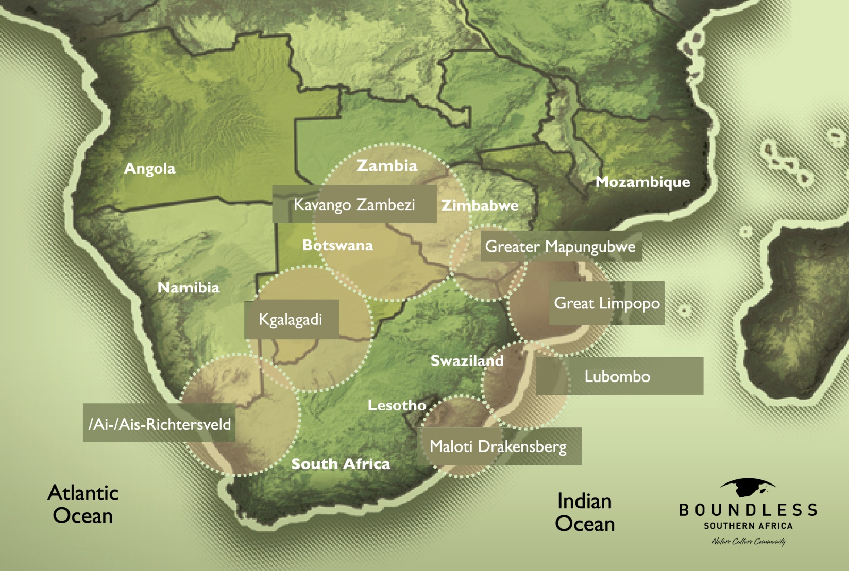
Countries: Angola, Botswana, Lesotho, Mozambique, Namibia, South Africa, Swaziland, Zambia and Zimbabwe

Slide 5
TFCA DEVELOPMENT STRATEGY
DEVELOPMENT CHALLENGES TO BE ADDRESSED
Limited awareness about TFCAs at local and international levels
Limited investment in tourism facilities and supporting infrastructure in TFCAs
Small number of tourists visiting TFCAs
STRATEGIC COMPONENTS
Marketing and Awareness raising (including development and popularizing of tourism products in TFCAs)
Investment promotion and Infrastructure development

Slide 6
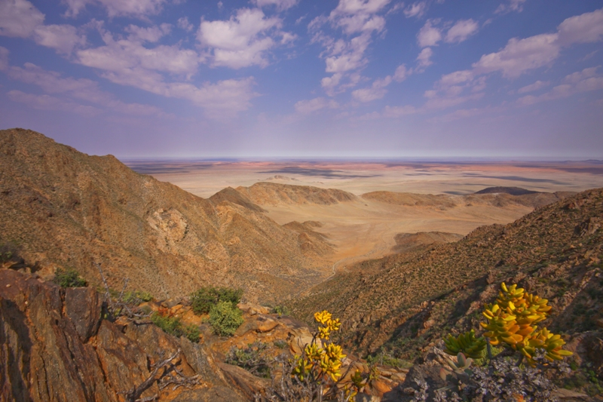
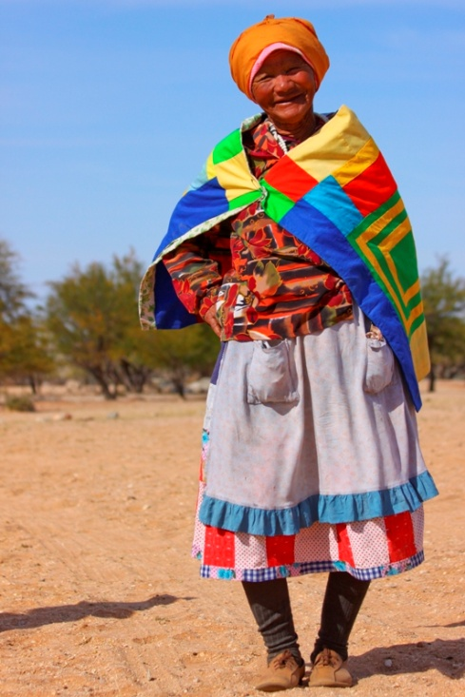
/Ai- /Ais Richtersveld
Namibia and South Africa

Slide 7
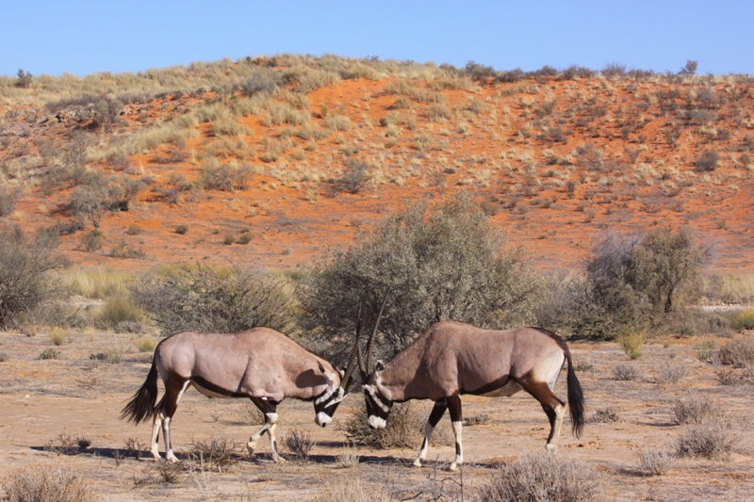
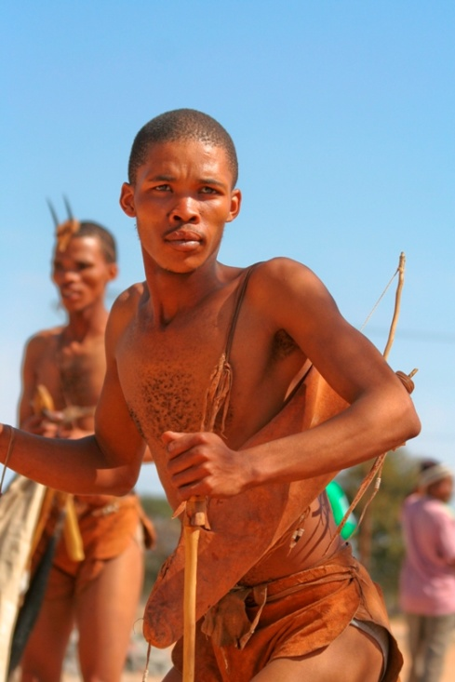
Kgalagadi Transfrontier Park
Botswana and South Africa

Slide 8
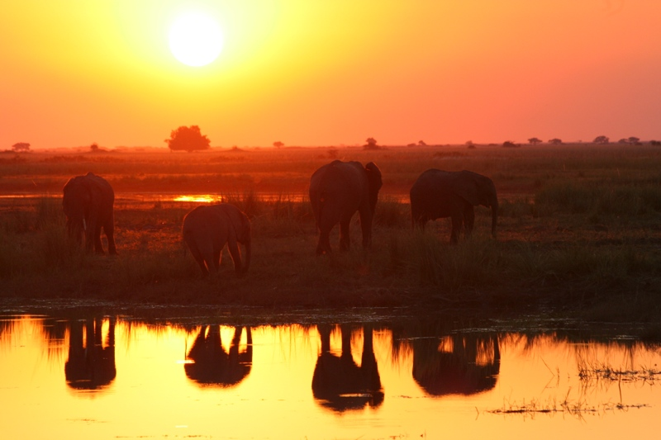
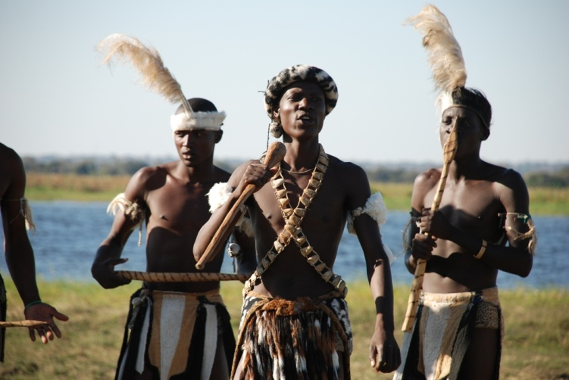
KAZA Transfrontier Park
Angola, Botswana, Namibia, Zambia, Zimbabwe

Slide 9
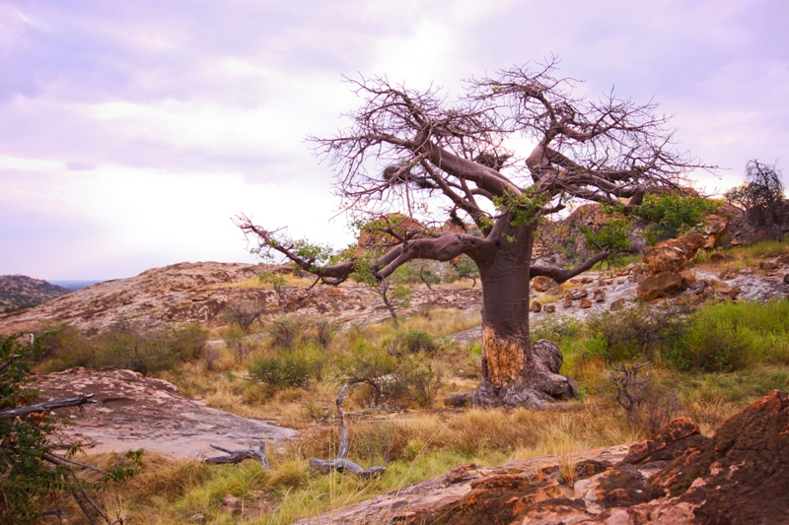
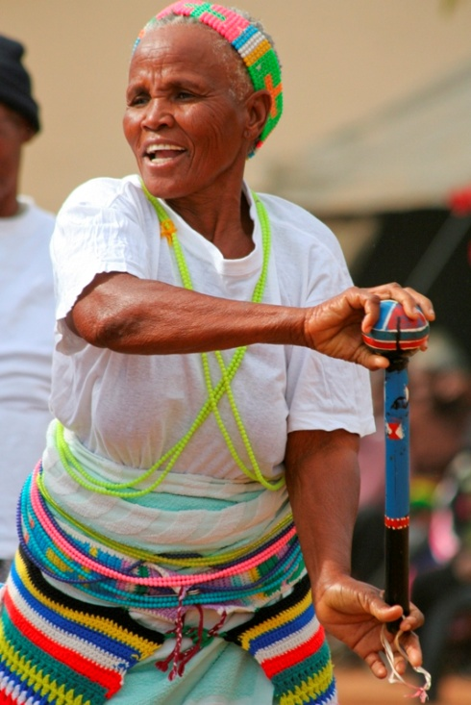
Greater Mapungubwe TFCA
Botswana, South Africa, Zimbabwe

Slide 10
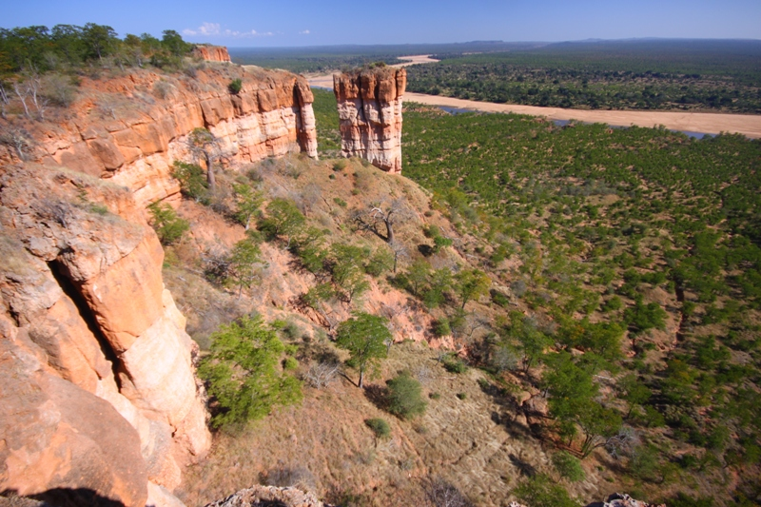
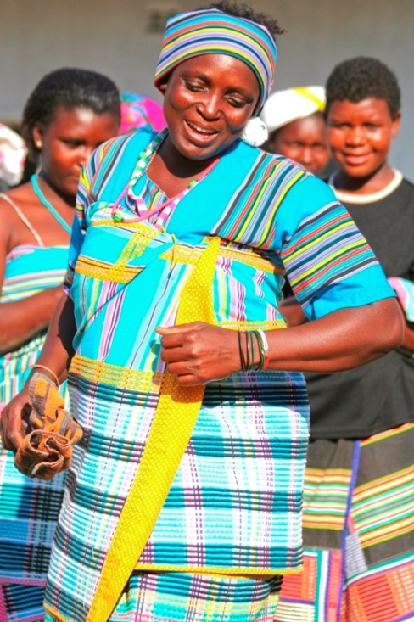
Great Limpopo Transfrontier Park
Mozambique, South Africa and Zimbabwe

Slide 11
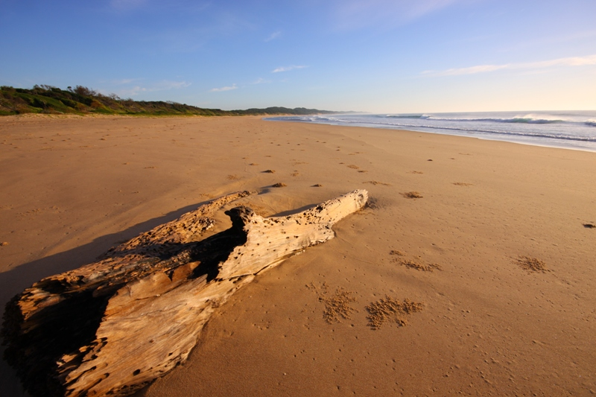
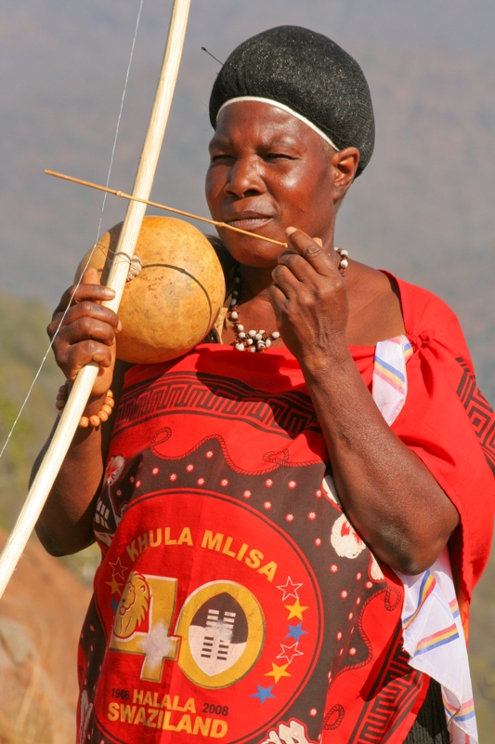
Lubombo TFCAs
Mozambique, South Africa, Swaziland

Slide 12
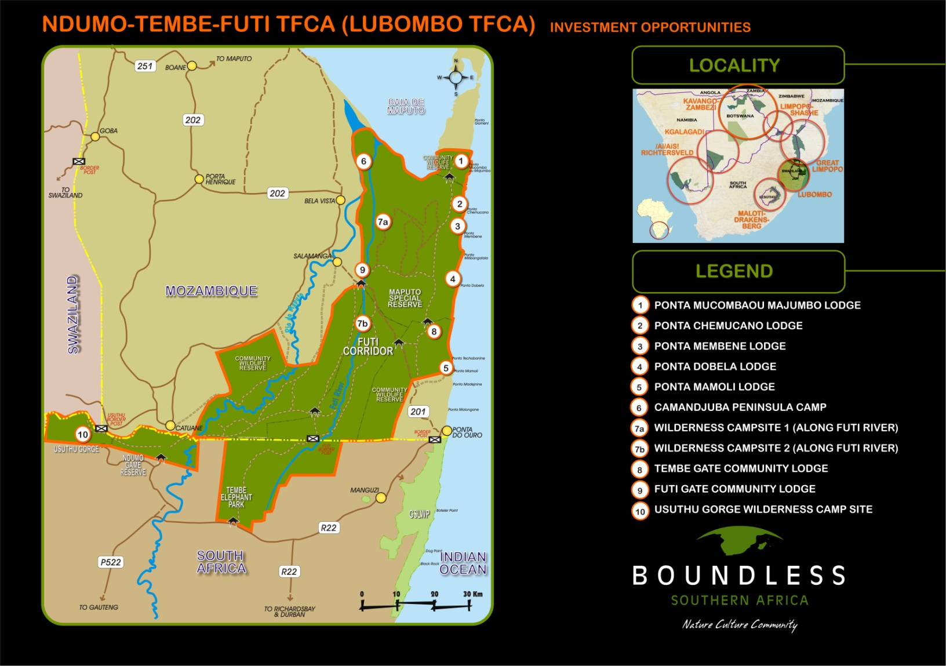

Slide 13
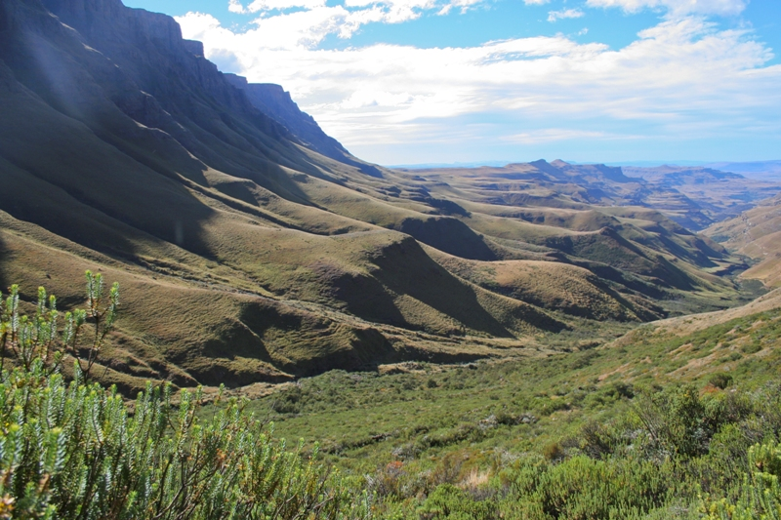
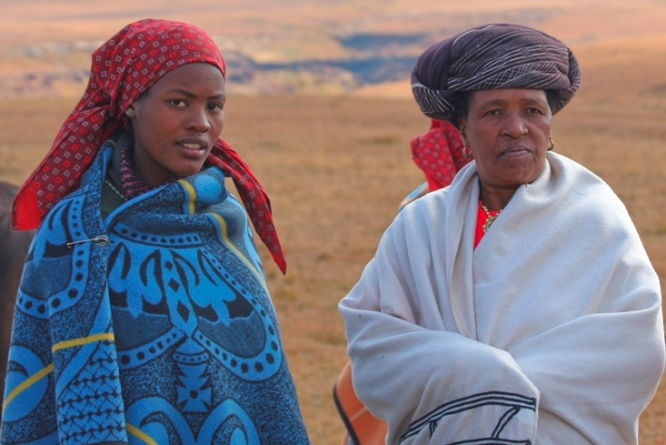
Maloti – Drakensberg Transfrontier Park
Lesotho and South Africa

Slide 14
PEOPLE TO PEOPLE MOVEMENT
Air access to TFCAs throughout the region
New border control points in TFCAs facilitate movement of people with TFCA
Innovative events within TFCAs to highlight tourism experiences, routes and future possibilities
Boundless Southern Africa Expeditions with Kingsley Holgate in 2009 and 24 Youth Ambassadors in 2013

Slide 15
AIR ACCESS TO TFCAs
TFCAs are located in rural areas of Southern Africa
Air access is limited, and flights to airports closest to TFCAs are relatively expensive
Upington airport is still 300 kms from the Kgalagadi Transfrontier Park and 450 kms from the /Ai/Ais-Richtersveld TFCA
Aviation sector very important in the Kavango Zambezi TFCA with many small operators flying out of Maun, Chobe, Livingstone and Victoria Falls

Slide 16
NEW ACCESS POINTS IN TFCAs
One stop border control has been developed at Tweerivieren in the Kgalagadi Transfrontier Park
Pontoon in place over the Orange River at Sendelingsdrift in the /Ai/Ais-Richtersveld Transfrontier Park with border control points between Namibia and South Africa
Giriyondo Border Post in the Greater Limpopo Transfrontier Park between South Africa and Mozambique
Work being done on pilot univisa between Zimbabwe and Zambia, and then expanding to other participating countries of the KAZA TFCA

Slide 17
INNOVATIVE EVENTS
Objective of creating events with TFCAs is to create routes that incorporate all countries of that specific TFCAs
Tour de Tuli, organised by Children in the Wilderness held in the Greater Mapungubwe Transfrontier Park with 300 participants
Desert Knights Tour in the /Ai/Ais-Richtersveld Transfrontier Park with 100 participants every year
Encourage new participants in these events through strategic partnerships
Other cross-border products being developed in Greater Limpopo and other TFCAs

Slide 18
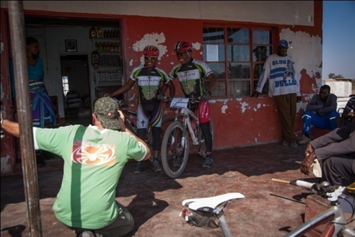
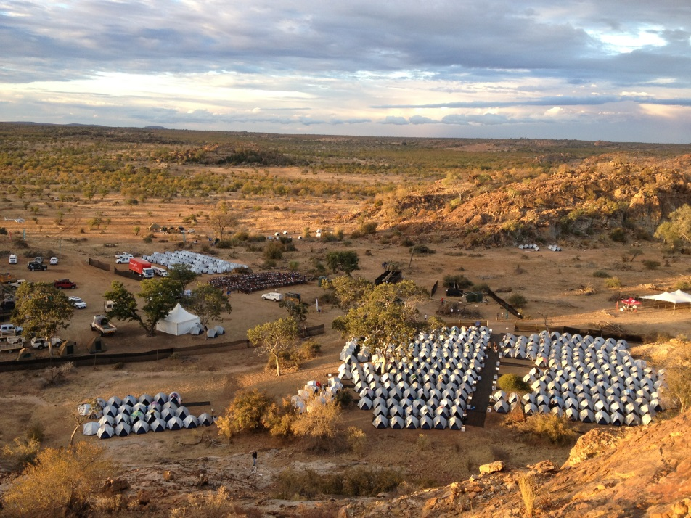
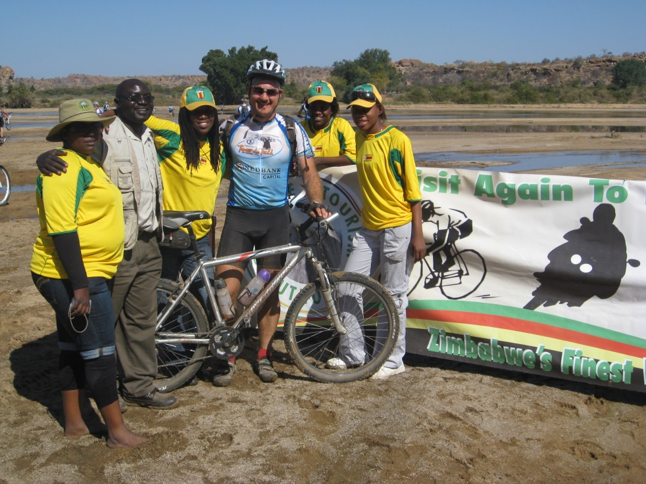
Tour de Tuli, Greater
Mapungubwe Transfrontier Park

Slide 19
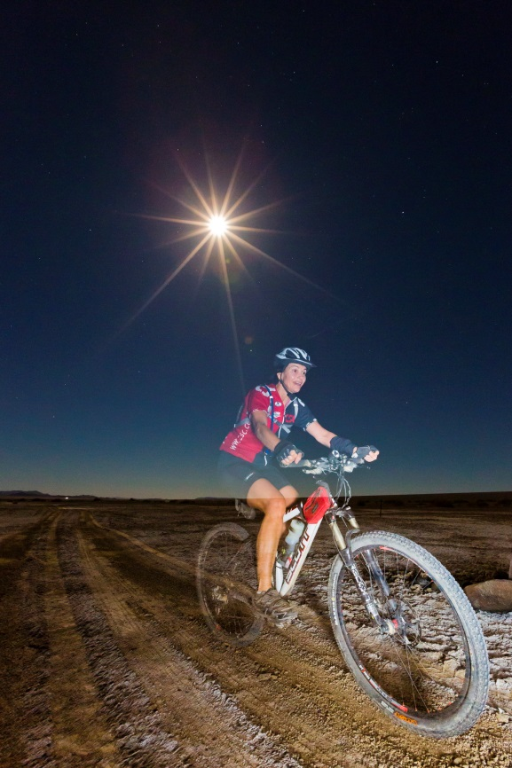
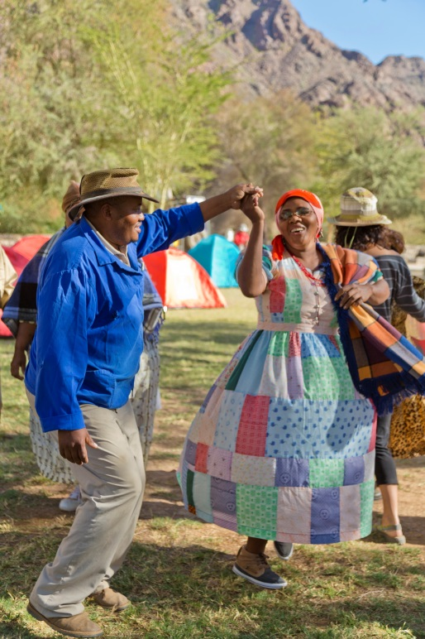

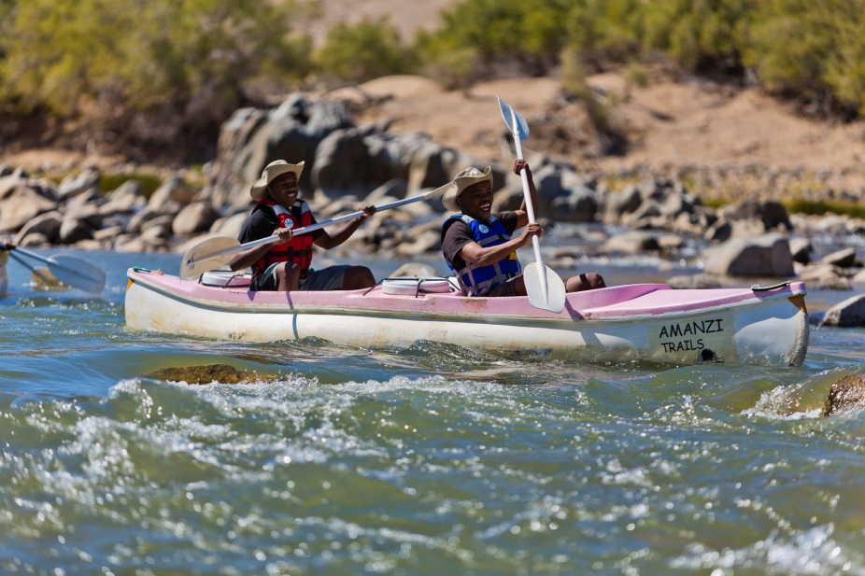
Desert Knights,
/Ai/Ais-Richtersveld
Transfrontier Park

Slide 20
BOUNDLESS EXPEDITIONS
In 2008 Kingsley Holgate left from the Durban ICC after the Tourism Indaba on a 3 month journey linking all 7 TFCAs that are part of the Boundless Southern Africa Initiative
In 2013 24 Boundless Southern Africa Ambassadors – young people living in communities bordering the 7 TFCAs went on a 2 week Expedition from Johannesburg through the KAZA TFCA to the UNWTO General Assembly being held in Victoria Falls – visiting 5 countries and engaging with various community, conservation and youth groups en route

Slide 21
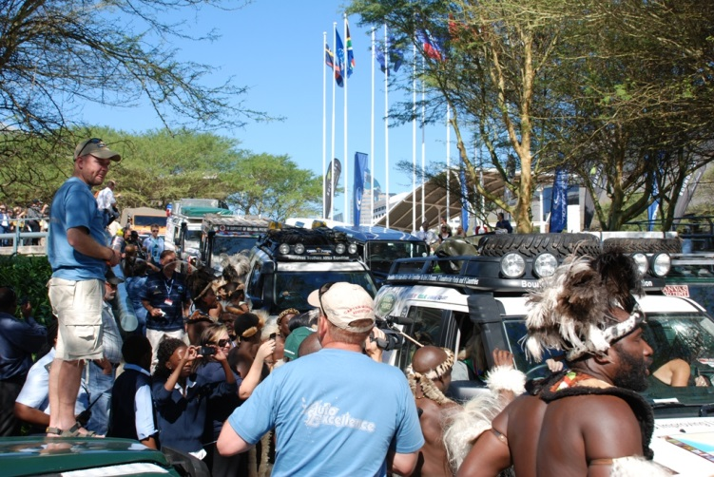
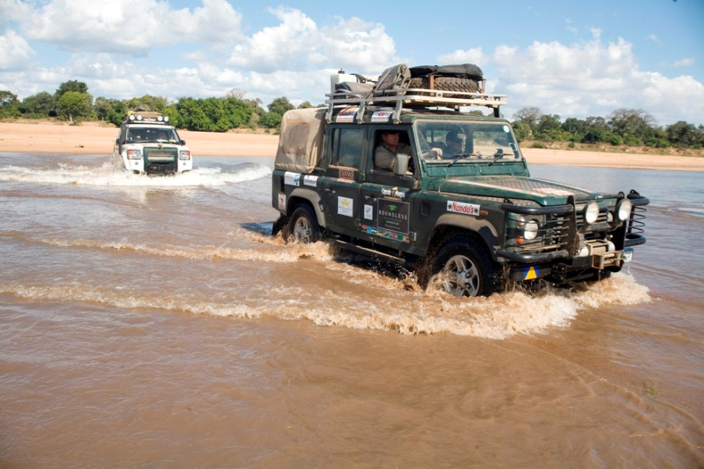
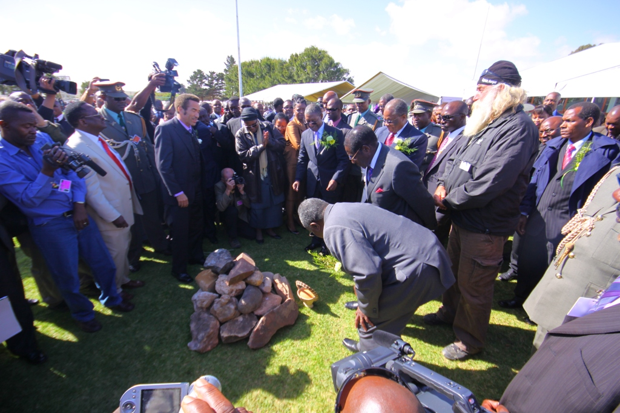
Boundless Expedition
2008

Slide 22
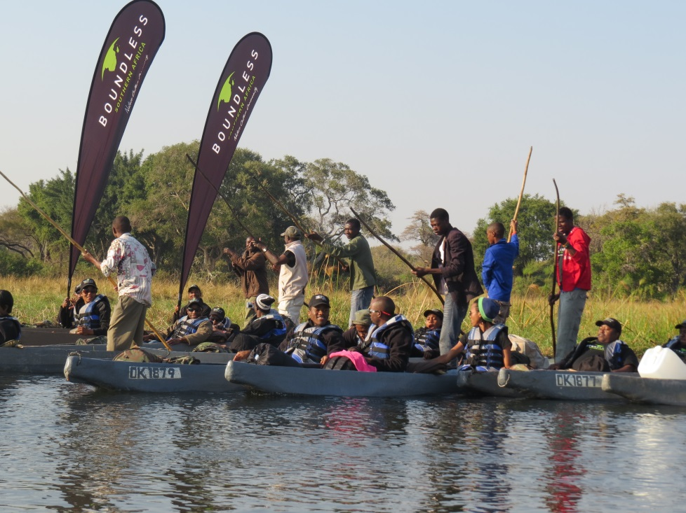
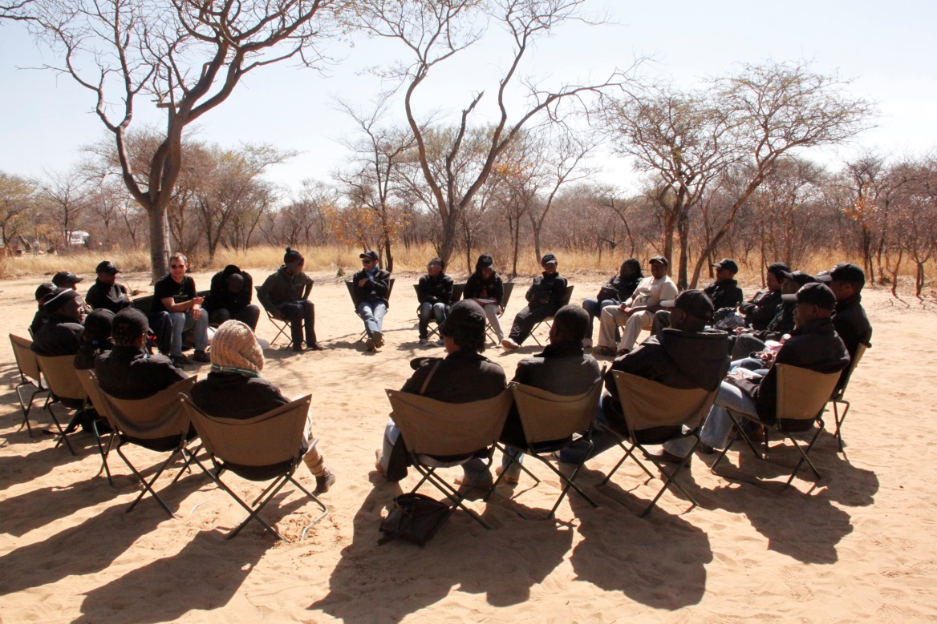
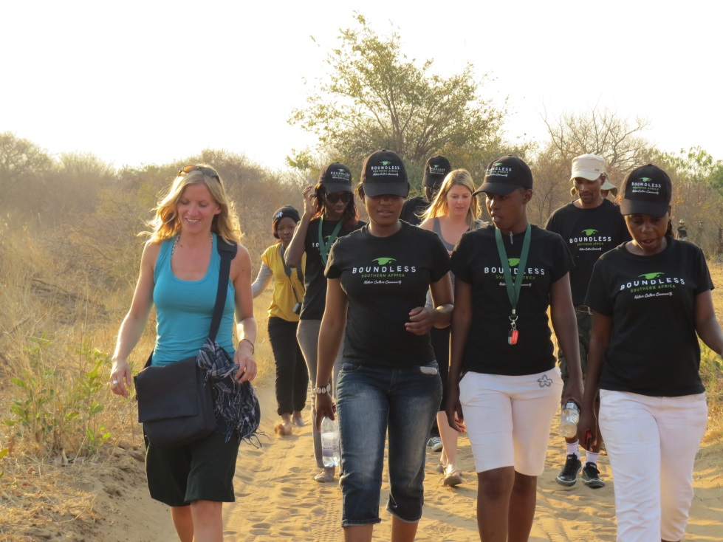
Boundless Expedition
2013

Slide 23
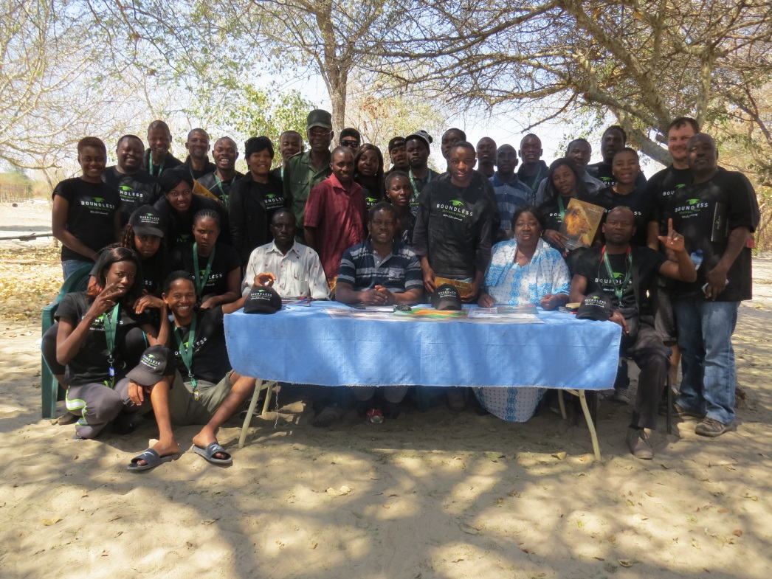
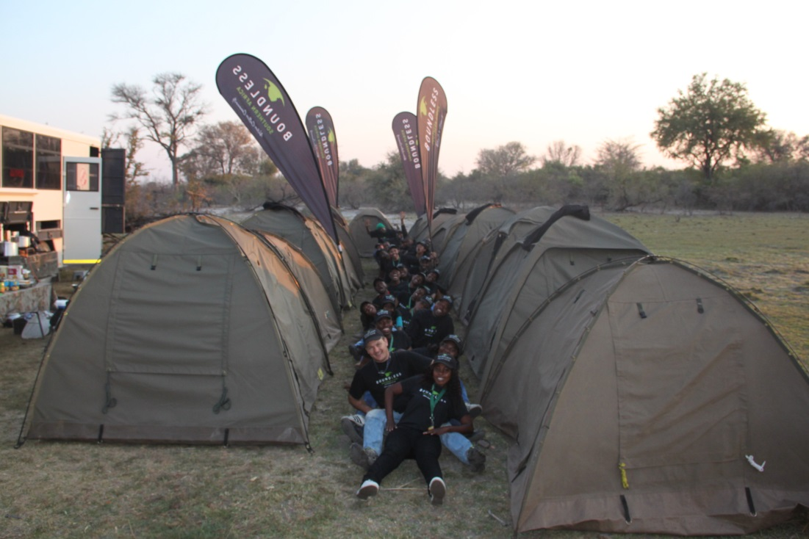
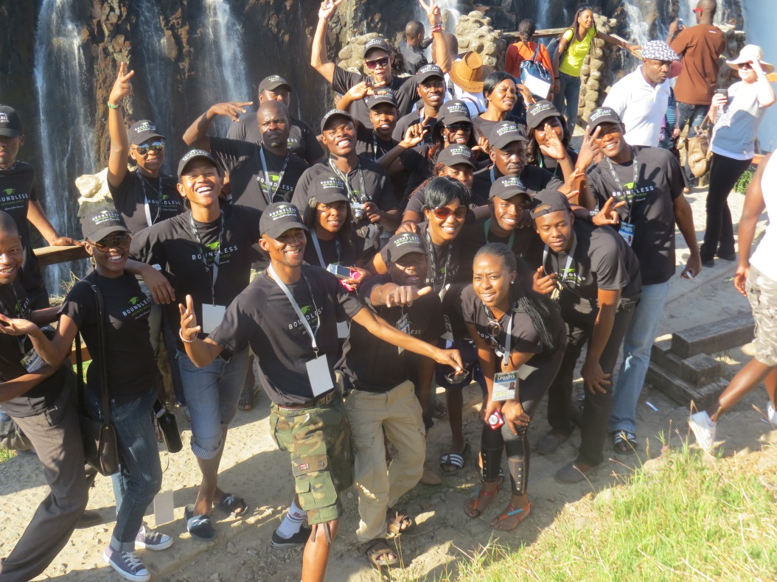
Boundless Expedition
2013

Slide 24
THANK YOU
Marketing Manager – Roland Vorwerk
rvorwerk@environment.gov.za

