Slide 1

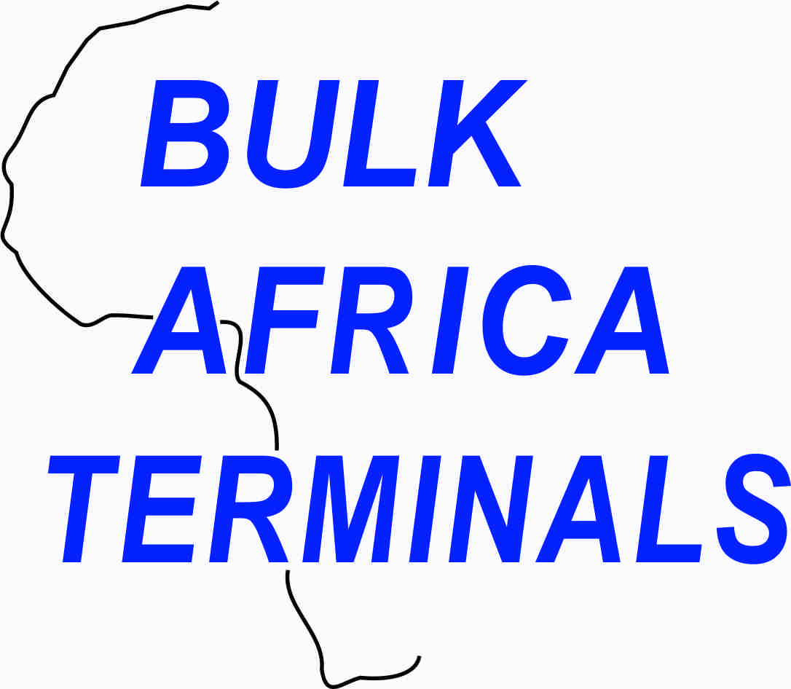
Presenter Chris Magagula
Managing Director
Bulk Africa Terminals (Pty) Ltd
The need for entrepreneurs to drive opportunities
in infrastructure development

Slide 2
Various Legislations has created positive environment
- MT&SI BEE Charter
- The National Ports Act
“National Ports Act Regulation 3 and as stated repeatedly by TNPA) is to increase black participation in and access to the ports and that the national strategy is to increase broad based black economic empowerment.”
The need for entrepreneurs to drive opportunities
in infrastructure development
The need to drive these opportunities in within the Maritime Industry

Slide 3
The need for entrepreneurs to drive opportunities
in infrastructure development
Lets look at the opportunities
- Dug-Out Port – Old Durban International Airport
- Dry Port (Inland) Container Depot
- Transnet Freight Rail Infrastructure Development
R201 billion has been channelled to Transnet Freight Rail to expand its rail infrastructure to create capacity and increase cargo volumes. Through this investment, TFR will be able to optimise its capital portfolio, build a world class capital execution function and leverage capital procurement and localisation.

Slide 4
The need for entrepreneurs to drive opportunities
in infrastructure development
Challenges:-
- Bringing more black players within the industry
- Finance – industry requires huge capital
- Various Legislations
- Red Tape within the industry: -
- Security & Guarantees a huge problem
- Skills & Empowerment

Slide 5
The need for entrepreneurs to drive opportunities
in infrastructure development
Challenges:-
- Bringing more black players within the industry
- Finance – industry requires huge capital
- Various Legislations
- Red Tape within the industry: -
- Security & Guarantees a huge problem

