Slide 1
IDC funding options in support of the
Maritime Sector
Herman Husselmann
Senior Account Manager:
Metal, Transport and Machinery Products SBU
22 May 2014

Slide 2
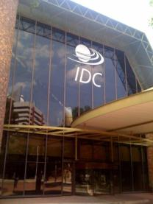
Introduction
IDC was established in 1940 with the aim of developing South African industry through the Industrial Development Corporation Act (No. 22 of 1940)
The vision of the IDC is to be the primary source of commercially sustainable industrial development and innovation to the benefit of South Africa and the rest of the African continent;
The IDC is a self-financing national development finance institution whose primary objectives are to contribute to the generation of balanced, sustainable economic growth in Africa and to the economic empowerment of the South African population, thereby promoting the economic prosperity of all citizens.
The IDC achieves this by promoting entrepreneurship through the building of competitive industries and enterprises based on sound business principles.
IDC pays income tax at corporate rates and dividends to the shareholder.
2

Slide 3
IDC’s Vision, Mission, Objectives and Outcomes
Vision
To be “the primary driving force of commercially sustainable industrial development and innovation to the benefit of South Africa and the rest of the African continent”
The IDC is a self-financing national development finance institution whose primary objectives are to contribute to the generation of balanced, sustainable economic growth in Africa and to the economic empowerment of the South African population, thereby promoting the economic prosperity of all citizens. The IDC achieves this by promoting entrepreneurship through the building of competitive industries and enterprises based on sound business principles.
Mission
Supporting industrial capacity development in line with industrial policy
Objectives
Sustainable employment
Regional equity (including development of the rest of Africa)
Growing SME sector
Outcomes
Broad-based black economic empowerment
Environmentally sustainable growth
New entrepreneurs entering the economy
Increased localisation

Slide 4
IDC Priorities and their Intended Outcomes
Outcomes to be Achieved
IDC Priorities
Facilitate sustainable direct and indirect employment
To lead industrial capacity development
Improving regional equity, including the development of South African rural areas, poorer provinces and industrialisation in the rest of Africa
This priority needs to be balanced with:
Growing the entrepreneurial and SME sectors
Ensuring long-term sustainability
Transformational impact on communities and growing black industrialists
Environmentally sustainable growth
Growing sectoral diversity and increased localisation of production

Slide 5
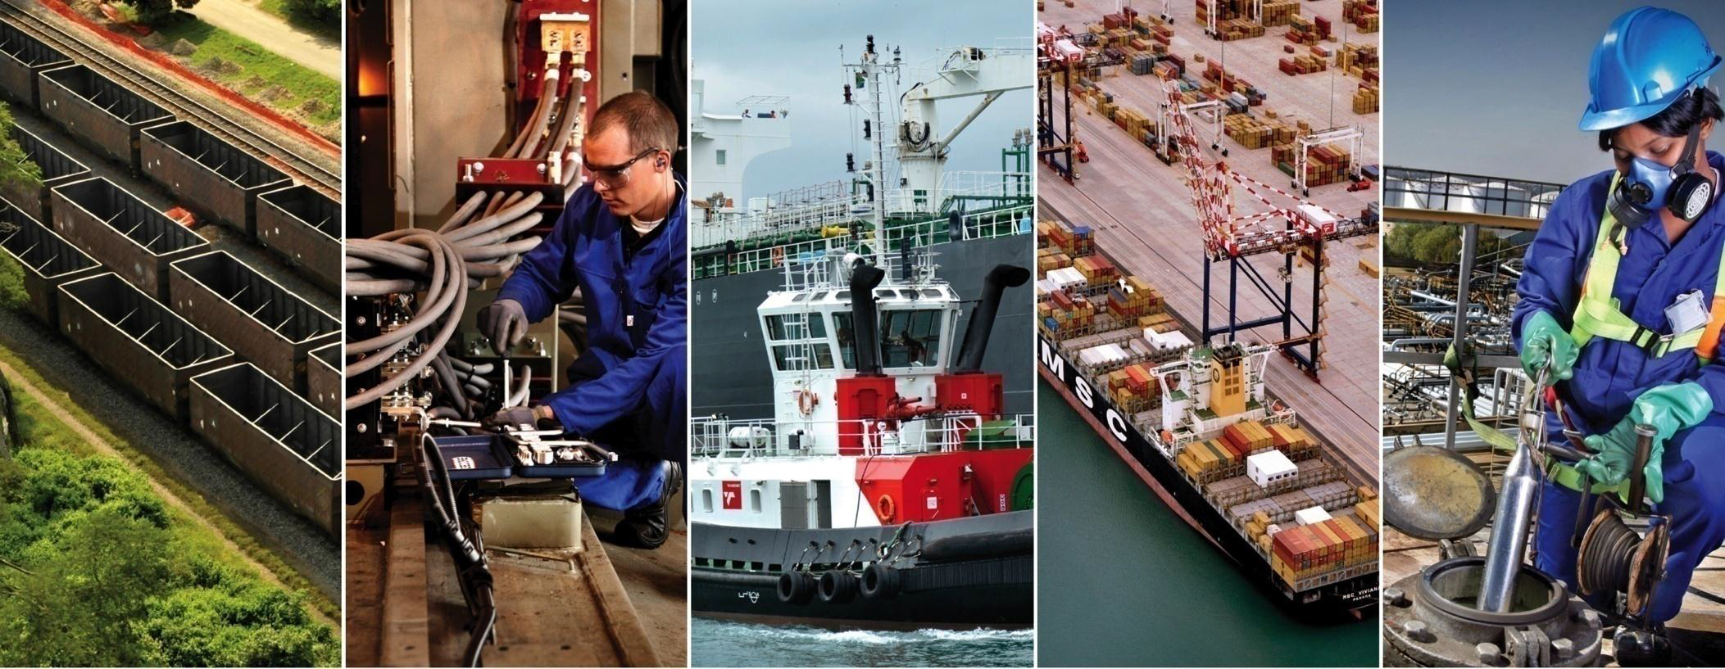
High Level Sector Development Strategy
Improving the balance of trade in downstream metal industries by 2020
Import replacement opportunities
Export development opportunities
Increase capacity for the local assembly of passenger vehicles, medium, heavy and commercial vehicles, buses, taxis and trailers
Incorporate local components manufacturing into global supply chains
Establish and expand local production capacity for infrastructure inputs
Develop New industries that will increase job creation and have export potential

Slide 6
IDC’s Positioning
Greater importance on social and developmental objectives
Greater importance on financial objectives
Government / NGOs
DFIs
Commercial Financiers
Non-commercial focus
Fiscal transfers and grants
Development objectives (social)
Developmental and commercial focus
Sharing risk
Internally generated funds, government funds, loans
High commercial focus
Private sector capital
Financial objectives
Known risks
Industrial Development Corporation (IDC)
Development Bank of Southern Africa (DBSA)
Small Enterprise Finance Agency (SEFA)
National Empowerment Fund (NEF)
.
ABSA Bank
Standard Bank
First National Bank
Nedbank
Etc.
IDC does not directly compete with any of these institutions, but encourages cooperation with a variety of these institutions to achieve its goals

Slide 7

IDC Sectorial Focus Areas
R102 billion funding available over the next five years.
R11.1 billion
Logistics, infrastructure and cross-sector projects
The green economy
  Logistics
  Industrial infrastructure
  Green and energy saving industries
  Bio fuels
R22.4 billion
Tourism, creative industries and high-level services
  Craft and film
Agricultural value chain
R7.7 billion
  Business process services
  Biotechnology
  Agro-processing
  Tourism
  Forestry, paper & pulp, furniture
  Mining related technologies
  Healthcare
  ICT
R14.8 billion
Manufacturing activities
  Automotives, components, medium and heavy commercial vehicles
  Metals fabrication, capital and transport equipment
The mining value chain
  Mining
  Downstream mineral beneficiation
  Advanced manufacturing
  Plastics and chemicals
  Clothing, textiles, footwear, leather
R22.1 billion
  Oil and gas
  Pharmaceuticals
  Green industry components
Other funding areas :
Venture Capital: R500 million
Funding to distressed companies: R2.5 billion
R20.8 billion
7

Slide 8
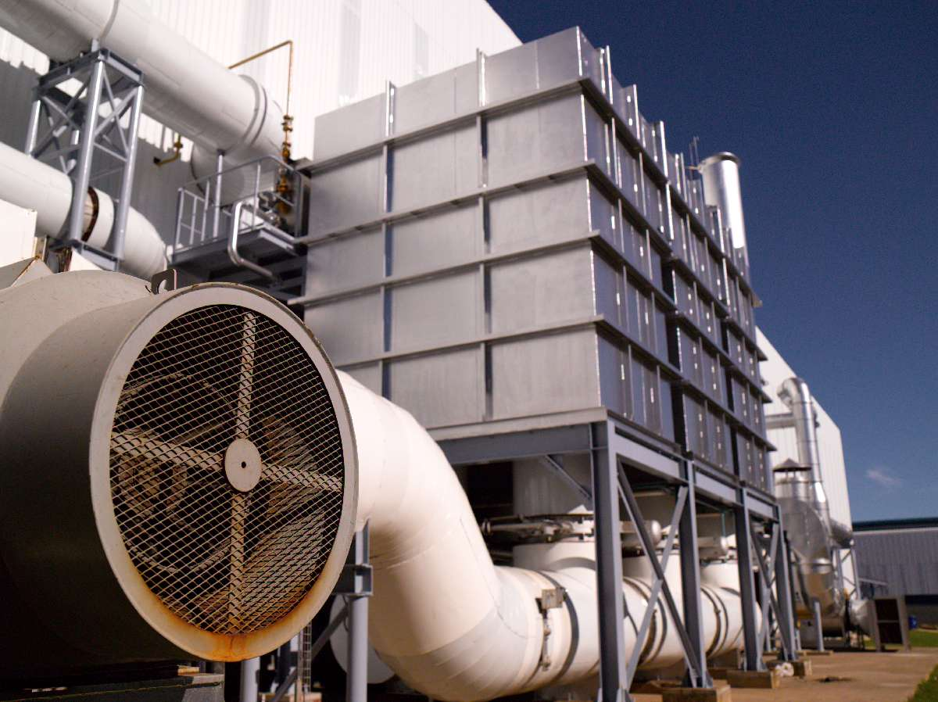
Metals SBU Vision and Mission
Vision
To lead in the development of the complete manufacturing downstream value-chain of the ferrous and non-ferrous metals sectors
Mission
To develop and support viable downstream developments and value-adding to the ferrous and non-ferrous metals sectors to improve competitiveness and increase the capacity of the metals industry in South Africa and the rest of Africa by working pro-actively, cost-effectively and taking more risk – a tolerant approach.

Slide 9
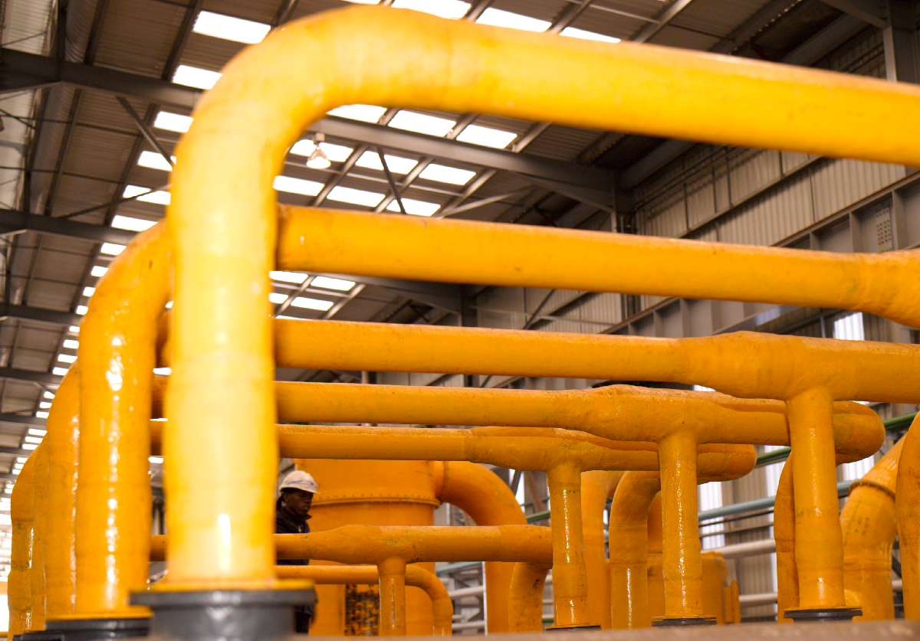
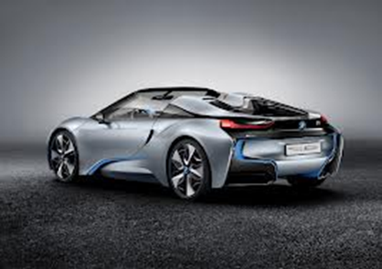
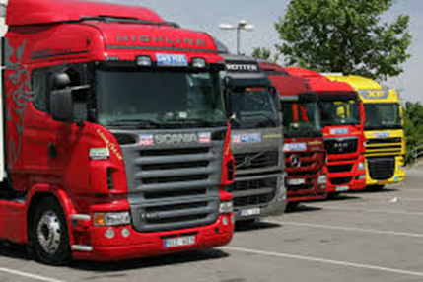
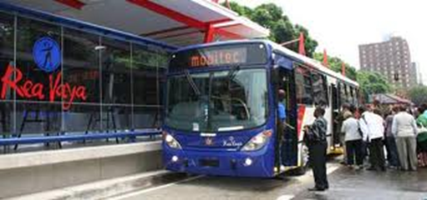
SBU Focus – IPAP2 Lead Sectors
Sectors
Automotive Sector, including buses, trucks, & trailers (MHCV)
Fabricated Metals, Capital and Transport Equipment Sector
Renewable Energy Components Sector
Advanced Manufacturing Sector, including Aerospace & Nuclear
Ship repair & ship building, and boat building & related services
Localisation and assembly of Rail Components

Slide 10
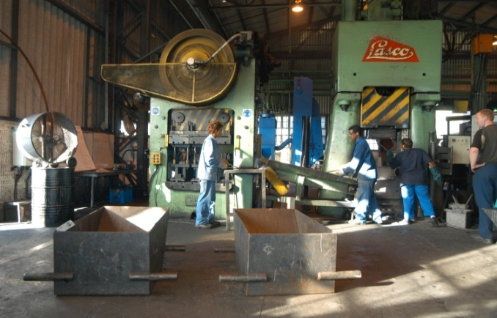
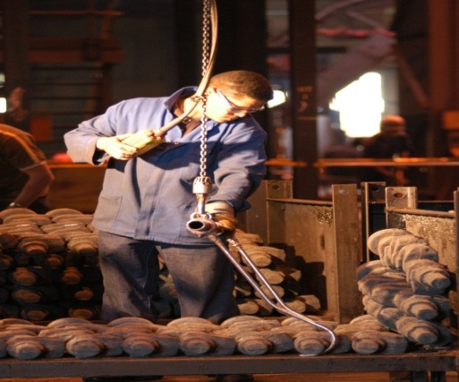
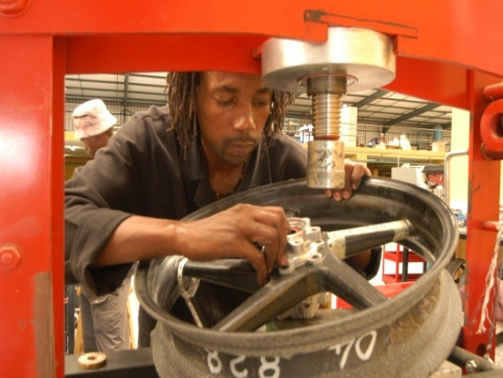
Automotive Sector
Doubling of local content in components
Finance capacity expansion at existing component manufacturers
Buses, Taxis, medium and heavy commercial vehicles
Leverage public transport procurement to generate enough demand for the viable local assembly of buses
Increase local content of electronics, interior, body panel and engine components
Leverage the extensive procurement in the taxi industry to attract a taxi assembly plant locally
Enhance existing capacity of local industry to assemble commercial vehicles and “yellow goods”

Slide 11
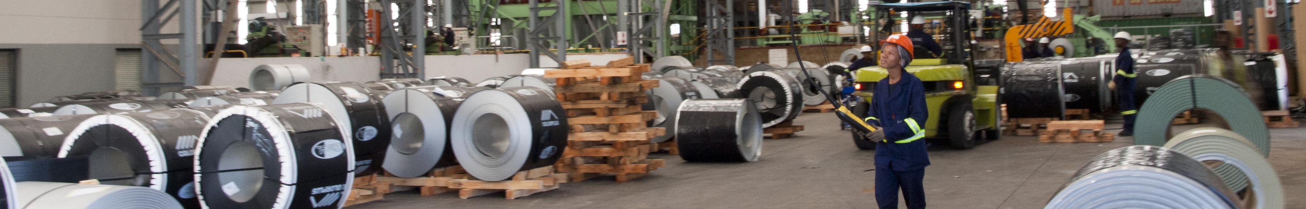
Metal Fabrication, Capital and Transport Equipment Sector
Increase local content of SOE CAPEX Programme
- Leverage upon Transnet and Eskom strategic procurement to develop globally competitive local industry
Resuscitate Foundries and Tool, Die and Mould (TDM) industries by 2020
- Roll-out of the National Foundry Technology Network Programmes
Innovative Financing Programme for OEMs and local suppliers
- Design a funding instrument/scheme to increase participation levels of local suppliers in the SOE CAPEX Programme
- Utilise CSDP and UNIDO Program to attract OEMs to set up locally
- Identify and exploit CSDP opportunities from municipalities and other private sector
- Development of an internationally competitive tooling cluster in South Africa
- Scrap metal beneficiation to form either billets or coils, and thereby reduce exportation of local scrap metal.

Slide 12
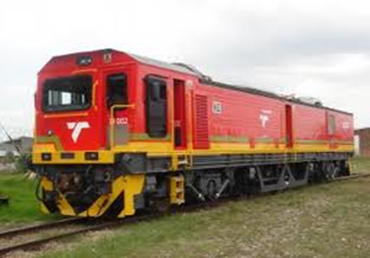

Infrastructure Inputs – Rail
Increase capacity for the local assembly and localisation of rail components
- Robust enforcement of local procurement policies and designated products
Development of a local Rail OEM Facility
Localisation of Rail Infrastructure
- Focus on rail tracks and slipway manufacturing facilities
- Increased economies of scale through regional market penetration
- Government incentive schemes for local manufacturers similar to the Auto Sector
- Increase utilisation of upstream and down stream industries
- Increase local content, reduce import leakage, and increase exports to the Rest of Africa (RoA)
- Leverage upon Transnet strategic procurement to develop a globally competitive local industry
- Reduce import leakage
- Increase participation of black industrialists

Slide 13
Renewable Energy Components Sector
Establishment of a local SWH manufacturing industry
Concentrated Solar Power components manufacturing
Wind energy components manufacturing
Photovoltaic components manufacturing

Slide 14
Advanced Manufacturing, Ship Building and Ship Repair Sectors
Advanced Manufacturing
Development of advanced material value chain (Titanium and Magnesium)
Aerospace
Integration of local industry into the global value chain
Ship Building and Ship Repair
Support existing fleet of large ships for Defense / Logistics / Tourism en-route to and from Africa via the Atlantic and Indian Oceans
Development of tier-2 and tier-3 suppliers
Consolidation of the Centurion Aviation Village cluster
Develop scarce technical ship repair and ship building skills locally
Develop local ship repair and ship building facilities to penetrate the international shipping market
Deepen footprint in the global shipping industry

Slide 15
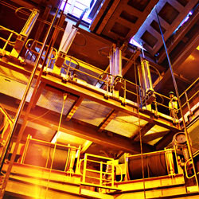
IDC Products
Funding Instruments
Equity
Quasi-equity
(Subordinated Loans & Preference shares)
Commercial debt
Export/import finance
Short-term trade finance
Bridging finance
Performance Guarantees
Venture capital
Wholesale funding through intermediaries
IDC is able to provide flexible funding packages to suite the client and industry requirements
IDC provides loan funding and not “grants”
Finance is structured according to client’s needs and cash flow requirements – this can include moratoria on repayments to enable business growth.
Minimum funding amount of R1 million
Notes:
Don’t call the R10bn a “scheme” – rather say allocating R10bn

Slide 16
Funding Process
Pipeline
Assessment and decision
Monitoring
Applications from existing/prospective businesses
Detailed due-diligence/feasibility study assessing development impact and sustainability of opportunities:
Development outcomes
Market for products/services
Technical viability and competitiveness
Financial viability
Management
Ongoing monitoring of client performance after funding is made available
Proactive identification and development of projects
Interventions in businesses experiencing difficulties
Business support
Restructuring of facilities
Etc.
More emphasis being placed on early stage involvement and development of projects
Structuring of funding depending on client’s needs
Approval of viable transactions at appropriate committee

Slide 17
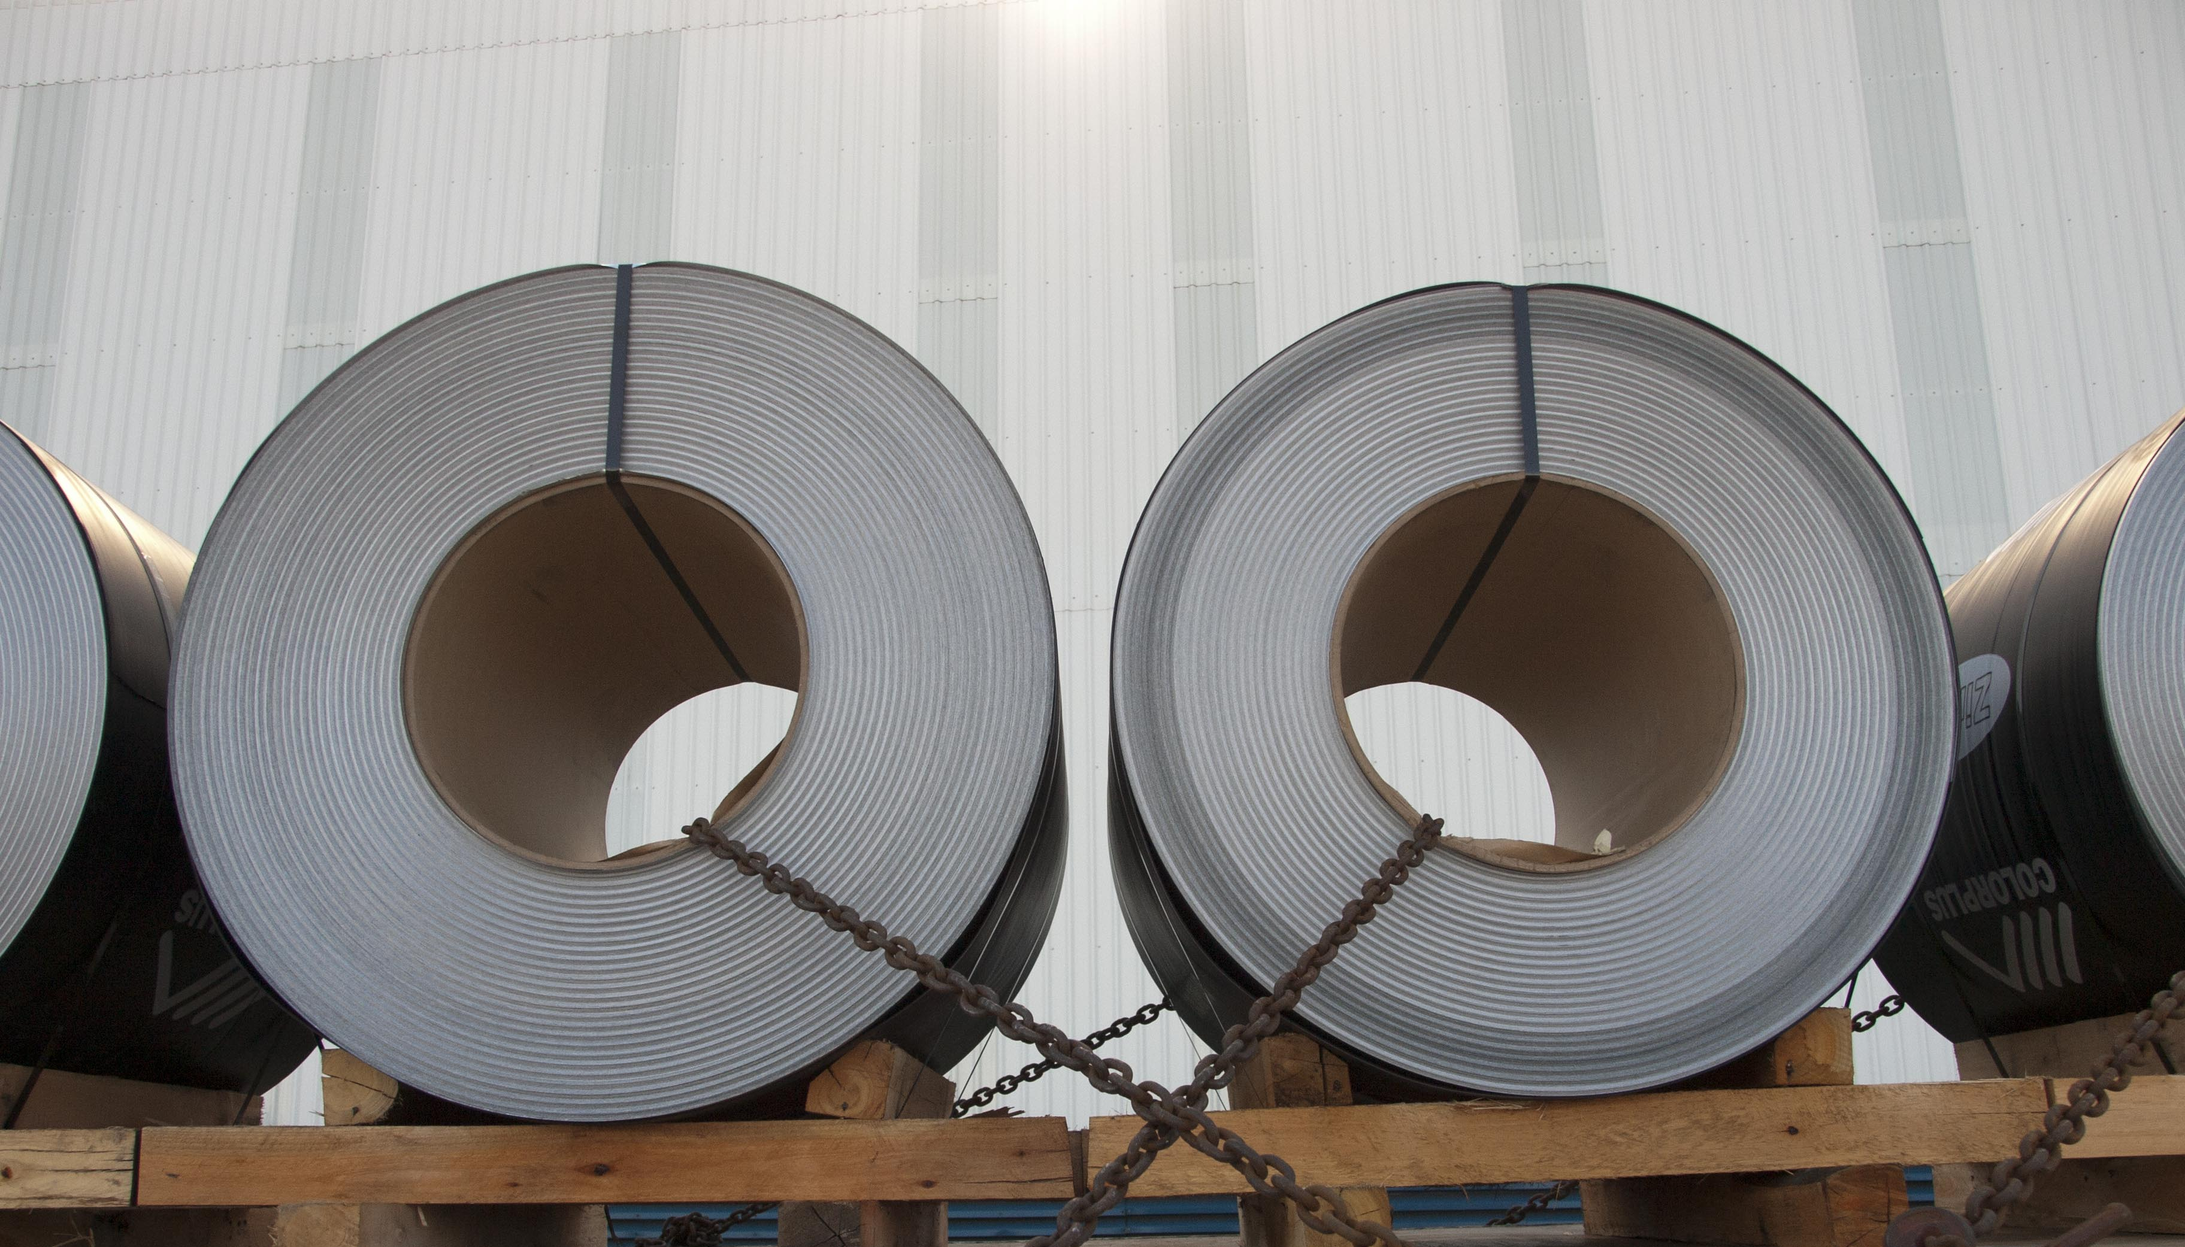
IDC Major Schemes
Gro-e Scheme
R10 billion, ring-fenced, on-balance sheet and available for 5 years or until scheme is exhausted
Encourage employment creation, thereby expanding South African production capacity
Qualifying Criteria:
- Economic merit
- Cost per permanent job created or saved must not exceed R500 000
- BBBEE certification is required
- Only available to businesses operating in or expanding in South Africa.
Funding provided:
- Across all IDC mandated sectors
- Start-ups and expansions, includes funding for buildings, machinery and working capital
- Minimum of R1 million with a maximum of R1 billion per project
- Own contribution will be determined
- First draw must occur within 1 year from approval
- Pricing - interest rate for loan products will be Prime less 3% for 5 years
- Rate of return for equities and sharing in the upside will depend on the development impact of the business

Slide 18
IDC Major Schemes
UIF Scheme
A R2 billion unsecured 5-year listed private placement bond subscribed by the Unemployment Insurance Fund
To contribute towards sustainable job creation and retention by supporting job creating transactions while providing concessionary funding
Qualifying Criteria:
- Economic merit
- Cost per permanent job created or saved must not exceed R450 000
- Only available to businesses operating in or expanding in South Africa.
Funding provided:
- Across all IDC mandated sectors
- Start-ups and expansions, includes funding for buildings, machinery and working capital
- Minimum of R1 million with a maximum of R100 million per project
- Own contribution will be determined
- First draw must occur within 7 months from approval
- Interest rates between 7.0% - 10.0% fixed, based on the risk and developmental impact in the transaction

Slide 19
IDC Major Schemes
Manufacturing Competitiveness Enhancement Programme (MCEP)
New suite of incentives for existing manufacturers to promote competitiveness in the manufacturing arena and ensure job retention in this sector
Consists of:
- Industrial financing loan facilities managed by the IDC; and,
- Production incentive grants administered by the Department of Trade and Industry.
Qualifying Criteria:
- Economic merit
Funding provided:
- South African-registered entities with existing manufacturing operations
- Manufacturing operations engaged in manufacturing, engineering services and conformity assessment services
that support manufacturing
- Working capital facility of up to R50 million, over a term of up to four years, at 4% interest
- Own contribution will be determined
- First draw must occur within 7 months from approval

Slide 20
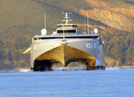





Questions?

Slide 21
Thank you
The Industrial Development Corporation
19 Fredman Drive, Sandown
PO Box 784055, Sandton, 2146
Telephone (011) 269 3000
Facsimile (011) 269 2116
E-mail callcentre@idc.co.za

