Slide 1
Emirates and South Africa
Fouad Caunhye
Regional Manager - Southern Africa
©2014 Emirates. All Rights Reserved.

Slide 2
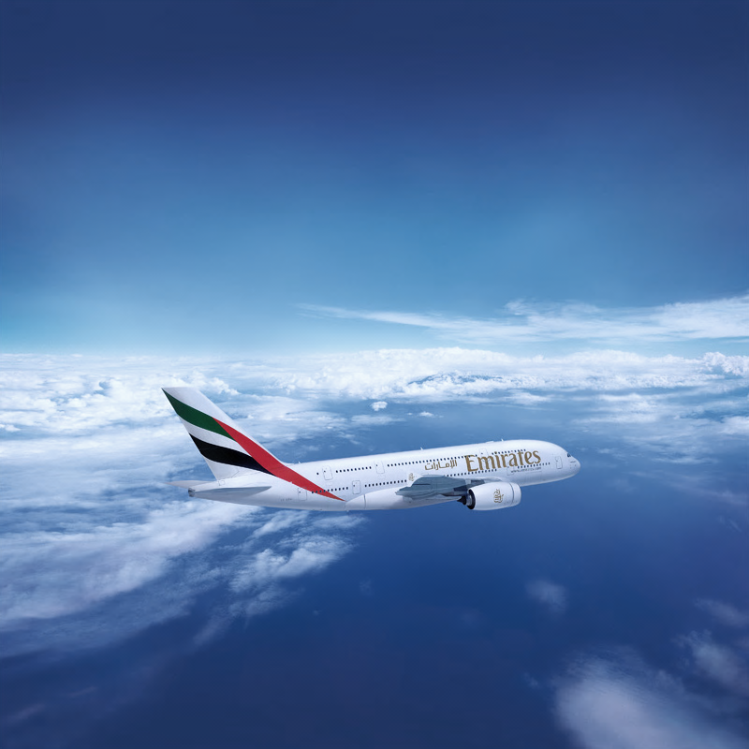
About Emirates
#1 International carrier by RPKs
In 2013/14 Emirates carried 44.5m passengers, up 13.1% with a seat factor of 79.7%
26 years of consecutive profits; US$887m on revenues of US$22.5b in 2013/14
142 destinations in 80 countries
Fleet of 217 wide-body aircraft, average fleet age 74 months
Order book of over 375 Airbus and Boeing aircraft to meet network growth, replace existing fleet

Slide 3
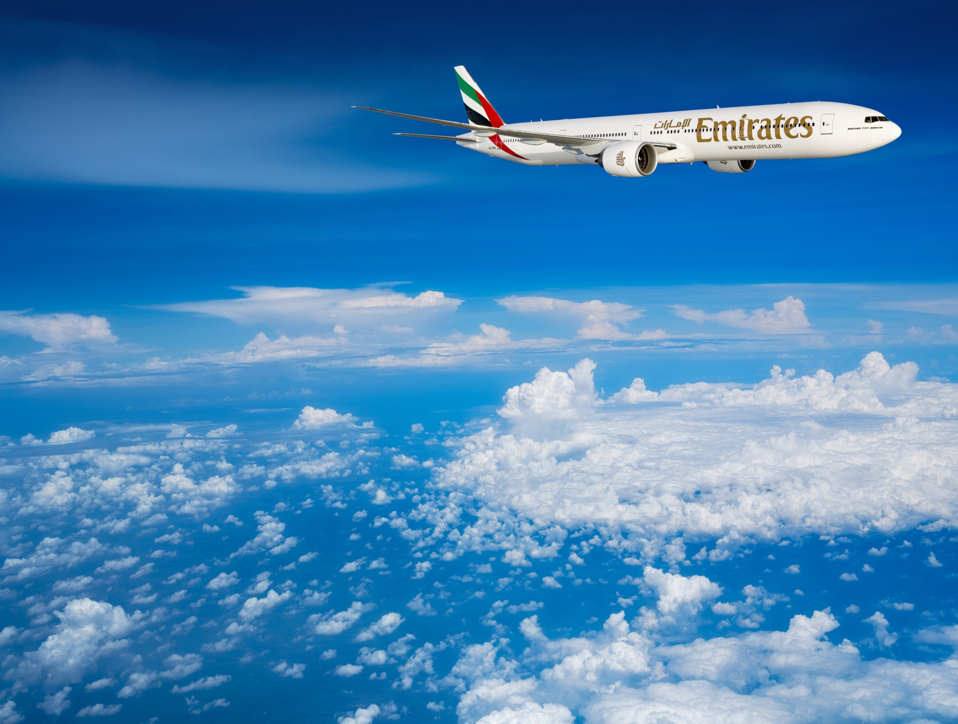
The top line: FY 13/14
              2012/13 2013/14 Change (%)
Revenue US$19.9 billion US$22.5 billion +13%
Net profit US$622 million US$887 million +42.5%
Dividends paid US$272 million US$280 million +2.6%
Operating margin 3.1% 3.9% +0.8 points
Passengers carried 39.4 million 44.5 million +13.1%
Capacity (ASKs) 236.6 billion 271.1 billion +14.4%
Passenger seat factor 79.7% 79.4% -0.3%
Cargo carried (tonnes) 2.09 million 2.25 million +7.9%
Average employee strength 47,678 52,516 +10.1%

Slide 4
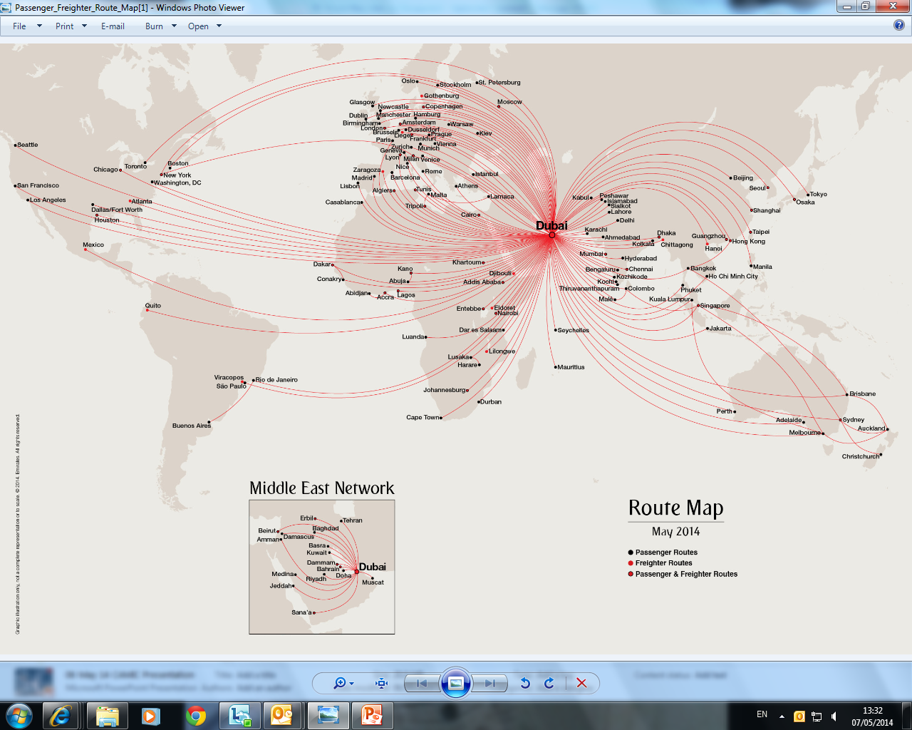
Connecting the unconnected
Accelerated growth – 25 destinations launched since January 2012 to all continents with a focus on world’s new city-pairs, 5 more in 2014
Notes:
Emirates currently serves 141 destinations in 80 countries
New points launched / to be launched in 2014: Kiev, Taipei and Boston……Abuja and Kano in Nigeria come online in August along with Emirates ninth US destination Chicago. Oslo, its third Scandinavian gateway and Brussels will be launched in September.

Slide 5
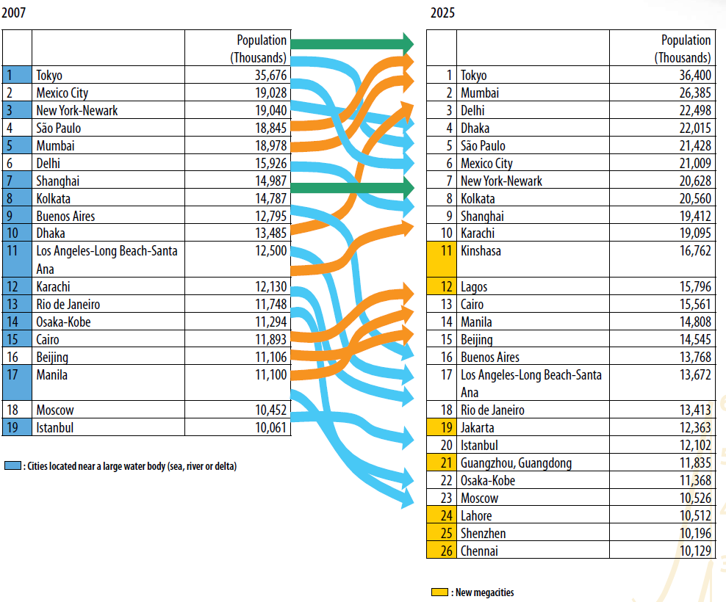
The place to be….the new megacities in 2025 are all located in Asia and Africa
Emirates’ network connects to 23 of the 26 megacities non-stop from Dubai…
Source: United Nations

Slide 6
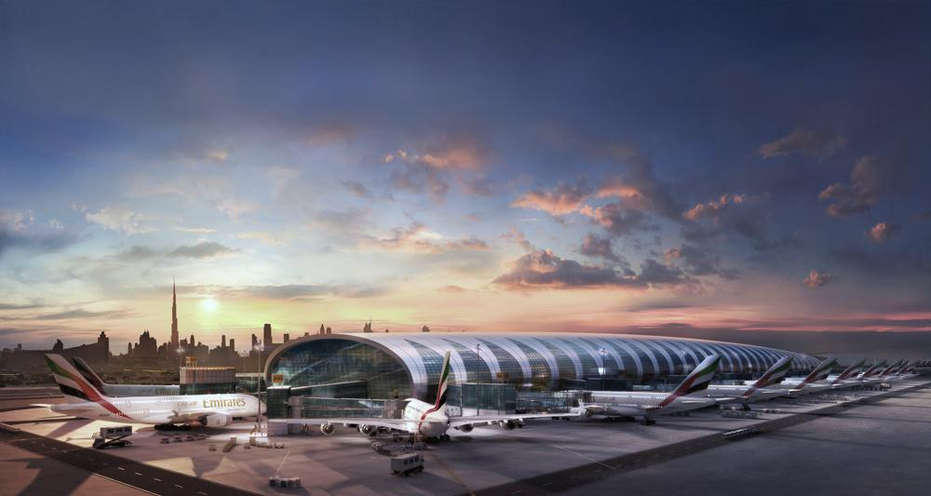
  66.4m international passengers in 2013 – 15.2% growth
  March 2014 – 6.25m international passengers – 7.5% growth
  Built for global connectivity: 220+ destinations, 130 competing carriers
  World’s first purpose-built A380 concourse, now fully open
  In 2013 overtook Hong Kong and Paris-CDG, on-track to be largest international passenger hub this year
  World’s second largest international cargo hub
  DWC – passenger and cargo operations now in accelerated, new services added monthly
The Dubai Hub
Notes:
In 2013 London-LHR was the world’s busiest International hub with 72.3m passengers

Slide 7
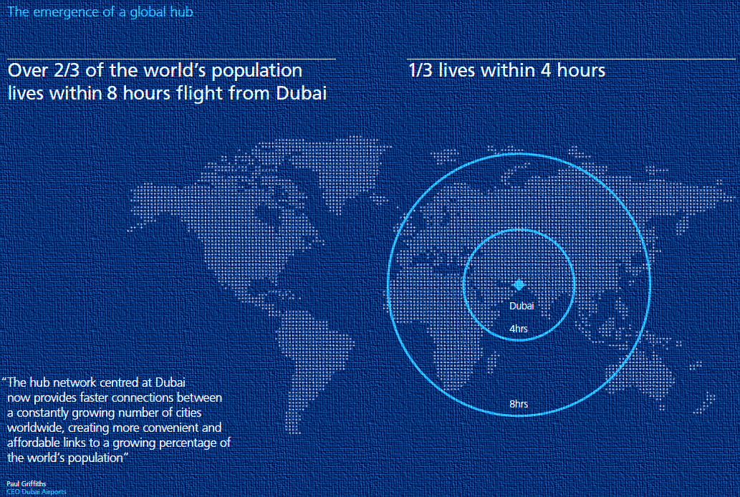
One-stop to anywhere
An uncomplicated view of the world – we move people and freight from A to B:
  2/3 of the world’s population lives within eight hours from Dubai
  1/3 lives within 4 hours
Notes:
Geography has played an important part in development of the Dubai hub
The range of long-haul aircraft continues to push the technology envelope, providing us with a platform to launch non-stop missions to connect to more primary and secondary cities.

Slide 8

South Africa well positioned, but not immune from global challenges
Fuel costs
Infrastructure issues
Currency fluctuations
Patchy global economic recovery and consumer sentiment
Competition issues
‘Green’ taxes
Protectionism + regulatory overreach

Slide 9
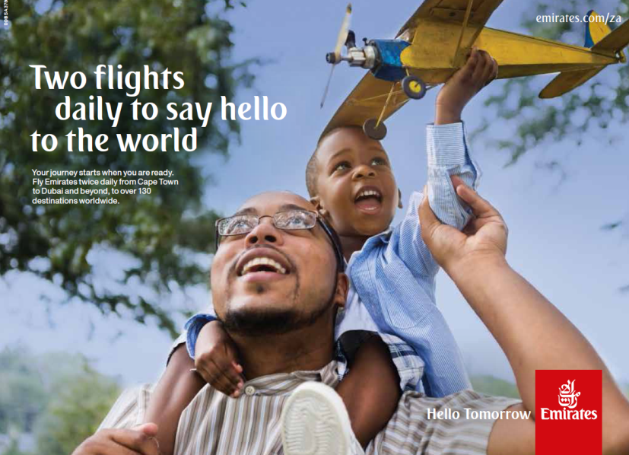
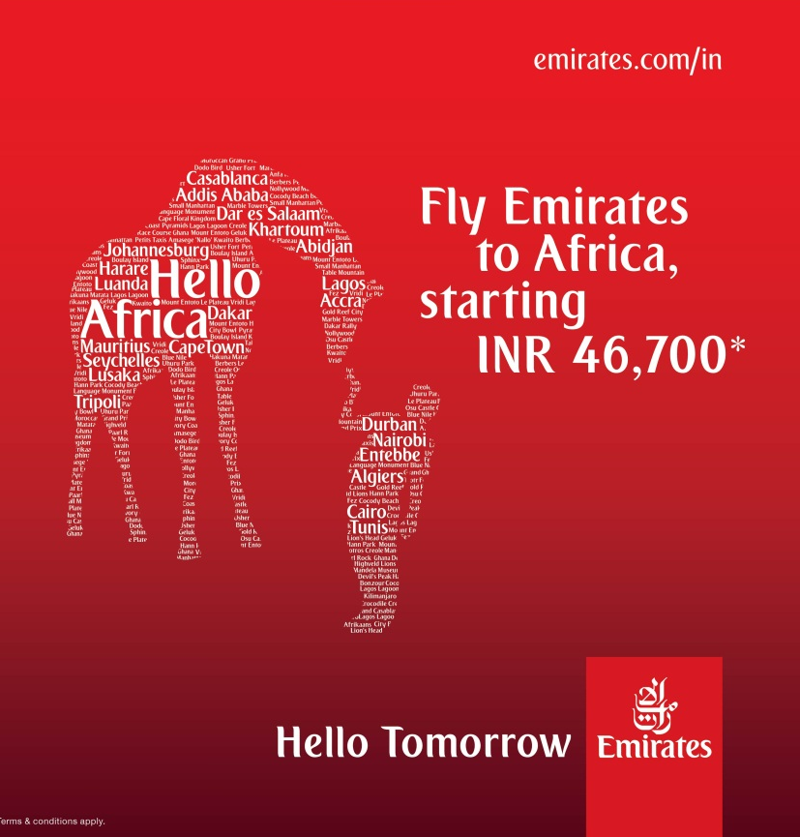
Emirates & South Africa
Emirates has carried over 5.1 million passengers on its South African services over last 5 years
42 flights per week, 3 destinations
2013:
  Passengers: A record 1.27 million, +10%
  Seat Factor: 85%, out-performing EK network average of 79.4%
  Cargo: 57,500 tonnes, marginal contraction in-line with softness in wider-economy
Over 1,000 South African employees globally
Vertically integrated investments:
  50% stake in Wings Inflight Services at Johannesburg and Cape Town Airports
  Evolved in 2013 to dnata Newrest with expanded capabilities and operational reach spanning southern Africa

Slide 10
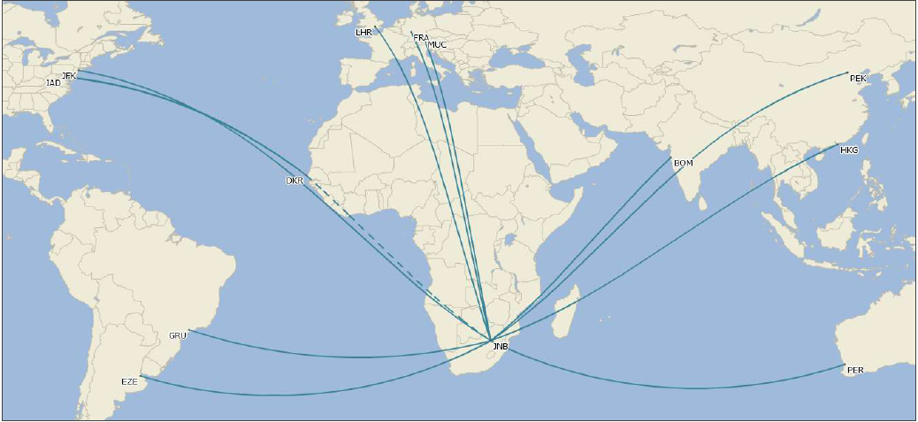
Commercial partnerships matter
SAA strategic global partner
Scope to further evolve and enhance the levels of co-operation
EK network provides SAA connectivity and reach beyond traditional hubs as well as domestic and intra-Africa reach

Slide 11

Inbound is a big part of the equation
Emirates is investing with South African Tourism to grow high-yield inbound
Perfect partnership of connectivity, product and destination
Tactical campaigns that bring together SAT’s dynamic destination marketing with Emirates network reach
New long-term agreement signed in October 2013
Notes:
Short-term capacity reduction in H2 11/12 and H1 12/13 due to A380 wing cracks remediation

Slide 12
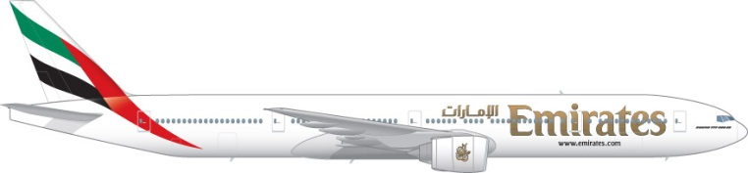
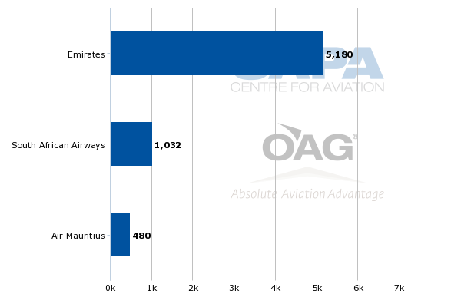
x1 Durban
2013: Up 22% to 233,983 passengers with an average seat factor of 81%
Emirates is the only long-haul carrier in the market, creating new traffic flows to Dubai and Middle East, rich vein of VFR traffic to UK + India
2010 FIFA World Cup provided perfect platform to launch new services, lowered risk in ramp-up
HD 2-class 428 seats

Slide 13
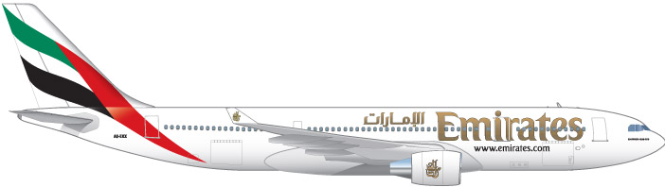
Maximum benefits
Incremental growth on the gauge has maximised passenger and cargo capacity, daily service now fully optimised
Boeing 777 platform, offers enhanced passenger experience and superior route economics
Real value for the Durban is the 90% growth in cargo capacity between A330 and B777 up-gauge

Slide 14
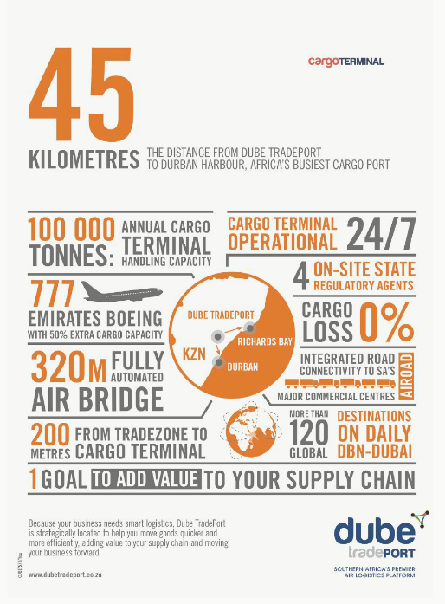
Why Durban?
Similar strategy to Hamburg, Perth and Osaka
Global-facing, export economies, world-class infrastructure
Natural synergies with the Emirates network, Dubai hub would enrich Durban and vice-versa
First mover - leverage the prevailing economic conditions
Exploit the connectivity vacuum and leverage the global network

Slide 15
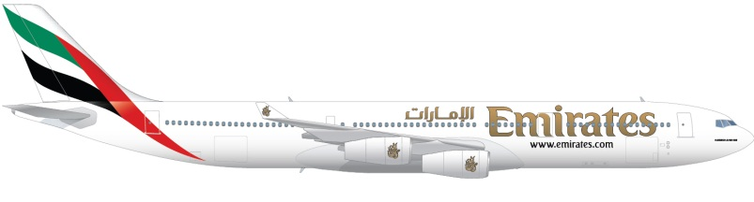
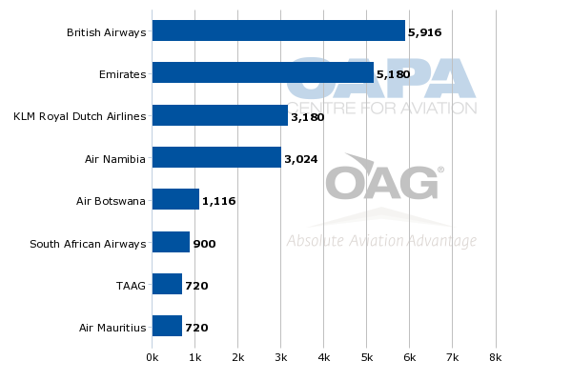
x2 Cape Town
Strength in ‘destination Cape Town’ is returning, highly elastic leisure traffic impacted by consumer sentiment and currency
13% passenger growth and 88% average load factor in 2013
Second daily service, back to year-round, A340s progressively being phased-out of fleet
3-class 262 seats
3-class 354 seats

Slide 16
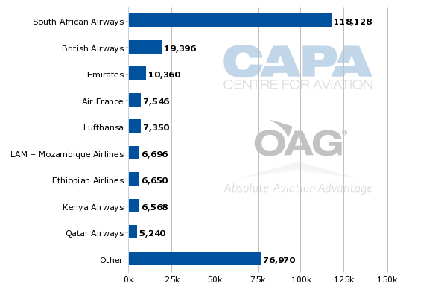
x3 Johannesburg
3rd largest international carrier to JNB, 1,000+ in-bound seats daily
Three daily flights provides maximum connectivity across the schedule for business travellers
Timed for seamless connectivity ex Dubai and with SAA’s domestic network
3-class 354 seats
3-class 354 seats
3-class 360 seats

Slide 17
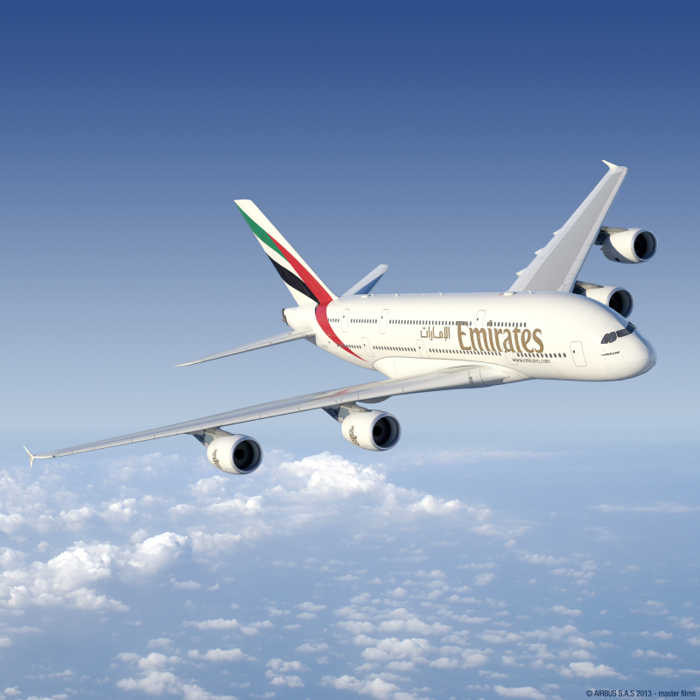
What about the A380?
Incredibly popular with South African travellers, highly visible driver in bookings beyond Dubai
Challenge: capacity vs connectivity, Boeing 777 platform gives greater flexibility across the three services
Strength of the premium market is returning which brings A380 back in to frame

Slide 18
Strong demand over the long-run
Emirates not immune, 2010 and 11 services were hit by depressed South African and European economies
Big dividends from staying the course and right-sizing capacity
Leveraging the global sales network was a key factor in the rebound

Slide 19
Growth across the region
South Africa well above trend, Cape Town and Durban performing like a new markets with strong growth
High growth rates Lagos and Luanda directly correlates to greater liberalisation and wider economic activity

Slide 20
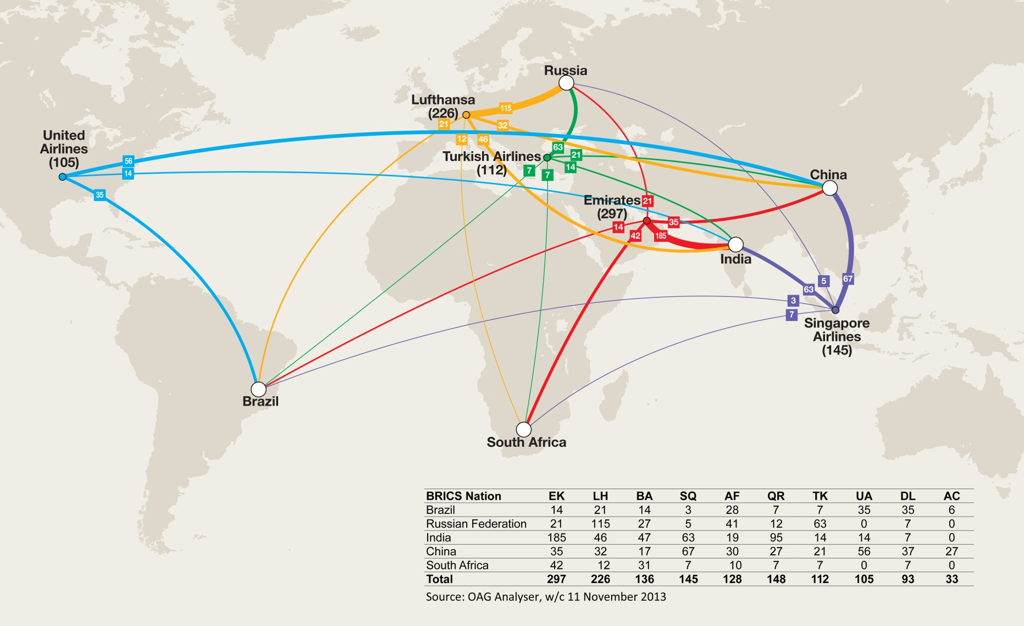
#tapping growth
BRICS connectivity

Slide 21
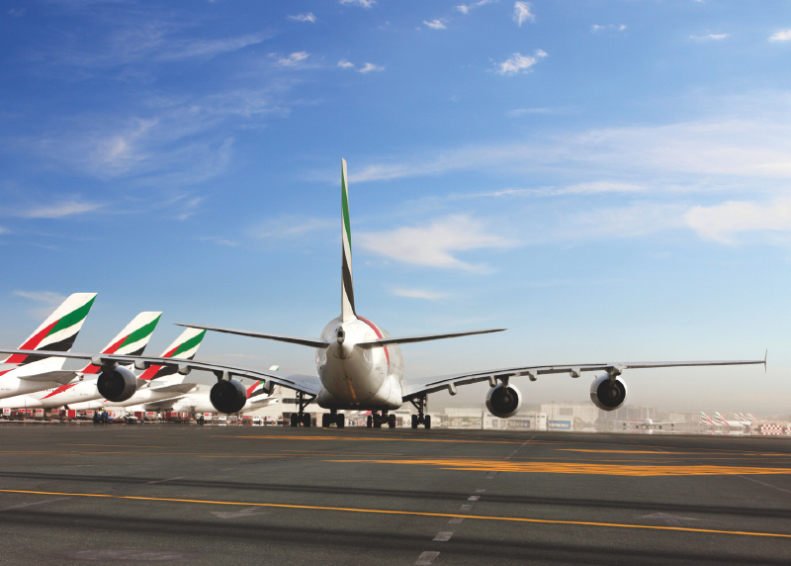
Thank you….

