Slide 1
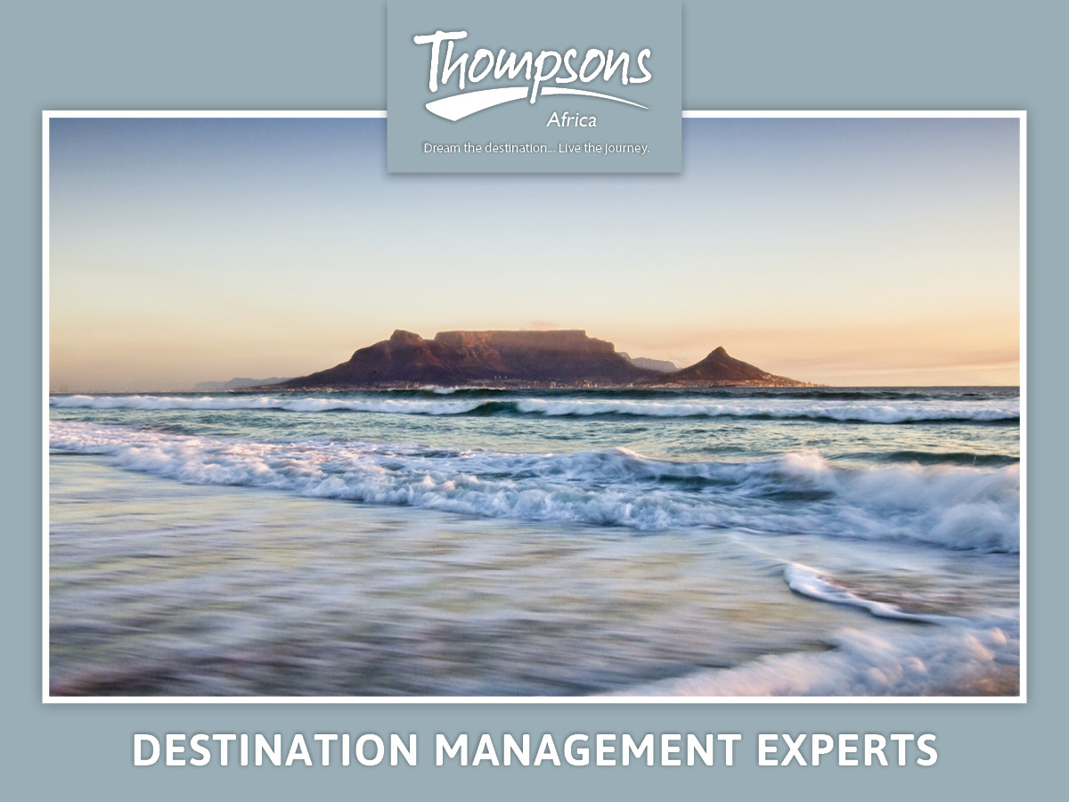

Slide 2

AFRICAN RENAISSANCE CONFERENCE
22 – 23 MAY 2014
CONNECTIVITY ON THE AFRICAN CONTINENT THROUGH TOURISM
TOUR OPERATORS: Marketing Agents For A Destination
By Craig Drysdale

Slide 3
BRINGING THE WORLD TO AFRICA
North Asia
North Asia
North
America
Europe
Central
Asia
East
Asia
Southwest
Asia
South
Asia
Africa
Southeast Asia
South
America
Oceania

Slide 4
DISCUSSION & METHODOLOGY
Identify Support Infrastructure
Determine Distribution Channels
Marketing & Sales Activations
Benefits to the continent

Slide 5
Identify Support Infrastructure
Air Connectivity – Key to seizing Africa’s tourism potential
Visa Facilitation and Embassy Support
Tourism Infrastructure Hotels, Car Rentals, Coach Operators, Emergency Services, Road & Air Connectivity etc.
Product

Slide 6
Determine Distribution Channels
Local DMC
Thompsons Africa
Overseas Wholesaler
Tour Operator
Retailer (Travel Agent)
Local Travel Agent
Guest
Consumer
INBOUND
OUTBOUND
DIRECT
TOURIST

Slide 7
Business to Business (B2B) & Business to Consumers (B2C)
Local DMC
Thompsons Africa
Overseas Wholesaler
Tour Operator
Retailer (Travel Agent)
Local Travel Agent
Guest
Consumer
B2B
B2B
B2C

Slide 8
Local DMC
Thompsons Africa
Overseas Wholesaler
Tour Operator
Retailer (Travel Agent)
Local Travel Agent
Guest
Consumer
Wholesaler’s Travel Agent
Travel Agent’s – Travel Agent

Slide 9
Marketing & Sales Activations
People:
Experienced and Innovative Sales Team
Exhibiting Destination & Products at International Trade Shows i.e. WTM’s; ITB; EIBTM; INDABA and Road Shows
International Sales Calls

Slide 10
Marketing & Sales Activations
Support:
Work Closely with International Embassies and Tourism Representation bodies. Form JMA’s
Work with local Tourism bodies and CVB’s
Engage with International, Regional and Domestic Airlines

Slide 11
Marketing & Sales Activations
Destination:
Market the Destination(s) and your Products through several mediums supporting the distribution channel:
Above The Line: Mass Media Campaigns – TV, Radio and Internet
Below The Line: Brochures, Pamphlets
Work with local Tourism bodies and CVB’s
Engage with International, Regional and Domestic Airlines

Slide 12
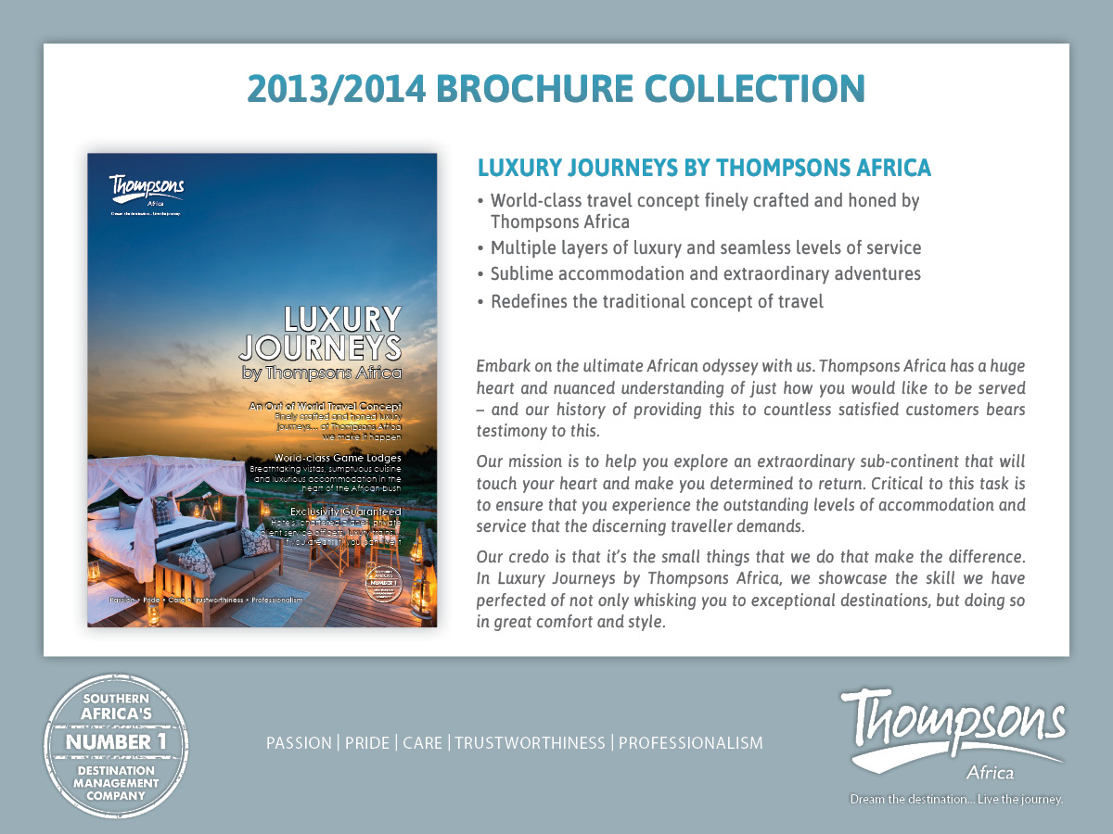

Slide 13
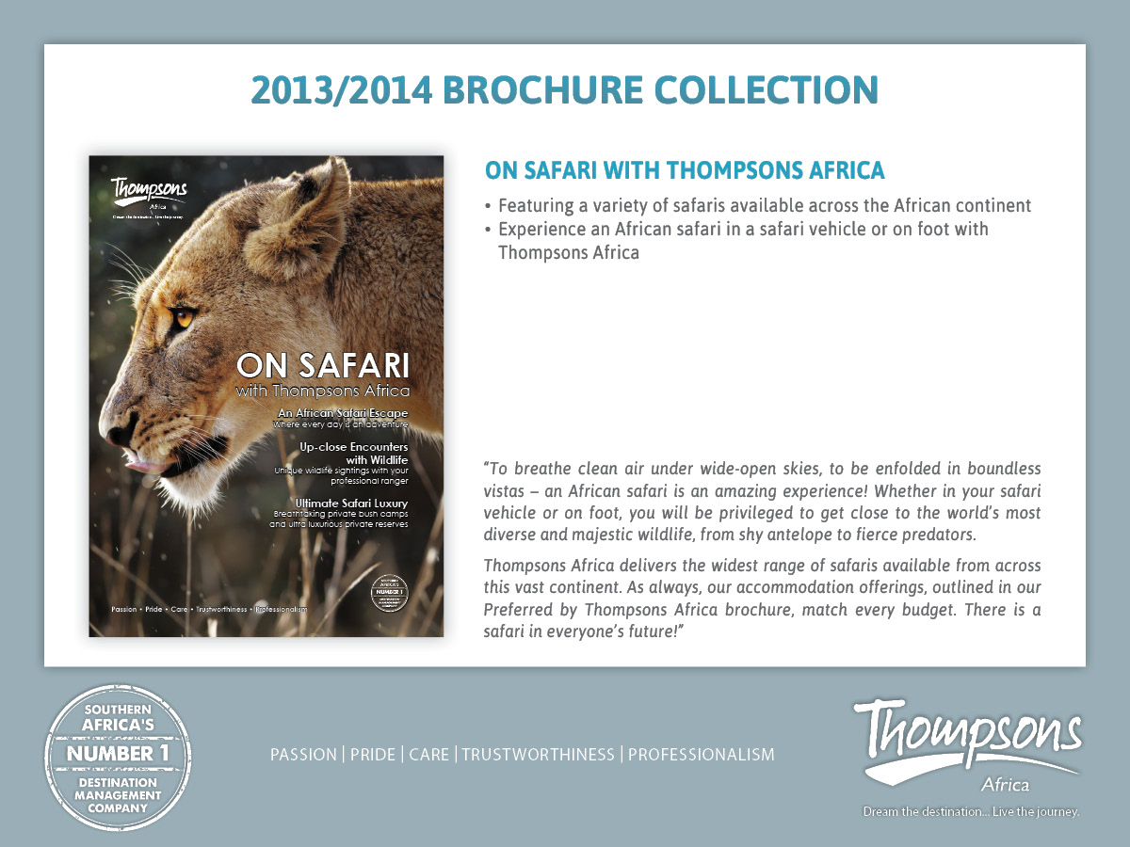

Slide 14
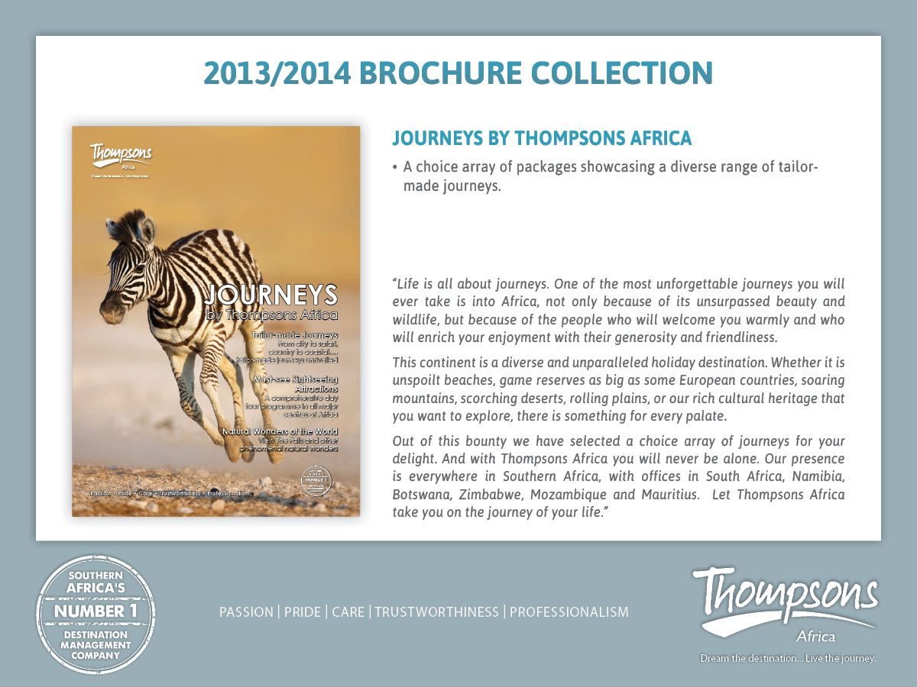

Slide 15
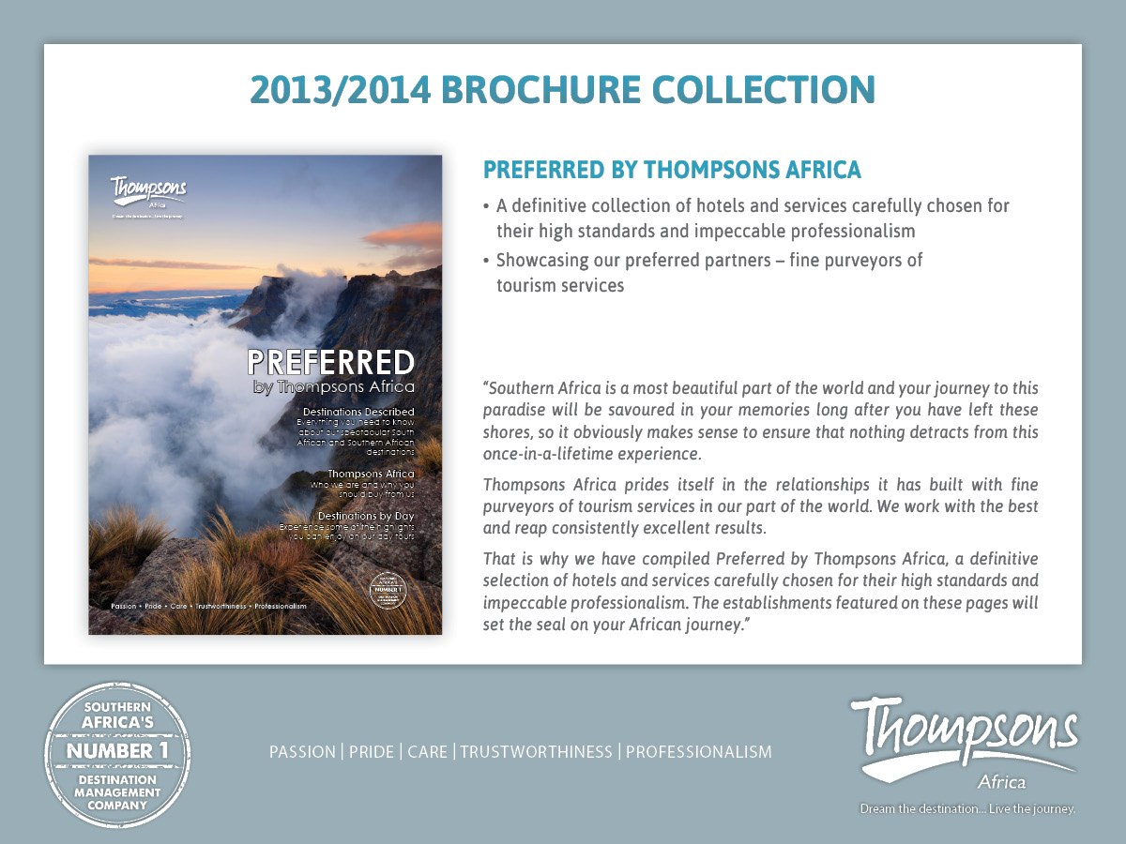

Slide 16
Marketing & Sales Activations
Training:
Invite Wholesalers / Travel Agents on Familiarisation trips – inspecting destination and products
Assist Wholesaler / Travel Agents with on-line product training i.e. constant Webinar’s and face to face seminars in their offices

Slide 17
Benefits to the Continent
Foreign Revenue
Employment (Cross-Sectorial Activity)
Growing infrastructure
Economic Incentive for Preservation of the Environment

Slide 18
“ If you ever have an opportunity in your lifetime to visit two continents – ensure you visit AFRICA twice! “
Thank You

