Slide 1
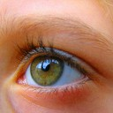

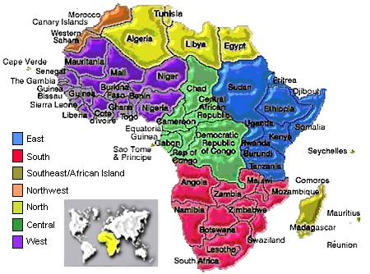

Africa In The Eyes Of The Tourism World
Cuthbert Ncube

Slide 2


Head line economic growth

Slide 3

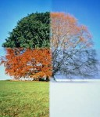
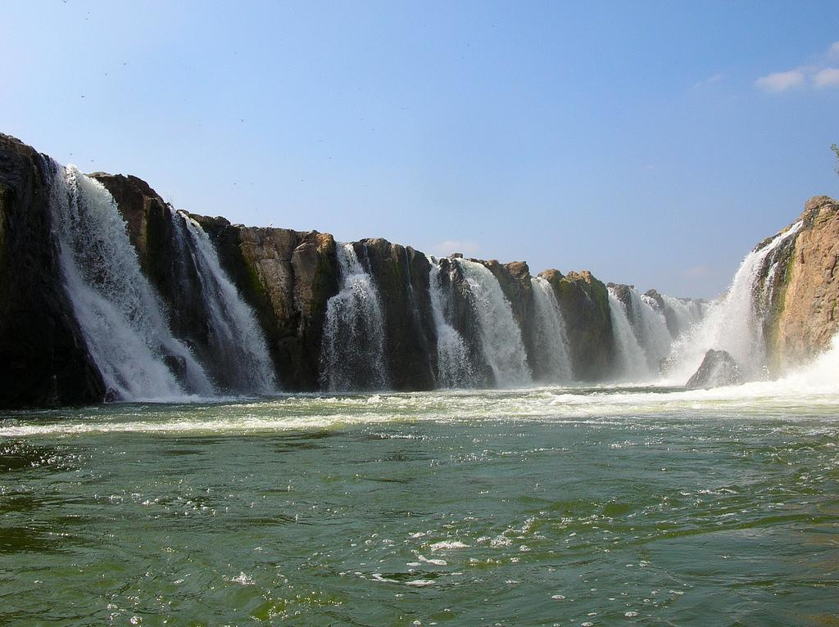
Time, Season, Place

Slide 4


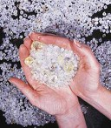
Natural resources

Slide 5
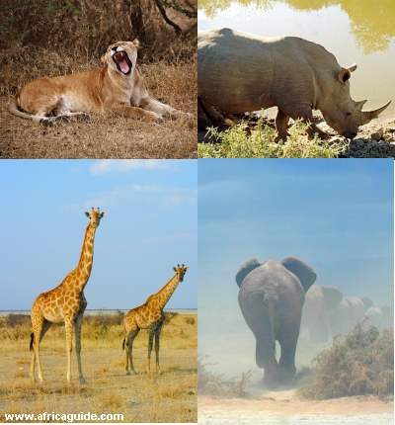
Game parks that offer days of camp outs in the African wilderness

Slide 6



Okavango Delta, Masai Plains, Jungles of Hwange Game Reserve, Kruger Park

Slide 7




Fully open to foreign tourists yet suspicious of our domestic clients

Slide 8

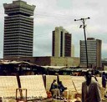
Developing Tourism Industry

Slide 9






A brotherhood of African states is the best legacy that we can live in and leave behind.

Slide 10






Working hard to breaking new frontiers

Slide 11



Let every wall that separates state from state people from people be brought down.

Slide 12
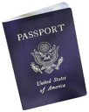
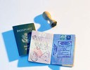

Kenya, Rwanda and Uganda have introduced a single visa.

Slide 13





Inter-Continental tourism is a must and not an option anymore

Slide 14
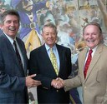




Economic tourism, educational tourism therefore doors of tourist sites cannot afford to be seasonal

Slide 15





Positive media coverage on African strides

Slide 16

AFRICA lets stand together as ONE!!

Slide 17
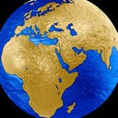



Hello AFRICA tell how you’re doing?!!

Slide 18



AFRICA UNITE!!

