Slide 1
A Case for Positioning
Marine Tourism and Leisure
Strategy in South Africa
Sindiswa Nhlumayo

Slide 2

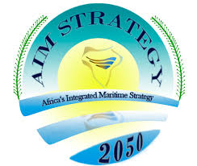
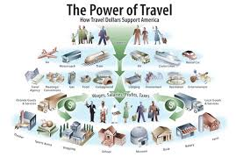

…tourism economy
Notes:
Strategy aimed at Strategy is to foster increased wealth creation from Africa’s oceans and seas by developing a sustainable thriving blue economy in a secure and environmentally sustainable manner”

Slide 3
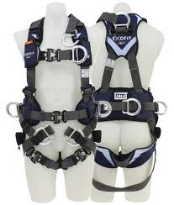
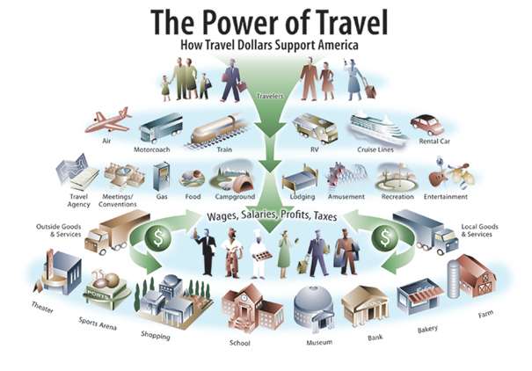

…. to harness

Slide 4
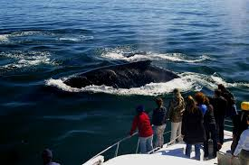
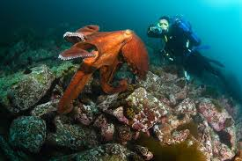
…maritime resources

Slide 5
Continental Level
Notes:
Strategy aimed at Strategy is to foster increased wealth creation from Africa’s oceans and seas by developing a sustainable thriving blue economy in a secure and environmentally sustainable manner”

Slide 6

Country Level
Notes:
Spells the long term development plan for South Africa, which is commended as development is long term and should not be defined in terms of political terms

Slide 7
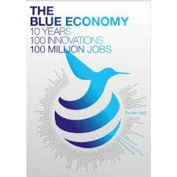
Cabinet Adopted

Slide 8
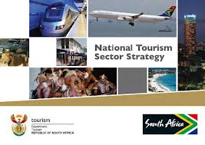
South Africa
Notes:
Long term vision for South African Tourism

Slide 9
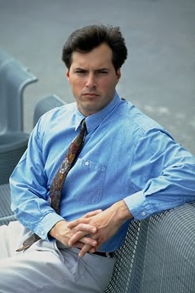

current reality …
Silence
on
Maritime
Issues

Slide 10
current reality …
Opportunities
Not fully
Exploited

Slide 11
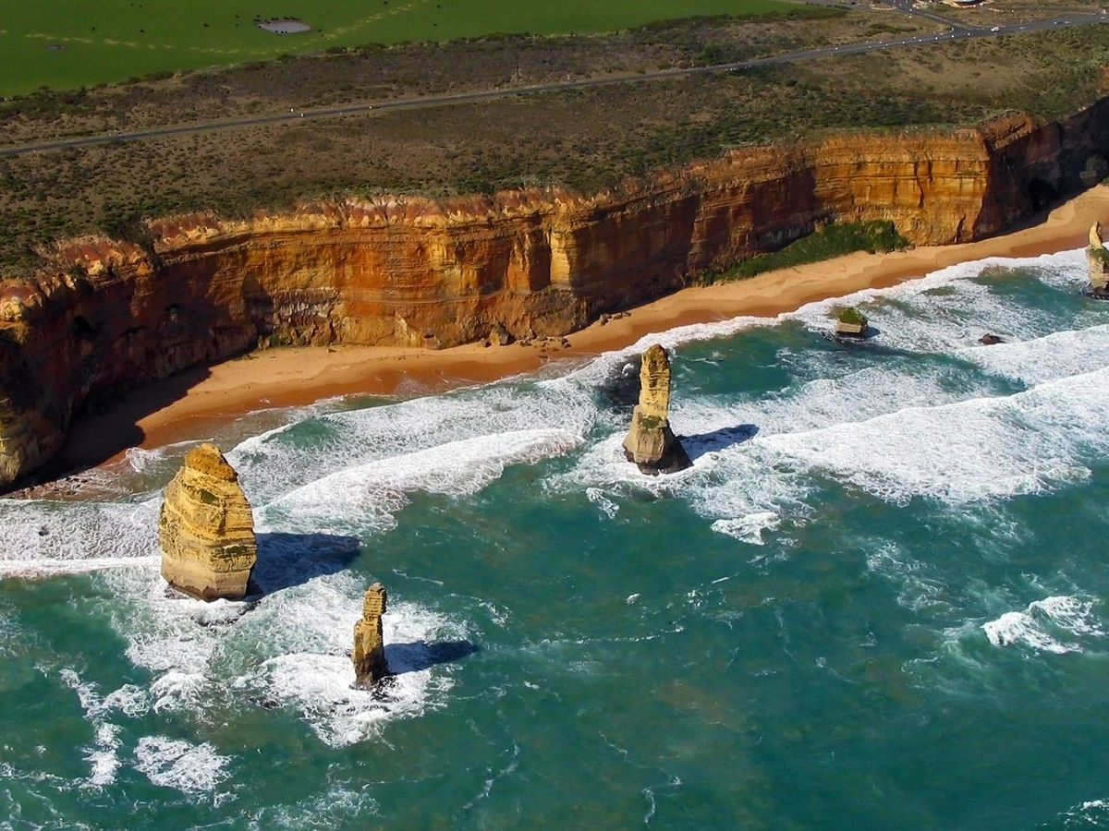
……. including our marine resources

Slide 12
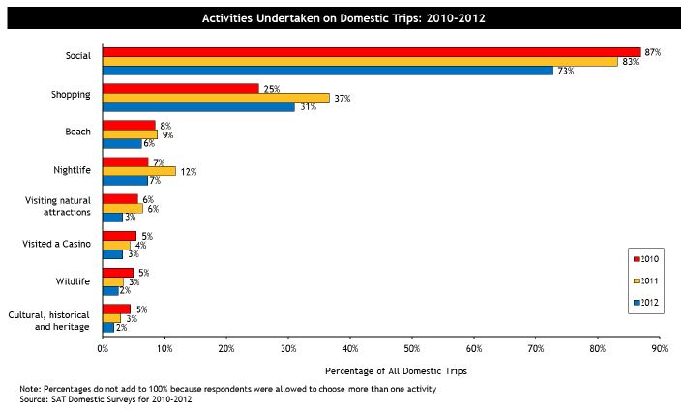
Domestic and International visitors activities
The beach was visited on 1.5 million domestic trips in 2012
The beach was visited on 2.7 million international visitors
natural attractions were visited on 760 000 domestic trips in 2012

Slide 13

Europe
2.3 million people employed
51 % bed capacity concentrated in areas with sea borders

Slide 14

USA
12/15 top tourism attractions are water based

Slide 15
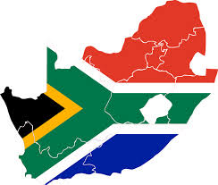
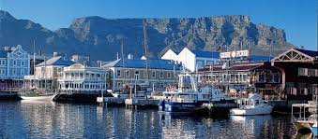
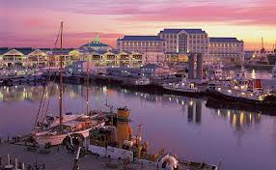
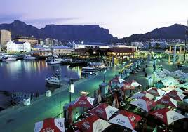
No 1 Tourist Attraction

Slide 16
The Maritime Sector
Extractive Economic Opportunities
Mining
Offshore oil and gas
Fishing
Aquaculture
Non-Extractive Economic Opportunities
Marine tourism & leisure
Marine manufacturing
Transportation

Slide 17
Defining Marine tourism and leisure
Water-based tourism relates to any touristic activity undertaken in or in relation to water resources, such as lakes, dams, canals, creeks, streams, rivers, waterways, marine coastal zones, seas, oceans and ice-associated areas
Marine tourism & leisure
Water-based
Tourism
Leisure/ recreation
Touristic activity refers to any activity, that is, any pursuit, sport, hobby, endeavour, pastime, game, exercise or experience undertaken when a person is “outside his or her usual environment for a specified period of time and whose main purpose of travel is other than exercise of an activity remunerated from the place visited”.
Recreation is any action that refreshes the mental attitude of an individual.
Recreation embraces a wide variety of activities which are undertaken out of choice during leisure or play

Slide 18
Definition of Marine…… includes inland waterways
Marine Tourism
Coastal tourism
Ocean-based tourism
Hinterland
Transite zone
Recreational zone
Inland or Fresh Water Tourism
Waterways
Lakes
Dams
Canals
Creeks
Streams
Rivers

Slide 19
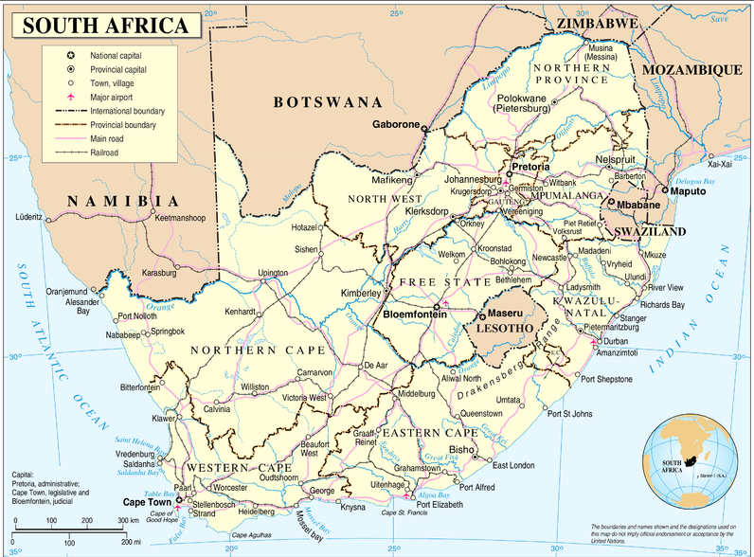
Dullstroom
Vaal
Orange
Elephant Coast
Sterkfontein
West Coast I
Dolphin Coast & Zululand
Gariep
Pondoland & South Coast
West Coast II
Wild Coast
The Mother City
Sunshine Coast
False Bay & Overberg
Overberg & Garden Route
Garden Route

Slide 20
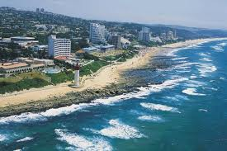
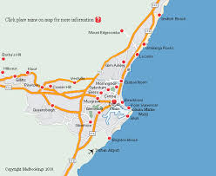
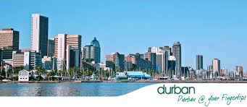
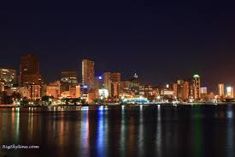
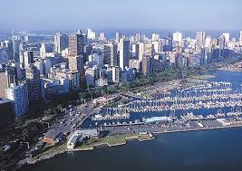
Just over 3000 Km Coastline

Slide 21
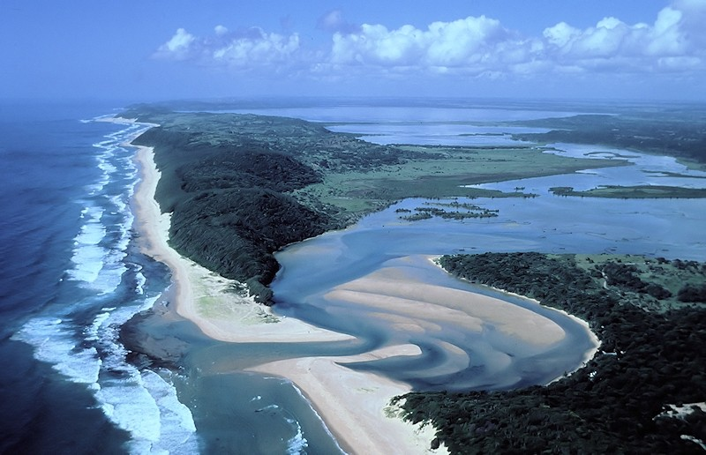
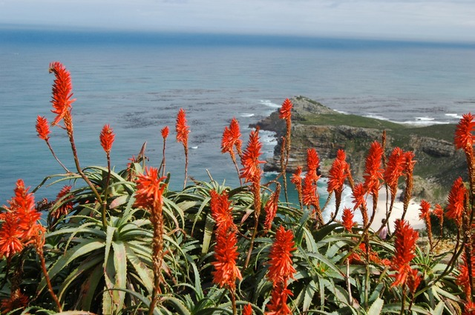
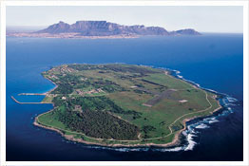
4 UNESCO Marine World Heritage Sites
SA has eight UNESCO World Heritage Sites, of which four are marine related.
  iSimangaliso Wetlands Park
  Cape Flora Region
  Robben Island
  Vredefort Dome

Slide 22

36 Blue Flag Beaches
  The Blue Flag is a voluntary eco-label awarded to beaches and marinas as an indication of their high environmental and quality standards.
The Blue Flag criteria include:
  standards for water quality,
  safety,
  environmental education and information,
  the provision of services and
  general environmental management criteria.
  The Blue Flag programme offers many benefits:
  improved tourism facilities,
  enhanced management of coastal ecosystems,
  increased awareness of the coast and
  capacity building of coastal municipalities.
South Africa has 36 Blue Flag beaches and 4 Marinas

Slide 23
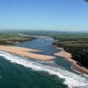
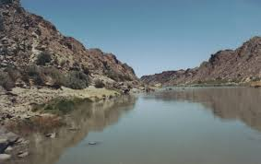
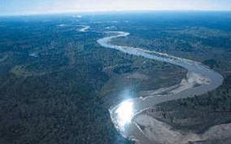
80 Major Rivers
80 major
rivers

Slide 24
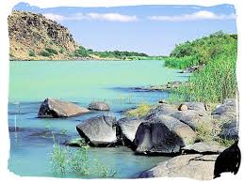
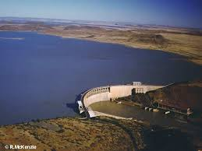
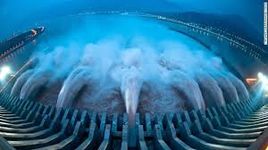
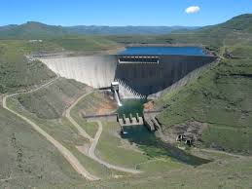
500 Dams

Slide 25
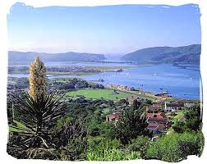
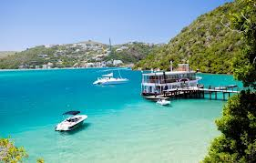
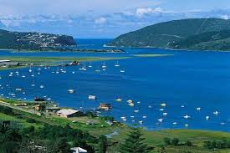
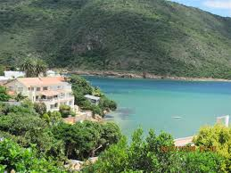
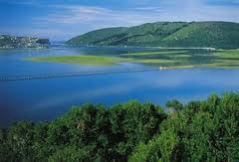
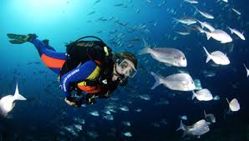
Over 60 Lakes and Lagoons

Slide 26
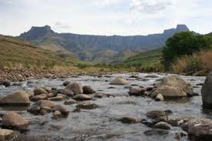
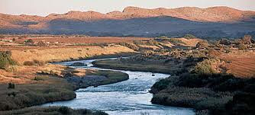
Over 100 Streams

Slide 27
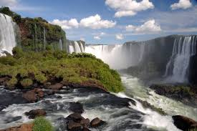
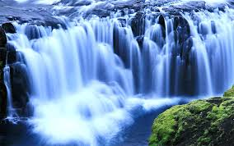
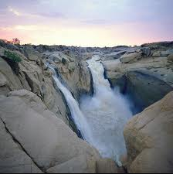
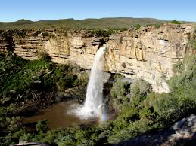
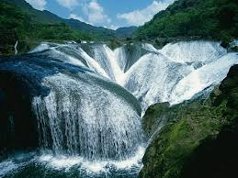
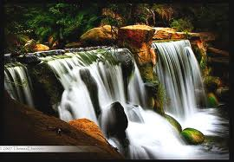
Over 20 Waterfalls

Slide 28
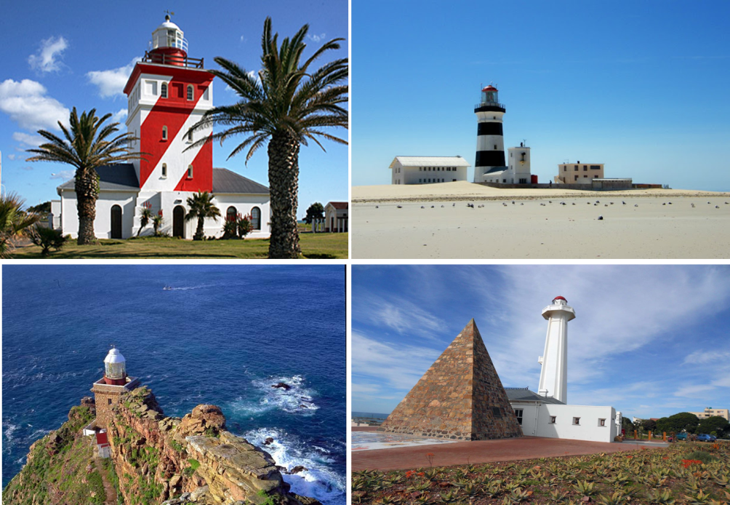
49 Lighthouses
49 lighthouses spread across the South African coastline
Each with stories to tell
  Shipwrecks
  Ghosts
  Compass Needles
  45 operational
  4 decommissioned

Slide 29

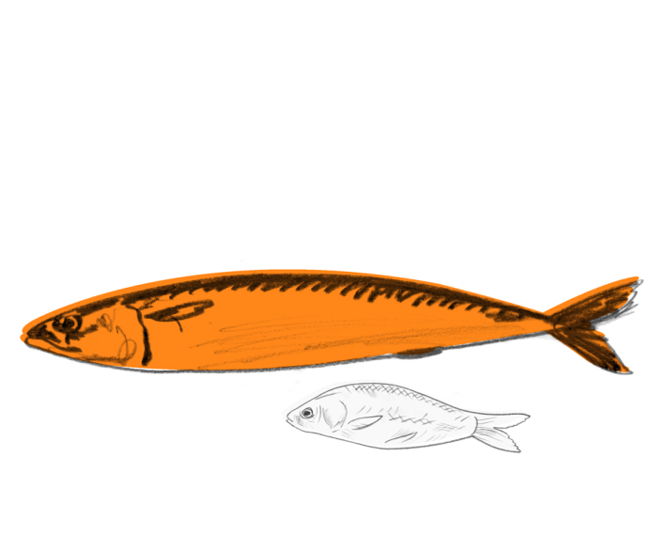
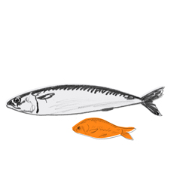
Sport & Recreational Fishing

Slide 30
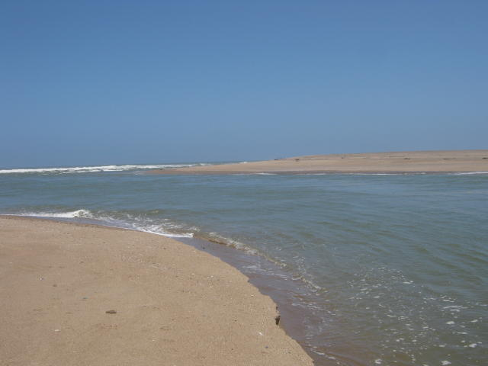
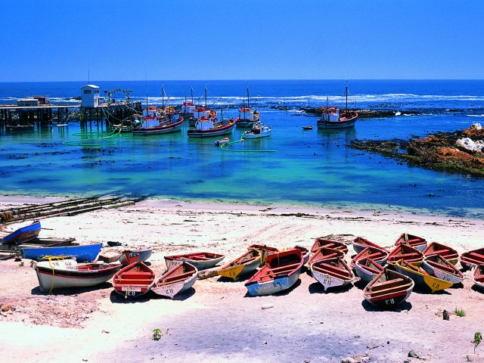








Slide 31








Slide 32









Slide 33

Cruise Tourism
Notes:
Potential to create 100 000 additional jobs by 2025…….not by default but proper interventions

Slide 34

Beach resorts

Slide 35





Examples of South African Beach Resorts

Slide 36





Examples of International Beach Resorts

Slide 37

Why planning is important

Slide 38





Slide 39





Slide 40
if we are serious …
… we have to change
#1
Notes:
If you keep what you have been doing….you keep getting what you have.

Slide 41


Slide 42
Marine Tourism Strategy
Tourism resources
Core Tourism Experience (s)
Tourism markets
Tourism Development Concept
(Destination Comparative Advantage)
Mission
Vision
Objectives
Tourism Product
Development Plan
Infrastructure Plan
Marketing
& Promotion Plan
HR & Service Excellence
Institutional Development
Projects &
Programmes
Implementation &
Monitoring Plan
Notes:
Chapter of the National Tourism Strategy

Slide 43


Slide 44

Singapore today

Slide 45
Marine tourism and leisure
is the
new currency
… to make it
‘bankable’
we need everyone’s
support
‘
’

Slide 46
I am an Marine Tourist
“I will sail through the African coastal and inland waters to see her musicians, poets, to see her dancers and her clothes and the varied ancient water games she plays. I would strive to hear how African sailors laugh, and the funny stories they tell and the richness of experiences; about the taste and the variety of food they eat and acquire the handcrafts Africans produce with their hands, with reeds and beads and bits of wood and animal skin, gaze at the elephant and other natural inhabitants”

Slide 47

Thank You

