Slide 1
SA Budget Overview
Dr. Clive Coetzee
General Manager: Infrastructure Management and Economic Services
KZN Provincial Treasury

Slide 2
Budget in Context of the SA Economy

Slide 3
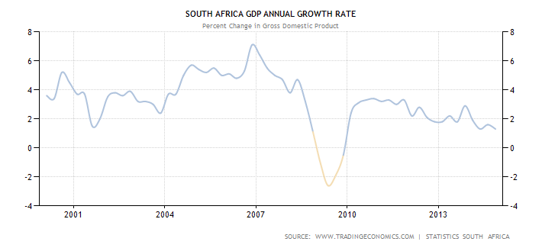
Budget in Context of the SA Economy – GDP (% pa)

Slide 4
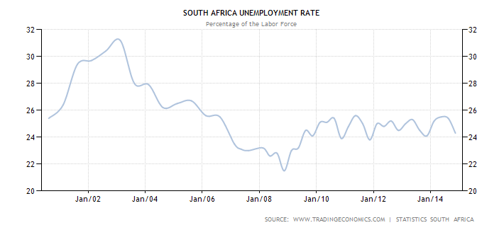
Budget in Context of the SA Economy – Unemployment (% pa)

Slide 5
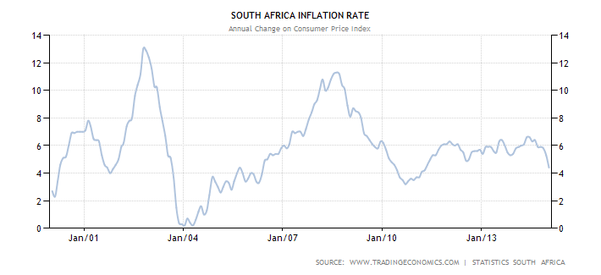
Budget in Context of the SA Economy – Inflation (% pa)

Slide 6
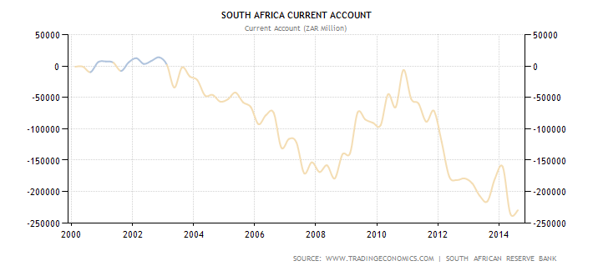
Budget in Context of the SA Economy – Current Account Deficit (R’m)

Slide 7
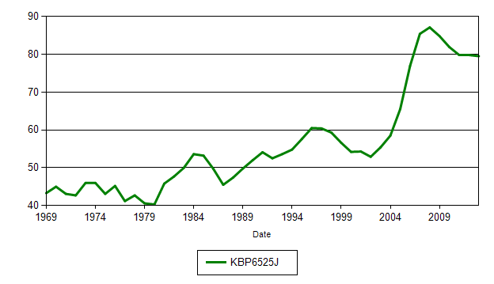
Budget in Context of the SA Economy – Household Debt (R’m)

Slide 8
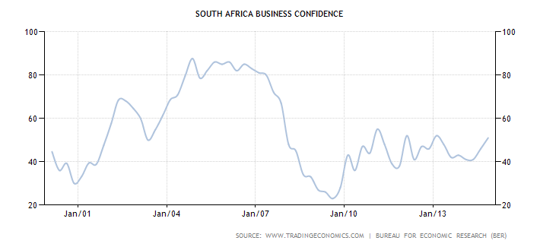
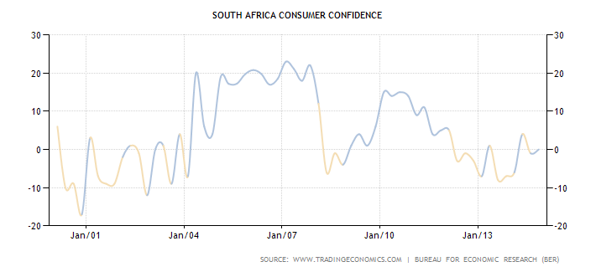
Budget in Context of the SA Economy – Confidence deficit

Slide 9
Budget History and Dynamics

Slide 10
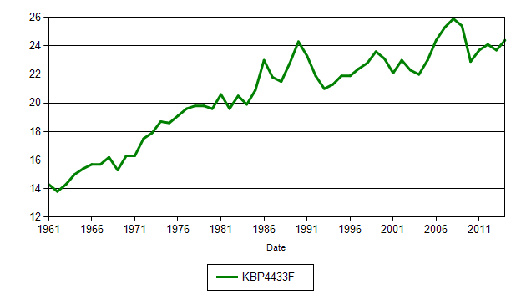
% National government revenue as percentage of GDP

Slide 11
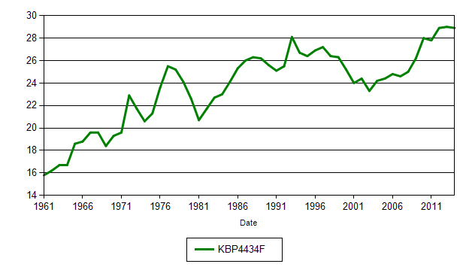
% National government expenditure as percentage of GDP

Slide 12
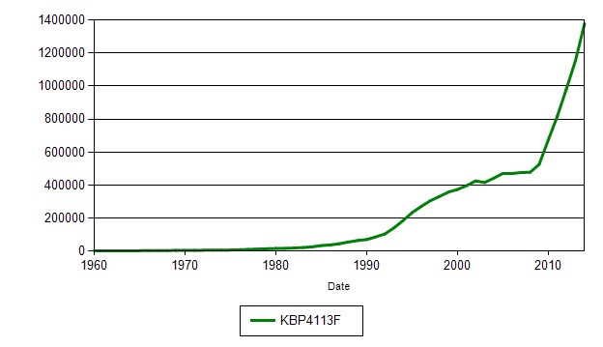
R millions Total loan debt of national government

Slide 13
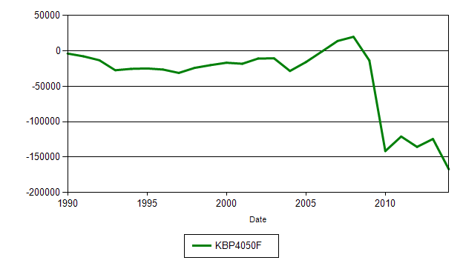
R millions National government deficit/surplus adjusted for cash-flows

Slide 14
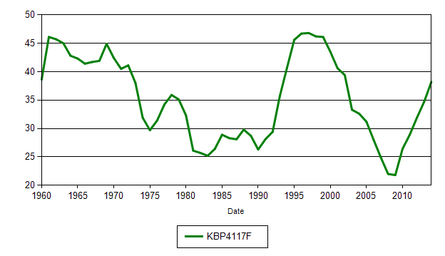
% Total net loan debt as percentage of GDP

Slide 15
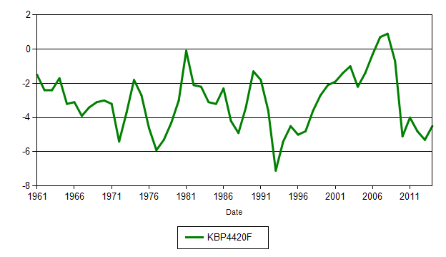
% National government deficit / surplus as % of GDP

Slide 16
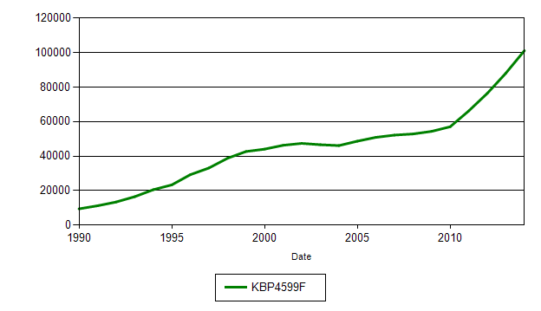
R millions National government expenditure: Interest

Slide 17
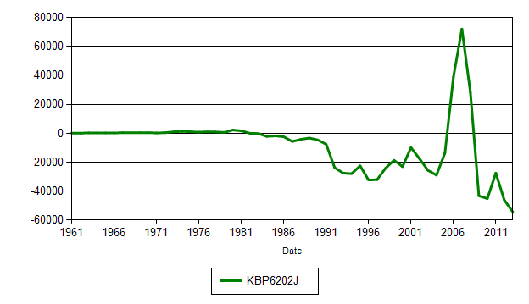
R millions Net saving by general government

Slide 18
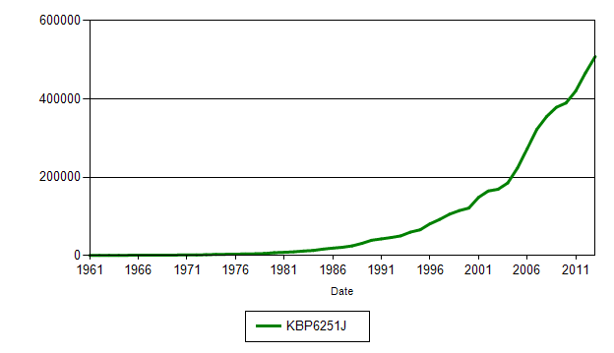
R millions General Government: Current taxes on income and wealth

Slide 19
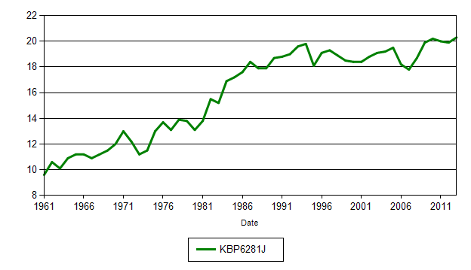
% Ratio of final consumption expenditure by General government to GDP

Slide 20
% General Government Services to GDP

Slide 21
% SA GDP with and without Government Services

Slide 22
Budget in Context of Current External Factors

Slide 23
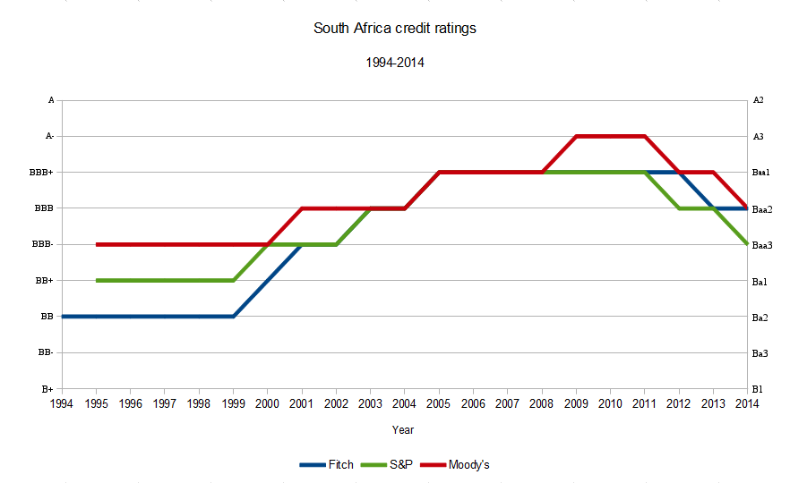
Budget in Context of External Factors

Slide 24
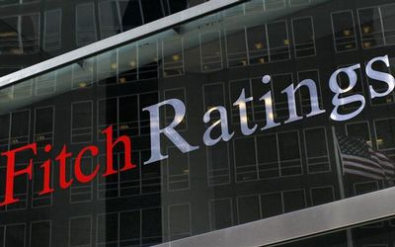
Budget in Context of External Factors

Slide 25
Budget in Context of External Factors

Slide 26
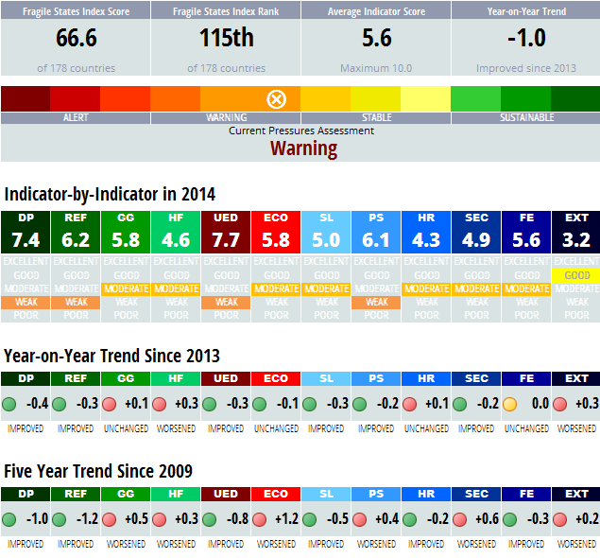
Budget in Context of External Factors

Slide 27
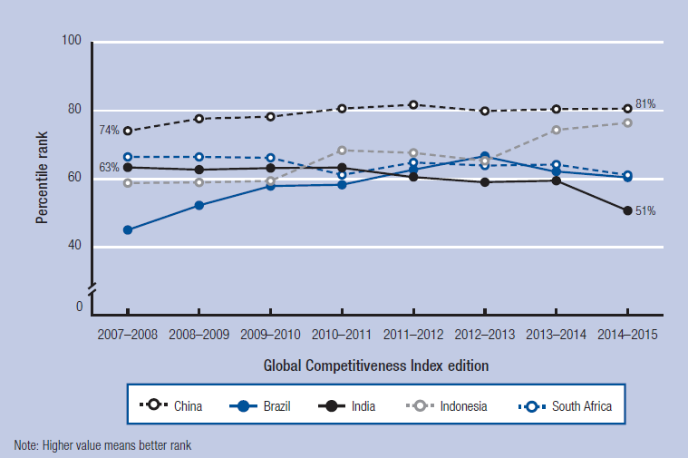
Budget in Context of External Factors

Slide 28
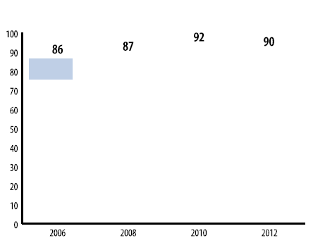

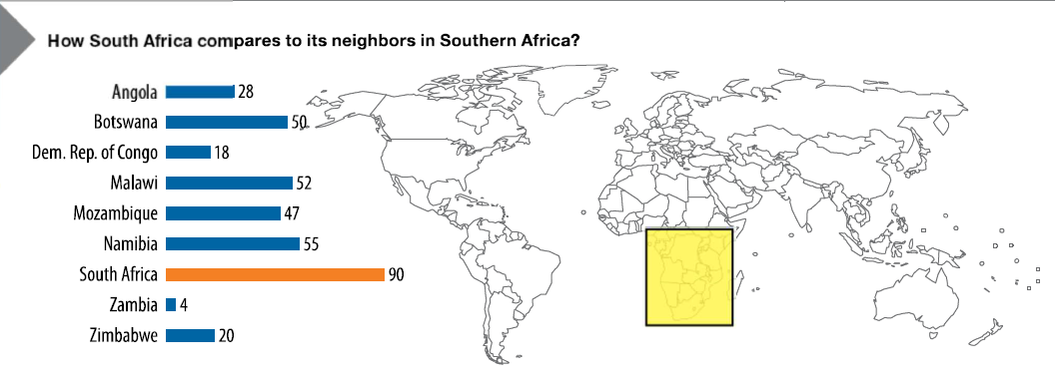
Budget in Context of External Factors

Slide 29
The 2015/16 Budget

Slide 39
The main tax proposals include:
Increasing marginal personal income tax rates by one percentage point for all taxpayers earning more than R181 900, and adjusting tax brackets and rebates to account for fiscal drag
Raising the general fuel levy by 30.5 c/litre and the Road Accident Fund (RAF) levy on fuel by 50 c/litre (a total increase of 80.5 c/litre)
Taking further steps to combat base erosion and profit shifting
Providing for a more generous turnover tax regime for small businesses
Increasing excise duties on alcohol and tobacco products
Reviewing the diesel refund scheme
Strengthening the energy-efficiency savings incentive
Raising the electricity levy
Changing transfer duty rates and brackets.

Slide 40
Baseline expenditure reductions of R25 billion over two years:
Reductions to current spending by national departments of R2.3 billion in 2015/16 and R3.9 billion in 2016/17, to be achieved mainly through decreases in budgets for non-core goods and services.
Reductions to capital spending of national departments by R280 million (2015/16) and R911 million (2016/17), mainly on non-critical items of machinery and equipment.
Reductions in allocations to public entities of R2.4 billion (2015/16) and R2.6 billion (2016/17).
Reductions in transfers to provinces of R4.4 billion (2015/16) and
R6.6 billion (2016/17).
Reductions in conditional allocations to local government of R921 million in 2015/16 and R1.4 billion in 2016/17.

Slide 41
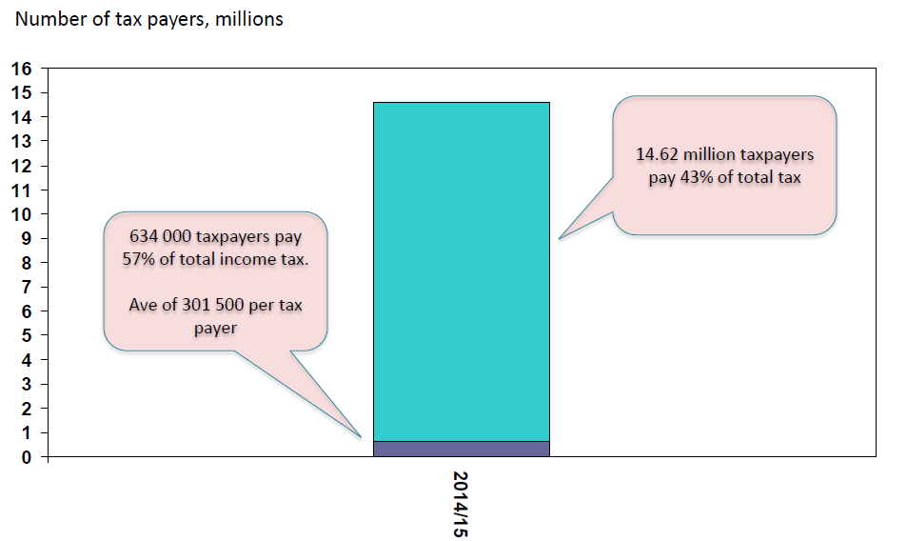

Slide 42
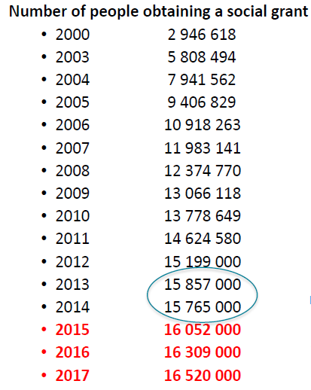
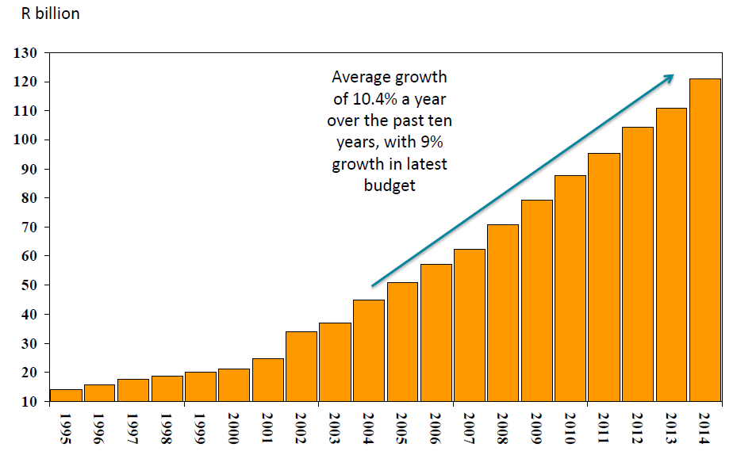

Slide 43
Tax revenue (% of GDP)

