Slide 1

PIETERMARITZBURG “BIKE CITY”
Clive Coetzee
KZN Provincial Treasury

Slide 2
According to a report for the Executive Committee of Msunduzi Municipality on the proposal for Pietermaritzburg (PMB) to Bid to be the Bike City of Africa, PMB Tourism received a call in 2007 from the Treble Group in Cape Town (an International Events Company) regarding the sourcing of a city in South Africa to become the “Bike City of Africa”.

Slide 3
The concept on the table at that stage was to position PMB as the “bike city” of Africa hosting at least three of the eight International Cycling Union (UCI) disciplines, i.e. road, mountain biking and BMX.

Slide 4
Pietermaritzburg is ideal because it has a long and proud history of staging major sporting events – PMB is the home to the Comrades Marathon, the Dusi Canoe Marathon and the Midmar Mile, and in more recent years; the Amashova Classic and the Postnet & Edendale Marathons. PMB also hosts major other events namely the Royal Show; the Garden & Leisure Show; Art in the Park and Cars in the Park.

Slide 5
Pietermaritzburg fundamentally is endowed with the natural assets and/or resources to host “outdoor” events and to excel in eco tourism
PMB is also centrally positioned within the province. It is the ideal stepping-off point to other major provincial attractions – mountains, beach or battlefields

Slide 6
Why focus on events???
To attract large numbers of visitors to the City (increased expenditure)
To brand Pietermaritzburg as the “City of Choice for World Class Events”
To gain national & international media exposure from the events
To encourage our youth to engage in healthy pursuits and to create interest

Slide 7
Why focus on events???
The feel-good factor is the biggest argument for hosting national and international sporting events. But it should be very obvious that once-off events are actually counterproductive because of the limited feel-good factor and that it’s actually the continuous infrastructure and tourism expenditure that creates lasting economic benefits.

Slide 8
2008-2010

Slide 9
Bike City in Practice
International Events
Cycling Discipline: | Road | Mountain Biking | BMX
 | Intakatech Worlds View Challenge | UCI MTB World Cup | UCI BMX World Cup Supercross
 | Feb-08 | Apr-09 | Aug-09
 |  | 3 Disciplines: X-Country; D/Hill & 4X | 1 Discipline: Supercross
Investment by Msunduzi | R 250,000 | R 300,000 | R 350,000
No of Visitors: International | 117 Top International Riders + 87 crew | 340 Competitors + 386 Crew + 94 Press | 70 Competitors + 34 Crew
Ticket Sales to Event | Free to 263 Rec Riders + 1’500 Spectators | 17’000 | 2’000
Economic Benefit: | Rands | Rands | Rands
Visitor Spend | R 5,982,400 | R 12,427,000 | R 825,000
Direct Spend by Event Organisers | R 2,038,978 | R 1,957,130 | R 1,703,111
Total Spend in the Economy | R 8,021,378 | R 14,384,130 | R 2,528,111
No of TV Viewers: Local & International | Highlights packages nationally & internationally | 2,134 Billion Viewers in 100 Countries + | 12.486 Million
No of TV Hours: Local & International | Approx R20 million | 939 Hrs,40 Mins, 31 Secs | 27 Hrs, 13 Mins

Slide 10
Bike City in Practice
National Events
Cycling Discipline: | Road | Mountain Biking | BMX
 | N/A | SA Nationals | SA Nationals
 |  | Apr-09 | Sep-09
Investment by Msunduzi |  | R 100,000 | R 50,000
No of Competitors |  | 300 | 250
No of Visitors |  | 2’200 | 2’000
Visitor Spend |  | R 7,020,000 | R 4,095,000
TV Media Packages |  | M-Net SuperSport 26 Min H/L pkg x 6 | M-Net SuperSport 26 Min H/L pkg x 6

Slide 11
Bike City in Practice
International Event
Cycling Discipline: | BMX
 | UCI BMX World Championships
 | Aug-10
Investment by Provincial Government | R 2,000,000
No of Visitors: International | 1073 Top International Riders + 1822 crew and family
Ticket Sales to Event | 14,000 Spectators
Economic Benefit: | Rands
Visitor Spend | R 25,771,200
Direct Spend by Event Organisers | R 3,163,287
Total Spend in the Economy | R 28,934,487
TV Media Packages | M-Net SuperSport 3 hours, 52 Min H/L pkg x 2 (9 x flightings each)
TV Media Packages | Host of International Sport Channels (4 x hrs live coverage + 52 mnt highlights)

Slide 12
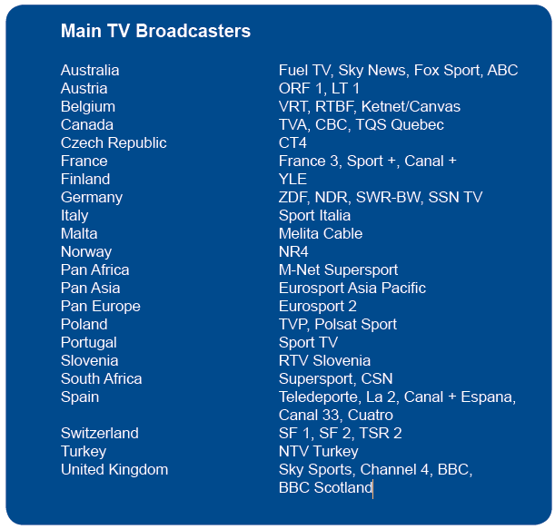
Bike City in Practice
More than 100 print, new media and photo journalists from over 25 nations covered the UCI BMX World Championships. The host broadcaster was MNET SuperSport and they delivered highlights programmes to a wide range of countries including all of Africa and the Indian Ocean Islands.
This was over and above the two 26 minute packages produced by the UCI for their own distribution and also over and above the live television coverage on MNET Supersport and Eurosport. The event was also carried live on Freecaster.tv.

Slide 13
Bike City in Practice
Summary Statistics
Total number of Competitors, Family and Crew | 4 836
Total Number of Spectators | 38 700
Total Direct Spend | R 64 983 106
Total Direct Spend PA | R 21 661 035
Total Direct Spend per Person | R 1 493
Total Cost to Government | R 3 050 000
Total Cost to Government PA | R 1 016 667

Slide 14
Pietermaritzburg has developed a competitive advantage and niche market in cycling and motocross events which in the main are family orientated events bringing young and old together.

Slide 15
The Financial Plan
Financial Year | Event | Amount Requested | Date/Month of Event Staging
2011/12 | CSA BMX National Series Event | R 50,000 | 18 September
 | UCI BMX Supercross World Cup | R 1,500,000 | 6-8 April
 | CSA MTB National Series Event | R 50,000 | 16,17 April
 | UCI MTB World Cup | R 1,670,000 | 22-24 April
 | Msunduzi Road Challenge | R 2,000,000 | 29,30 October
 | Total | R 5,270,000
 | Other Funding
 | UCI | R 1,750,000
 | Toyota | R 750,000
 | Other Sponsors | R 1,200,000
 | Entry Fees | R 250,000
 | CSA | Shortfall
 | Municipality | Land/Site
 | Total | R 3,950,000
 | Grand Total | R 9,220,000

Slide 16
The Financial Plan
Financial Year | Event | Amount Requested | Date/Month of Event Staging
2012/13 | CSA BMX National Series Event | R 50,000 | June
 | UCI BMX Supercross World Cup | R 1,600,000 | April
 | CSA MTB National Series Event | R 100,000 | April
 | UCI MTB World Cup | R 1,660,000 | April
 | UCI Masters Road World Championships | R 3,500,000 | Aug/Sept
 | Total | R 6,910,000
 | Other Funding
 | UCI | R 2,500,000
 | Toyota | R 750,000
 | Other Sponsors | R 2,500,000
 | Entry Fees | R 1,000,000
 | CSA | Shortfall
 | Municipality | Land/Site
 | Total | R 6,750,000
 | Grand Total | R 13,660,000

Slide 17
The Financial Plan
Financial Year | Event | Amount Requested | Date/Month of Event Staging
2013/14 | CSA BMX National Championships Event | R 200,000 | June
 | UCI BMX Supercross World Cup | R 2,500,000 | April
 | UCI MTB Masters World Championships | R 500,000 | August
 | UCI MTB World Championships | R 5,500,000 | Aug/Sept
 | Total | R 8,700,000
 | Other Funding
 | UCI | R 2,500,000
 | Toyota | R 850,000
 | Other Sponsors | R 3,500,000
 | Entry Fees | R 1,000,000
 | CSA | Shortfall
 | Municipality | Land/Site
 | Total | R 7,850,000
 | Grand Total | R 16,550,000

Slide 18
2011

Slide 19

UCI BMX Supercross World Cup

Slide 20
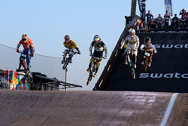
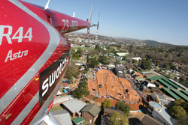
UCI BMX Supercross World Cup

Slide 21
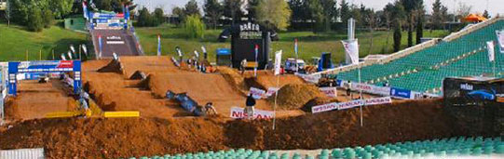
UCI BMX Supercross World Cup
Total length of the track:
minimum of 300 metres, maximum of 350 metres with an average lap time of 30-40 seconds.
Area of track:
minimum 90 x 60 meters
Width of the track:
minimum of 5 meters
Height of the scaffolding starting ramp:
minimum of 8 meters

Slide 22
UCI BMX Supercross World Cup
Date | 7-9 April 2011
Venue | Alexandra Park
Participants | 120
Out of Towners | 113
Support Teams | 212
Event Spectators | 1700

Slide 23
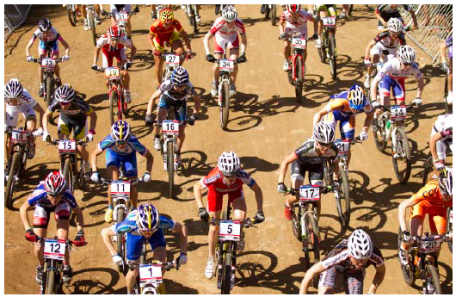
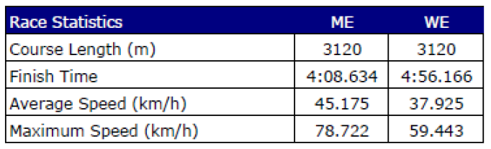
2011 UCI MTB World Cup

Slide 24
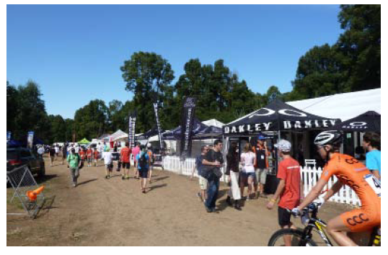
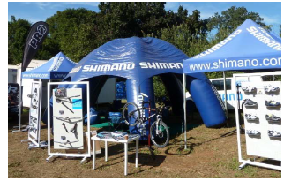
2011 UCI MTB World Cup

Slide 25
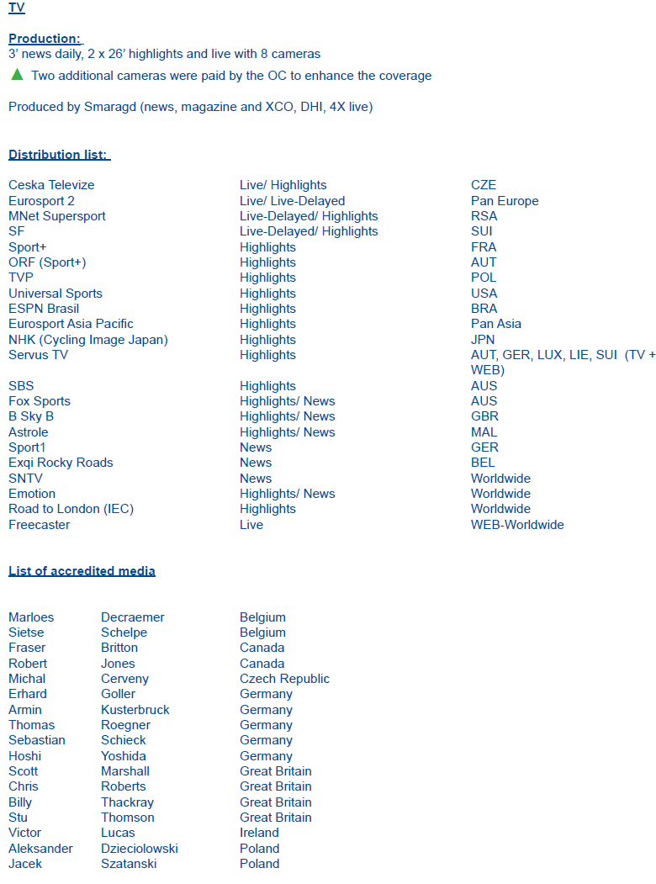


Slide 26
2011 UCI MTB World Cup
Date | 23-24 April 2011
Venue | Cascades
Participants | 423
Out of Towners | 85%
Support Teams | 386
Event Spectators | 12 000+

Slide 27

Msunduzi Road Challenge
Date | 29 & 30 October
Venue | Alex Park + Surrounds
Participants | 1500 - 2000
Out of Towners | 70 - 80%
Support Teams | 200+
Event Spectators | 2000+

Slide 28
Msunduzi Road Challenge
SCHEDULE
Friday 28th October | 10am - 7pm | Rider Registration
 | 6pm - 10pm | Pasta Party
Saturday 29th October | 9am - 1pm | Time Trial Competition
 | 10am - 4pm | Rider Registration (Road Race)
Sunday 30th October | 7am - 3pm | Road Race
 | 3pm - Late | After Party

Slide 29
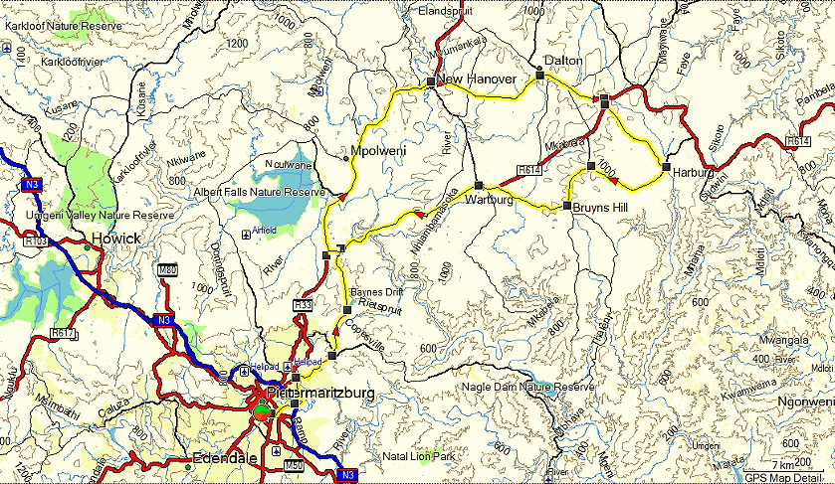
Msunduzi Road Challenge
ROUTE MAP - 126KM
52.1km of climbing, highest point of climb 1059.4 m above sea level at km 77.7

Slide 30
2012

Slide 31
Tour of South Africa
 |  | 24 Feb: | Stage 5: Ladysmith - Pmb
 |  | 25 Feb: | Stage 6: Pmb - Pmb
 |  | 26 Feb: | Stage 7: Pmb - Dbn
 |  | Venue | Alex Park - Starts & Finishes
 |  | Participants | 120
 |  | Out of Towners | 80%
 |  | Support Teams | 200
 |  | Spectators | 1500
MTB National Series Event
 |  | Date | 10 & 11 March
 |  | Venue | Cascades
 |  | Participants | 300+
 |  | Out of Towners | 60%
 |  | Support Teams | 150+
 |  | Event Spectators | 2000+
UCI MTB World Cup
 |  | Date | 16 - 18 March
 |  | Venue | Cascades
 |  | Participants | 500+
 |  | Out of Towners | 75%
 |  | Support Teams | 1000+
 |  | Event Spectators | 15 000 - 18 000

Slide 32
CSA KZN All Africa Challenge
 |  | Date | 22 - 24 April
 |  | Venue | Alex Park & Cascades
 |  | Participants | 600+
 |  | Out of Towners | 60%
 |  | Support Teams | 500 +
 |  | Event Spectators | 3000+
BMX National Series Event
 |  | Date | TBC
 |  | Venue | Alex Park
 |  | Participants | 200+
 |  | Out of Towners | 70%
 |  | Support Teams | 50+
 |  | Event Spectators | 750+
Masters Road World Champs
 |  | Date | Aug / Sept
 |  | Venue | Alex Park & Surrounds
 |  | Participants | 3000+
 |  | Out of Towners | 80%
 |  | Support Teams | 200+
 |  | Event Spectators | 5000+

Slide 33
2013

Slide 34
UCI MTB Masters World Championships
 |  | Date | 14 – 18 August
 |  | Venue | Cascades
 |  | Participants | 650+
 |  | Out of Towners | 70%
 |  | Support Teams | 400+
 |  | Event Spectators | 6000+
UCI BMX Supercross World Cup
 |  | Date | April
 |  | Venue | Alex Park
 |  | Participants | 150+
 |  | Out of Towners | 90%
 |  | Support Teams | 100+
 |  | Event Spectators | 2000+
BMX National Series Event
 |  | Date | TBC
 |  | Venue | Alex Park
 |  | Participants | 200+
 |  | Out of Towners | 70%
 |  | Support Teams | 50+
 |  | Event Spectators | 750+
UCI MTB World Championships
 |  | Date | 21 Aug - 1 Sept
 |  | Venue | Cascades
 |  | Participants | 650+
 |  | Out of Towners | 80%
 |  | Support Teams | 1500+
 |  | Event Spectators | 20 000 - 30 000

Slide 35
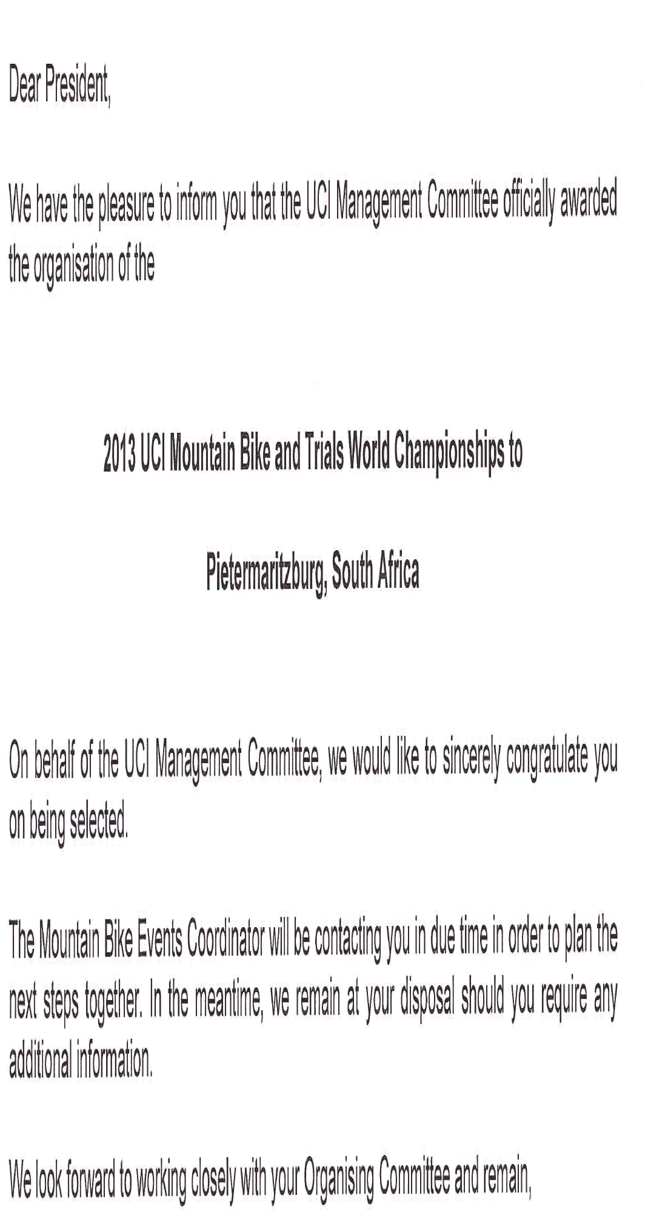

Slide 36
UCI World Cycling Forum
2012 or 2013?

Slide 37
UCI is seeking a host city and organiser to help plan and execute the UCI World Cycling Forum. As this will be the first ever UCI World Cycling Forum, the conference offers a dynamic platform with which a city can actively promote itself by leveraging the appeal of the sport of cycling and derive the benefits that will come with the status of hosting the first ever Forum.
The specific aims of the UCI World Cycling Forum include:
• To develop a network of stakeholders from countries throughout the world
• To provide a forum for the exchange of knowledge and information about cycling operations
• To examine and compare common management and sport issues
• To anticipate new issues and identify approaches which might be taken to address them
• To offer a pool of experts from which NFs/teams might be constructed to examine and provide advice on particular issues

Slide 38
The Forum will also host meetings of the following entities of the UCI:
UCI Congress (If applicable) CAD – Anti-doping Commission
Management Committee Medical Commission
UCI ProTour Council Para-cycling Commission
Road Commission Cycling for All Commission
Track Commission Disciplinary Commission (if applicable)
Mountain Bike Commission Licence Commission (if applicable)
Cyclo-cross Commission Ethics Commission (if applicable)
BMX Commission Training and Development Commission
Trials Commission
Indoor cycling Commission

Slide 39
Hosting the Forum
Situated in the heart of Pietermaritzburg is the Royal Show Grounds – the proposed venue for the 2012 UCI World Cycling Forum..
Accommodation
Transport
Catering & Meals
Partner Programme & Tours
Courier Arrangements
Side Events

Slide 40
Bottom Line

Slide 41
Summary Statistics (over the 6 years)
Total Number of Competitors, Family, Crew and Spectators | 153 706
Total Number of Competitors, Family, Crew and Spectators pa | 25 618
Total Direct Spend | R 229 426 068
Total Direct Spend pa | R 38 237 678
Total Direct Spend per Person | R 1 493
Total Cost to Government | R 22 920 000
Total Cost to Government pa | R 3 820 000
Return on Investment | 10.01
Values are estimates at this stage only

Slide 42
Multiplier | Spend
Direct | 1.00
Indirect | 0.79
Induced | 0.90
Total | 2.69
Total Direct, Indirect and Induced Spend | R 617 156 123
Total Direct, Indirect and Induced Spend pa | R 102 859 354
Return on Investment | 26.93
Multipliers are estimates at this stage only

Slide 43
 | Cash Flow | Discount Cash Flow | Cost to Government | NPV
2008 | R 38 237 678 | R 35 659 826 |  | t = 6
2009 | R 38 237 678 | R 33 255 764 |  | r = 7%
2010 | R 38 237 678 | R 31 013 776 |  | m=12
2011 | R 38 237 678 | R 28 922 935
2012 | R 38 237 678 | R 26 973 051
2013 | R 38 237 678 | R 25 154 621
 | R 229 426 068 | R 180 979 973 | R 22 920 000 | R 158 059 973
NPV is estimates at this stage only

Slide 45
Decision Criteria
 | NPV | PI | IRR | MIRR
Option A | Accept | Accept | Accept | Accept
Option B | Accept | Accept | Accept | Accept

Slide 46
THANK YOU

